Slide 1
Wait...Where Does That Go Again? The Curriculum Development and Approval Process
Randy Beach, ASCCC Executive Committee Jan Young, ASCCC Noncredit Committee, Glendale Community College
2018 ASCCC Career and Noncredit Education Leadership Institute May 3-5, 2018 Westin South Coast Plaza

Slide 2
Description
With all the items that land on a faculty member’s plate (lesson preparation, grading, committee work, program review, etc.), it’s easy for faculty to lose from memory the intricacies of negotiating the curriculum approval process. Also, most courses and programs are reviewed on a 3-5 year cycle, and the passage of time and changing standards and processes may cause faculty to feel in the dark when they begin a curriculum development or review process. In this breakout attendees will be provided a big-picture overview of the curriculum approval processes for all curriculum, including credit, noncredit, and CTE courses and programs, to help them get back on the curriculum track.
2018 ASCCC Career and Noncredit Education Leadership Institute Westin South Coast Plaza

Slide 3
Today’s Learning Outcomes
Why are you here today?
What would you like to learn?
Understand the criteria and standards around developing and approving curriculum
Understand types of courses and programs
Understand the approval process for curriculum
2018 ASCCC Career and Noncredit Education Leadership Institute Westin South Coast Plaza

Slide 4
History/Legal Authority for Curriculum
2018 ASCCC Career and Noncredit Education Leadership Institute Westin South Coast Plaza

Slide 5
History/Legal Authority for Curriculum
Ed Code §70902 (b) (7): Establish procedures not inconsistent with minimum standards established by the board of governors to ensure faculty, staff, and students the opportunity to express their opinions at the campus level, to ensure that these opinions are given every reasonable consideration, to ensure the right to participate effectively in district and college governance, and to ensure the right of academic senates to assume primary responsibility for making recommendations in the areas of curriculum and academic standards.
2018 ASCCC Career and Noncredit Education Leadership Institute Westin South Coast Plaza

Slide 6
History/Legal Authority for Curriculum
TITLE 5 §53200, DEFINITIONS: Details the implementation of California Education Code, states the faculty authority for curriculum, and defines Academic Senate and its purview: The Academic Senate means an organization whose primary function is to make recommendations with respect to academic and professional matters. Academic and professional matters mean the following policy development matters:
Curriculum, including establish prerequisites and placing courses within disciplines
Degree and certificate requirements
Grading policies
2018 ASCCC Career and Noncredit Education Leadership Institute Westin South Coast Plaza

Slide 7
History/Legal Authority for Curriculum
Educational program development
Standards or policies regarding student preparation and success
College governance structures, as related to faculty roles
Faculty roles and involvement in accreditation processes, including self-study and annual reports
Policies for faculty professional development activities
Processes for program review
Processes for institutional planning and budget development, and
Other academic and professional matters as mutually agreed upon between the governing board and the academic senate
2018 ASCCC Career and Noncredit Education Leadership Institute Westin South Coast Plaza

Slide 8
Curriculum Committee (Title 5, §55002)
The college and/or district curriculum committee recommending the course shall be established by the mutual agreement of the college and/or district administration and the academic senate.
The committee shall be either a committee of the academic senate or a committee that includes faculty and is otherwise comprised in a way that is mutually agreeable to the college and/or district administration and the academic senate.
2018 ASCCC Career and Noncredit Education Leadership Institute Westin South Coast Plaza

Slide 9
Other Title 5 Sections to Note
55000.5 Handbook: Monitoring and Review of Approved Courses and Programs 55002 Standards and Criteria for Courses and Classes 55002.5 Credit Hour 55003 Policies for Prerequisites, Corequisites, and Advisories on Recommended Preparation 55005 Publication of Course Standards 55022 Pass-No Pass Options 55064 Acceptance of Noncredit Courses 55100 Credit Course Approval
55130 Approval of Credit Programs 55150 Approval of Noncredit Courses and Programs 55151 Career Development and College Preparation 55154 Adult High School Diploma Programs 55155 Noncredit Certificates 55160 Approval of Community Service Programs 55170 Contract Courses
2018 ASCCC Career and Noncredit Education Leadership Institute Westin South Coast Plaza

Slide 10
Development Criteria and the COR
2018 ASCCC Career and Noncredit Education Leadership Institute Westin South Coast Plaza

Slide 11
Why Create a Course or Program?
Appropriateness to the Mission Programs must be directed at the appropriate level for community colleges. Programs must address a valid transfer, occupational, basic skills, civic education, or lifelong learning purpose. Programs should also be congruent with the mission statement and master plan of the college and district.
2018 ASCCC Career and Noncredit Education Leadership Institute Westin South Coast Plaza

Slide 12
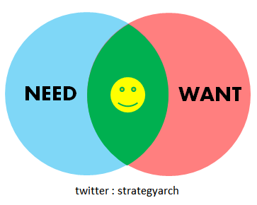
Why Create a Course or Program?
Need New programs that meet stated goals and objectives in the region must not cause harmful competition with an existing program at another college. Need is determined by multiple factors, including but not limited to; educational master plan, accreditation standards, program review, economic development interests, labor market data, and community surveys.
2018 ASCCC Career and Noncredit Education Leadership Institute Westin South Coast Plaza

Slide 13
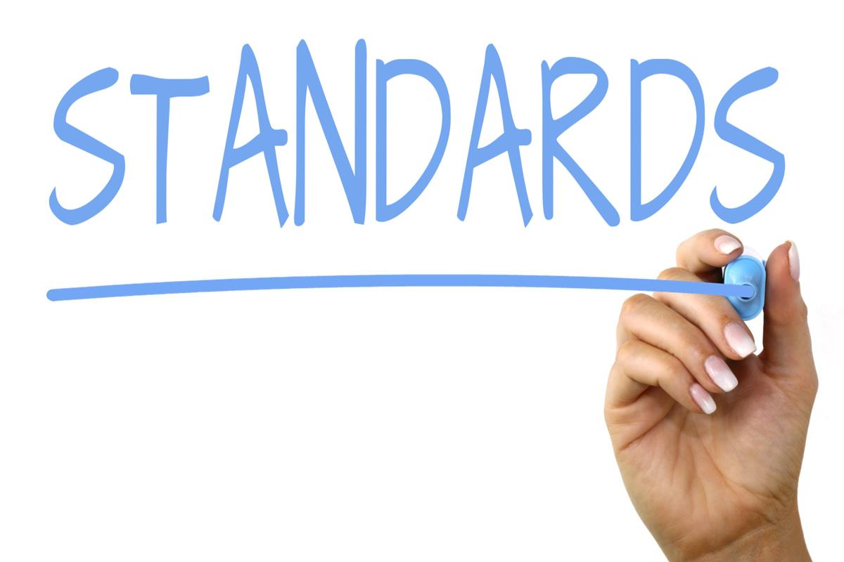
Why Create a Course or Program?
Curriculum Standards Title 5 mandates that all credit and noncredit curriculum be approved by the college curriculum committee and the district governing board. CTE credit programs must be reviewed by Career Technical Education Regional Consortia. The proposed program must be consistent with requirements of accrediting agencies as applicable. Programs are designed so that successful completion of the program requirements will enable students to fulfill the program goals and objectives.
2018 ASCCC Career and Noncredit Education Leadership Institute Westin South Coast Plaza

Slide 14
Why Create a Course or Program?
Adequate Resources In developing a new program, the college commits to offering all of the required courses for the program at least once every two years. Hence, the college must have adequate resources for faculty, facilities and equipment, and library and learning resources.
2018 ASCCC Career and Noncredit Education Leadership Institute Westin South Coast Plaza

Slide 15
Why Create a Course or Program?
Compliance The design of the program must not be in conflict with any law including state and federal laws.
2018 ASCCC Career and Noncredit Education Leadership Institute Westin South Coast Plaza

Slide 16
Course Creation CTE and Noncredit
Establishing learning outcomes and/or competencies (CTE) (NC)
If for a program, link course outcomes to program outcomes (CTE) (NC)
Identifying industry needs and changes (CTE) (NC)
Dialogue with advisory committees (CTE)
Industry Needs (CTE) (NC)
Advisory Boards for (CTE)
Labor Market Data (CTE) (NC)
Regional Consortia Recommendation (CTE)
Stackable Credentials (CTE) / Short-term Vocational (NC)
2018 ASCCC Career and Noncredit Education Leadership Institute Westin South Coast Plaza

Slide 17
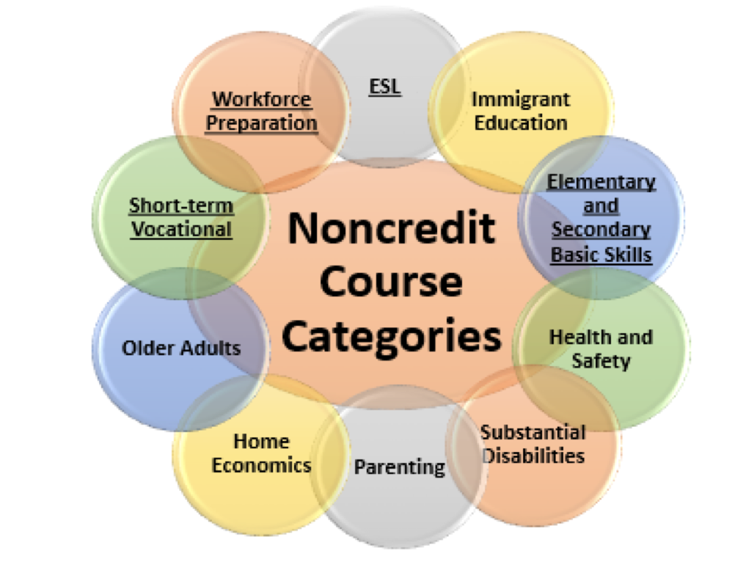
Noncredit Courses: Ten Categories
English as a Second Language (ESL)*
Immigrant Education
Elementary and Secondary Basic Skills*
Health and Safety
Substantial Disabilities
Parenting
Home Economics
Courses for Older Adults
Short-term Vocational*
Workforce Preparation*
*Areas (1), (3), (9), (10) are eligible for Enhanced Funding if associated with an approved noncredit program.
2018 ASCCC Career and Noncredit Education Leadership Institute Westin South Coast Plaza

Slide 18
Tale of the Tape: Side by Side Comparison
Credit and CTE
Generate apportionment; student fees apply
Fees
Unit granting
Degree applicable and non-degree applicable (basic skills)
Certificates of Achievement
Not designated as repeatable (except in limited circumstances)
Auto-approval and chaptering at the CCCCO
Noncredit
Generate apportionment—two levels (noncredit and enhanced noncredit)
No student fees
No units (positive attendance taken)
Certificates of Competency & Completion
Designated as repeatable
Requires CCCCO approval
2018 ASCCC Career and Noncredit Education Leadership Institute Westin South Coast Plaza

Slide 19
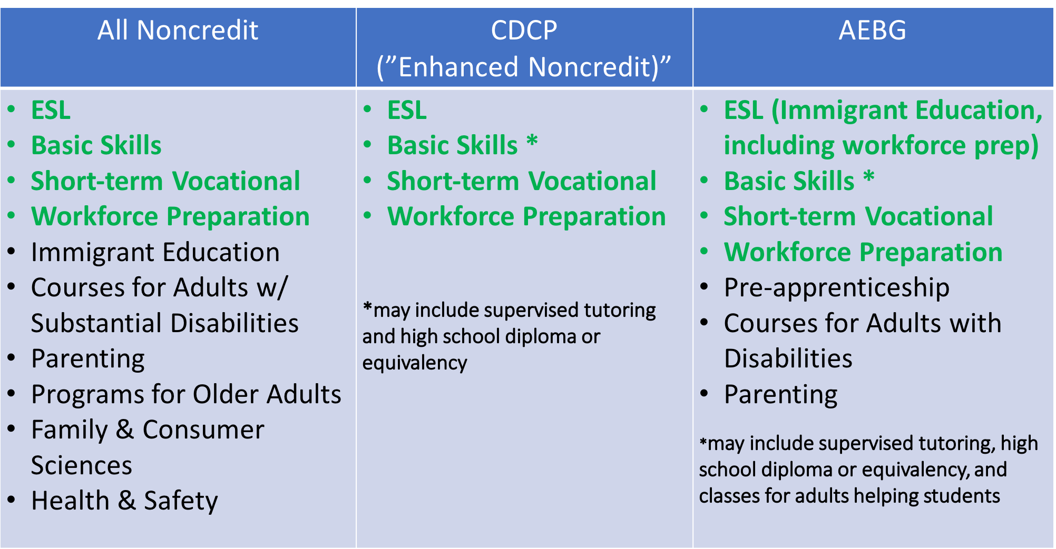
Development Criteria for Noncredit and Benefits
2018 ASCCC Career and Noncredit Education Leadership Institute Westin South Coast Plaza

Slide 20
Elements of the Course Outline of Record
Credit Noncredit
Course number and title
Unit value
Total student learning hours (In & out of class)
Prerequisites, corequisites, advisories on recommended preparation (if any)
Catalog description
Objectives
Content - specific body of knowledge
Types or examples of assignments
Instructional methodology
Methods of evaluation
Course number and title
Minimum/Maximum Contact Hours
Advisories on recommended preparation (if any)
Catalog description
Objectives
Content - specific body of knowledge
Types or examples of assignments
Instructional methodology
Methods of evaluation
2018 ASCCC Career and Noncredit Education Leadership Institute Westin South Coast Plaza

Slide 21
Programs
2018 ASCCC Career and Noncredit Education Leadership Institute Westin South Coast Plaza

Slide 22
Types of Programs
Bachelor of Arts (BA)
Bachelor of Sciences (BS)
Associate in Arts for Transfer (AA-T) (60 units)
Associate in Science for Transfer (AS-T) (60 units)
Associate in Arts (AA) (60 units)
Associate in Science (AS) (60 units)
Certificates of Achievement (18 or more semester degree-applicable units or 27 or more quarter degree-applicable units)*
* At this time, a proposal is being considered to revise the minimum number of units for certificates of achievement in Title 5.
2018 ASCCC Career and Noncredit Education Leadership Institute Westin South Coast Plaza

Slide 23
Types of Programs
Certificates of Achievement (12 or more semester degree-applicable units or 18 or more quarter degree-applicable units) which require approval by the CCCCO in order to be included on a student's transcript.*
Certificate of less than 12 units that may be created and does not require approval by the Chancellor’s Office; however, these certificates are not transcriptable and cannot be called a “Certificate of Achievement,” “Certificate of Completion” or “Certificate of Competency.”* (Skill Builders)
* At this time, a proposal is being considered to revise the minimum number of units for certificates of achievement in Title 5.
2018 ASCCC Career and Noncredit Education Leadership Institute Westin South Coast Plaza

Slide 24
Types of Programs
Noncredit Certificate of Completion (a sequence of Career Development and College Preparation (CDCP) courses in short-term vocational or workforce preparation areas.
Noncredit Certificate of Competency (a sequence of Career Development and College Preparation (CDCP) courses in ESL or Elementary & Secondary Basic Skills
2018 ASCCC Career and Noncredit Education Leadership Institute Westin South Coast Plaza

Slide 25
What is Approved Locally and What’s Approved by CCCCO?
Local Approval/ CCCCO Chapters CCCCO Approval
New credit courses
Modifications to credit courses
Modifications to existing programs
New programs including ADTs
All noncredit curriculum
Work Experience courses
2018 ASCCC Career and Noncredit Education Leadership Institute Westin South Coast Plaza

Slide 26
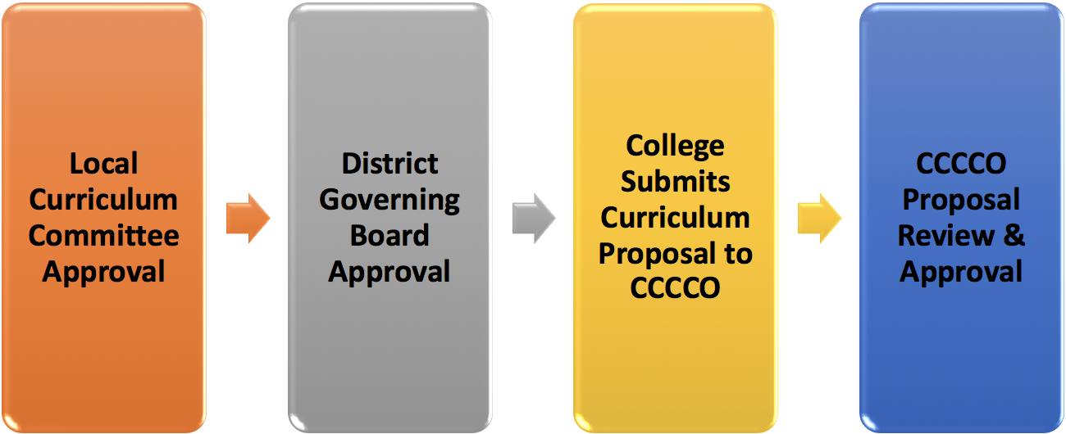
Curriculum Review and Timelines
2018 ASCCC Career and Noncredit Education Leadership Institute Westin South Coast Plaza

Slide 27
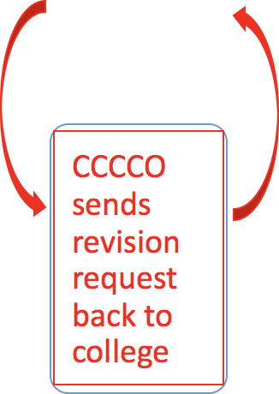
Curriculum Review and Timelines
2018 ASCCC Career and Noncredit Education Leadership Institute Westin South Coast Plaza

Slide 28
Chancellor’s Office Review for Programs
Proposal fields complete
Course Outline of Records (CORs) attached
CORs in Narrative, Course Report & Supporting Documentation match
Narrative is complete and accurate
Total hours, course titles, and course numbers in proposal record must match the information in the Narrative
2018 ASCCC Career and Noncredit Education Leadership Institute Westin South Coast Plaza

Slide 29
Resources
ASCCC Website - http://asccc.org
Contact the ASCCC – info@asccc.org
Application for Statewide Service - http://asccc.org/content/application-statewide-service
ASCCC Publications - http://asccc.org/publications
ASCCC Events - http://asccc.org/calendar/list/events
ASCCC Services - http://asccc.org/services#
Disciplines List and MQs - http://asccc.org/disciplines-list
2018 ASCCC Career and Noncredit Education Leadership Institute Westin South Coast Plaza

