Slide 1
Welcome Area A !

Slide 2
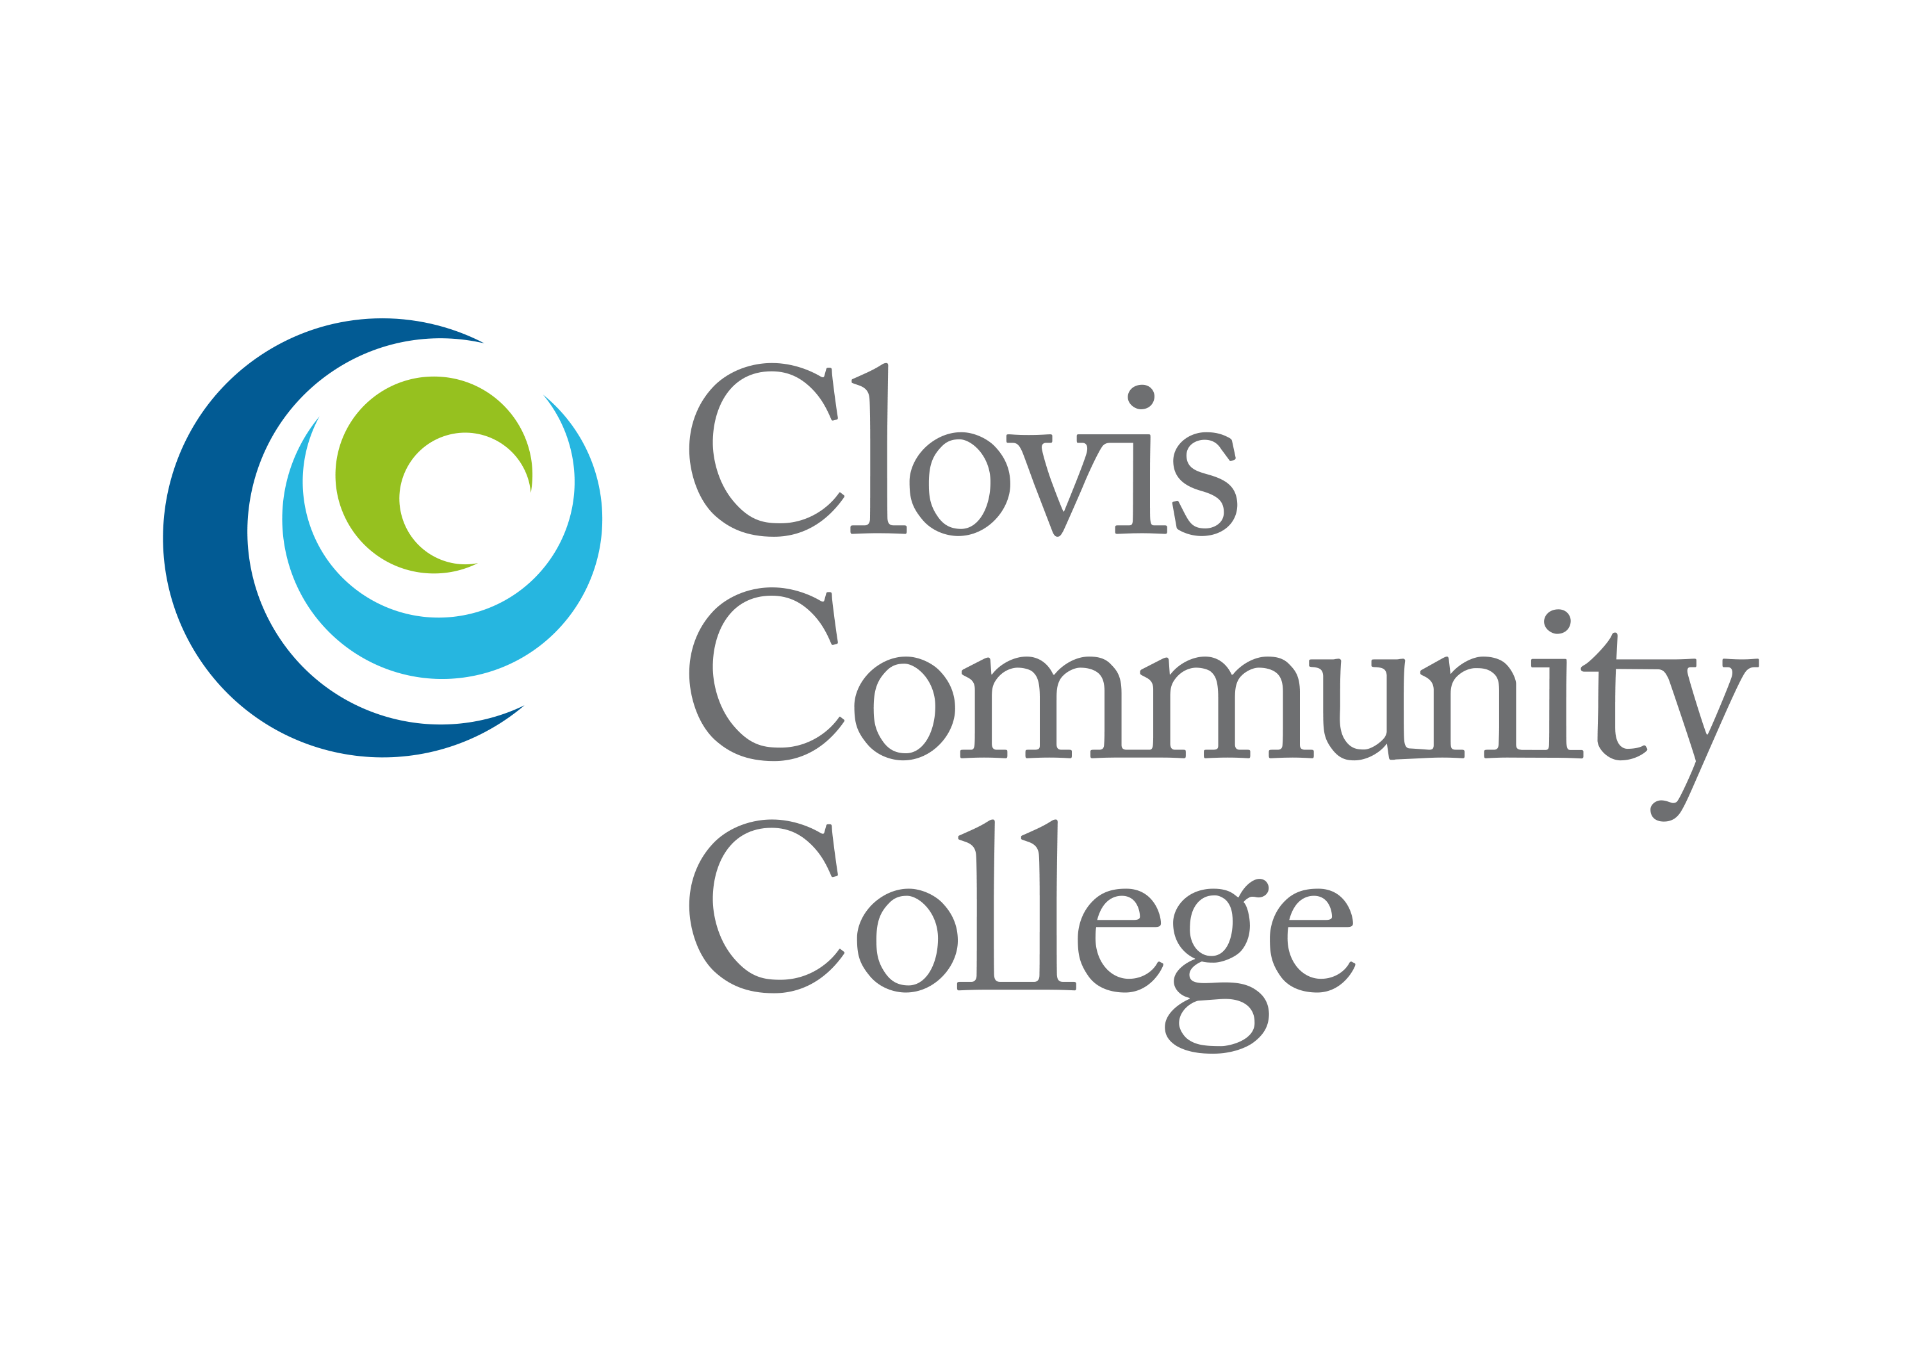

Slide 3
What’s an Area Meeting?
A chance to talk and collaborate with local senate members
Hear President/Vice President Report
Review Pre-Session Resolutions
Discuss Newly Proposed Resolutions
Address Area Concerns
Highlight Special Program/Host College
Community Building
– Get to know Senate Leaders
Notes:
Pre-session resolutions—Time to send in amendments!

Slide 4
What does the Area Rep do?
Provide information about Academic Senate activities and resources
Provide communication to the field
Listservs https://www.asccc.org/signup-newsletters
Help senate presidents/delegates prepare for Plenary
Facilitate Area Meetings
Before and at Plenary
Notes:
Regional meetings
Exec Meetings at colleges
Senate presidents – Hayward readers

Slide 5
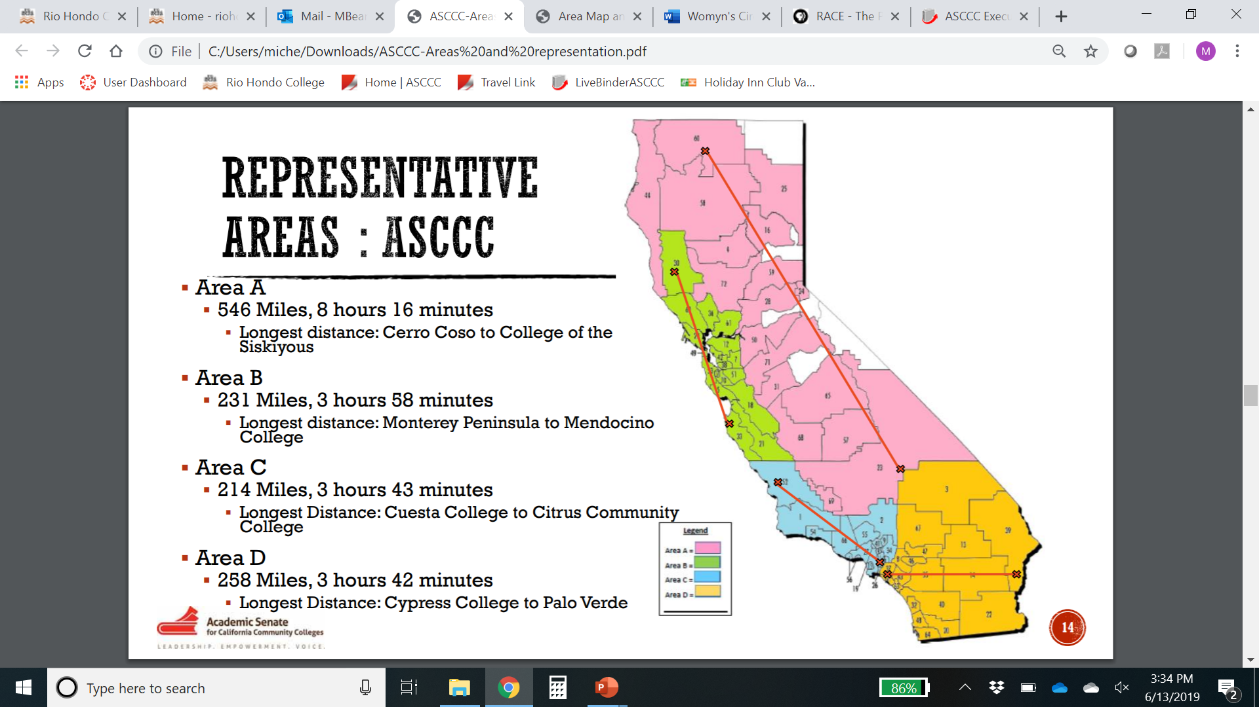
Area Colleges

Slide 6
AREA A – 29 Colleges
American River College
Bakersfield College
Butte College
Cerro Coso College
Clovis Community College
Columbia College
Cosumnes River College
Feather River College
Folsom Lake College
Fresno City College
Lake Tahoe Community College
Lassen College
Madera Community College
Merced College
Modesto Junior College
Porterville College
College of the Redwoods
Reedley College
Sacramento City College
San Joaquin Delta College
College of the Sequoias
Shasta College
Sierra College
College of the Siskiyous
Taft College
West Hills College Coalinga
West Hills College Lemoore
Woodland Community College
Yuba College
Notes:
Area A runs from the Oregon border through the Central Valley to Bakersfield

Slide 7
AREA B – 29 Colleges
College of Alameda
Berkeley City College
Cabrillo College
Canada College
City College of San Francisco
Chabot College
Contra Costa College
De Anza College
Diablo Valley College
Evergreen Valley College
Foothill College
Gavilan College
Hartnell College
Laney College
Las Positas College
Los Medanos College
College of Marin
Mendocino College
Merritt College
Mission College
Monterey Peninsula College
Napa Valley College
Ohlone College
San Jose City College
College of San Mateo
Santa Rosa Junior College
Skyline College
Solano College
West Valley College
Notes:
Area B encompasses the Greater Bay Area, from Mendocino to Monterey

Slide 8
AREA C – 26 Colleges
Allan Hancock College
Antelope Valley College
College of the Canyons
Cerritos College
Citrus College
Compton College
Cuesta College
East Los Angeles College
El Camino College
Glendale College
Los Angeles City College
Los Angeles Harbor College
Los Angeles Mission College
Los Angeles Pierce College
Los Angeles Southwest College
Los Angeles Trade Technical College
Los Angeles Valley College
Moorpark College
Mt. San Antonio College
Oxnard College
Pasadena City College
Rio Hondo College
Santa Barbara City College
Santa Monica College
Ventura College
West Los Angeles College
Notes:
Los Angeles and the Central Coast

Slide 9
AREA D – 33 Colleges
Barstow College
Chaffey College
Coastline College
Copper Mountain College
Crafton Hills College
Cuyamaca College
Cypress College
College of the Desert
Fullerton College
Golden West College
Grossmont College
Imperial Valley College
Irvine Valley College
Long Beach City College
MiraCosta College
Moreno Valley College
Mt. San Jacinto College
Norco College
North Orange Continuing Education
Orange Coast College
Palo Verde College
Palomar College
Riverside City College
Saddleback College
San Bernardino Valley College
San Diego City College
San Diego Continuing Education
San Diego Mesa College
San Diego Miramar College
Santa Ana College
Santiago Canyon College
Southwestern College
Victor Valley College
Notes:
Area D is Orange County, San Diego, the Inland Empire, and across the Arizona border

Slide 10
Area A Fun Facts
Area A has the oldest and newest California Community College: Fresno City (est. 1910) and Madera (est. 2020)
Columbia College’s architectural style is based on the CA Gold Rush Area
Lake Tahoe’s mascot was the Kokanee salmon until 2014 when it was changed to a coyote
Butte college is located on a wildlife refuge
Sacramento City college was founded by a woman Belle Coolidge and had a all female first graduating class.
Columbia, Cerro Coso, Feather River, Lassen, College of the Redwoods and Reedley, Shasta and Sierra, Taft and West Hills Colleges, Coalinga have dorms (all 11 are in Area A)
College of the Siskiyous is the northernmost college in California
Dolores Huerta is a graduate of San Joaquin Delta College
George Lucas gradated from Modesto Jr. College
West Hills Lemoore offers courses at Lemoore Naval Air Station

Slide 11
Reviewing Resolutions
In Area Meetings we review resolutions before voting sessions.
Read the Resolved substituting “ We” for Academic Senate for California Community Colleges
At Area Meetings (before and during plenary) faculty can ask clarifying questions about the resolution/amendment but not debate.

Slide 12
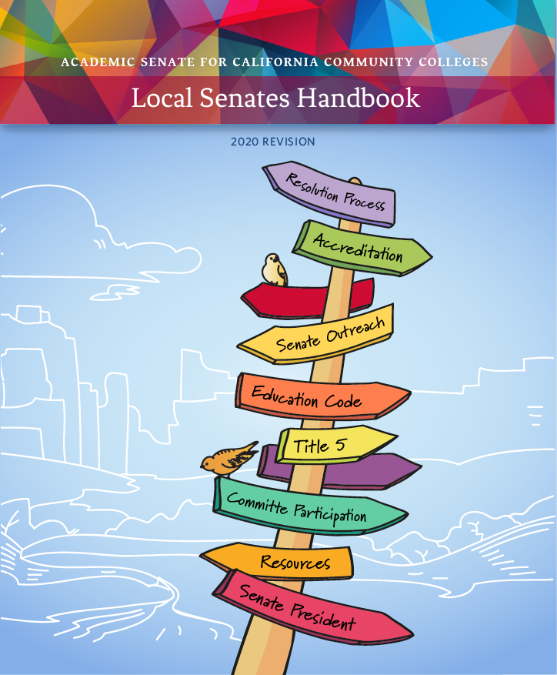
What about Resources?
Bookmark ASCCC.org
Volunteer for Committees
Download the Handbook
Consider a Technical Visit
Sign-up for Listservs
Notes:
Communities under the RESOURCES tab
Handbook under the COMMUNITIES tab
Technical Visits under SERVICES tab
Listservs under RESOURCES

Slide 13
info@asccc.org
If you have questions about senate issues you can send a inquiry to ASCCC for a formal reply.
Email info@asccc.org

Slide 14
Sign Up for Statewide Service
Each year the ASCCC appoints hundreds of faculty members to committees, workgroups and task forces.
Each one of you has expertise that is needed across our system
Sign up for statewide service with the Faculty Application for Statewide Service

Slide 15
Introductions, College Highlights and Questions
Tell us what college you are from and what is your title and role in senate
Tell us something fun about your college
Any questions you might have about Academic Senates

Slide 16
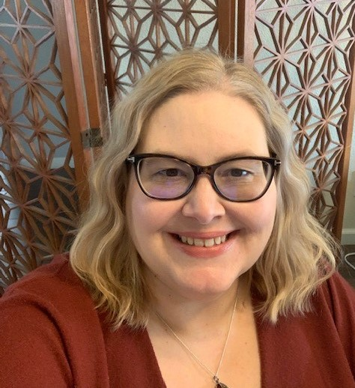
Thank You!
Contact Information—email me anytime!
Stephanie Curry
ASCCC Area A Representative
stephanie.curry@reedleycollege.edu

