Slide 1
What Did You Mean by That?
Learning to Understand Each Other
Sam Foster, ASCCC South Representative
Luke Lara, MiraCosta College

Slide 2
Has This Ever Happened to You?
Someone says a word or phase that evokes an emotional response
You later find out that your interpretation was different than what they meant
Sometimes it’s useful to focus on understanding and inquire:
What did you mean by that?

Slide 3
Overview
This session will be interactive: You are encouraged to participate in the discussion and activities
We will examine some of the dynamics that surround discussions of diversity, student equity, and structural racism
We will engage in a case study discussion
We will practice communication technique called Calling-in as an inquiry based approach
We will provide additional tips for engaging in bold and informed conversations

Slide 4
Guidelines for Dialogue
Be true to yourself. We want to create an atmosphere for open, honest exchange.
Commit to learning from each other. Listen to each other and acknowledge that we all come from different backgrounds, skills, interests, abilities, and values. We realize that it is these very differences that will increase our awareness and understanding through this process.
Acknowledge each other’s experiences. We will not devalue people for their experiences, lack of experiences, or difference in interpretation of those experiences.

Slide 5
More Guidelines for Dialogue
4. Trust that others are doing the best they can. We will try not to ‘freeze people in time’ but leave space for everyone to learn and change through our interactions with one another.
5. Challenge the idea and not the person. If we wish to challenge something that has been said, we will challenge the idea or the practice referred to, not the individual sharing this idea or practice.
6. Speak your discomfort. If something is bothering you and you are open to sharing, please share it with the group. Often our emotional reactions to this process offer the most valuable learning opportunities
7. Step Up, Step Back. Be mindful of taking up much more space than others. On the same note, empower yourself to speak up when others are dominating the conversation.

Slide 6
Consider This Case Study
In 2013, the Black Lives Matter movement began with a hashtag on social media in response to the acquittal of George Zimmerman in the shooting death of African American teen Trayvon Martin in Feb. 2012. Almost immediately, the phrases “All Lives Matter” and ”Blue Lives Matter” began to counter the Black Lives Matter movement.
The U.S. population’s perception of Black Lives Matter varies considerably by race.¹
What do each of these phrases mean?
What is the historical and contemporary context?
Who is centered in each of these phrases?
Notes:
¹https://www.dropbox.com/s/j64c02ub48aipja/PBS-NEWSHOUR-MARIST-POLL-SEP2015.pdf

Slide 7
Interdisciplinary Context
Five different areas of study can help shed some light on what is going on:
History
Sociology
Communication Studies
Counseling
Critical Studies

Slide 8
History
Treatment of African Americans in the U.S. from start of Slavery (1619) to today
Killing of African Americans by law enforcement – assumption of criminality
Black Lives Matter inspired by Civil Rights Movement, Black Power movement, Black Feminist movement, Pan-Africanism, Anti-Apartheid Movement, hip hop, LGBTQ social movements, and Occupy Wall Street.
Online campaign – quickly gained momentum with social media.
Inclusive movement that embraces intersectionality – Black queer and trans folks, disabled folks, black-undocumented folks, documented folks, women, and all Black lives along the gender spectrum.²
How else do you think History contributed to the development of #BlackLivesMatter?
Notes:
²https://www.blackpast.org/African-American-history/black-lives-matter-growth-new-social-justice-movement/

Slide 9
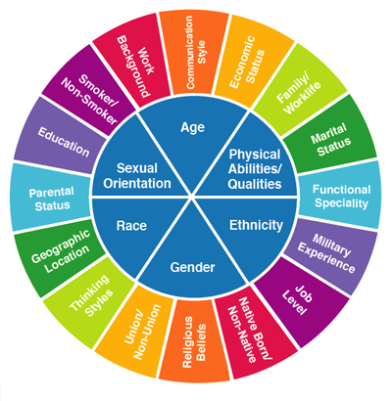
Sociology
We have complex individual and group identities that are informs our social location: our lived experienced set in the context of space (e.g., neighborhood, country), time (e.g., historical moment), and statuses (e.g., race, gender, educational level).
We may have parts of our identity that are more salient than others at times (e.g., race, gender, age).
Our social location is our lens through which we experience the world, it affects our reality and shapes what we see as opportunities.³
What is your Social Location? What identities are most salient to you?
Notes:
³https://www.reference.com/world-view/social-location-sociology-1fb47cb88f2659c7
Handout

Slide 10
Communication Studies
Communication has five purposes: to inform, imagine, influence, meet social expectations, and express feelings.⁴
Communication process involves three steps: thought, encoding, and decoding.
Two elements are involved: content (actual words) and context (nonverbal elements)
Cultural bias is often a barrier that prevents communication from being effective. For example, a person’s cultural background, beliefs, values, and prior experiences may change the meaning (e.g., decoding) of the message (e.g., social location).
How do you think your Social Location contributes to your interpretation of #BlackLivesMatter?
Notes:
⁴https://www.reference.com/world-view/five-purposes-communication-c608fbff696806fe

Slide 11
Counseling
Racial Microaggressions – “Brief and commonplace daily, verbal, behavioral, or environmental indignities, whether intentional or unintentional, that communicate hostile, derogatory, or negate racial slights and insults toward people of color” (Sue et al., 2007).⁵
Three types of Microagressions – Microinsults, Microinvalidations, and Microassaults
Creation of Black Lives Matter is also in part a response to Racial Microinsults endured by African Americans: second-class citizen, pathologizing culture, and assumption of criminality.
“All Lives Matter” and “Blue Lives Matter” in this context are Racial Microinvalidations: Color Blindness and denial of individual racism
Notes:
⁵Sue, D. W., Capodilupo, C. M., Torino, G. C., Bucceri, J. M., Holder, A. M. B., Nadal, K. L., & Equilin, M. (2007). Racial microaggressions in everyday life: Implications for clinical practice. American Psychologist, 62(4), 271-286. http://doi.org/10.1037/0003-066X.62.4.271

Slide 12
Critical Studies
Critical lenses allow us to de-center dominant framing (e.g., from a white male perspective to black female perspective).
Critical Race Theory – Emerged from Critical Legal Studies and Civil Rights Movement⁶
Centers race and racism and its intersection with other oppressions, seeks to interrupt the status quo/dominant narrative, focus on racial and social justice, centers experiential knowledge of people of color, frames whiteness as a property interest, and engages in a transdisciplinary approach.
Black Feminism – Intersectionality of sexism, class oppression, and racism informs the Black women’s experience.⁷
What new narratives are created by Black Lives Matter?
Notes:
⁶Delgado, R., & Stefancic, J. (2017). Critical race theory: An introduction (3rd ed.). New York: New York University Press.
⁷Collins, P. H. (2007). Defining Black feminist thought. The Feminist Ezine. Retrieved from http://www.feministezine.com/feminist/modern/Defining-Black-Feminist-Thought.html

Slide 13
Case Study Wrap-up
In pairs, discuss the following:
How did examining the Black Lives Matter vs. ”All Lives Matter” and “Blue Lives Matter” through an interdisciplinary lens impact your understanding of BLM?

Slide 14
How we Talk About Equity
When discussing Student Equity on our campuses, can we name the tensions between the following phrases?
“Removing barriers for disproportionately impacted students”
“Removing barriers for All students”
In what other ways are our discussions about student equity hindered or advanced on our campuses?
Let’s talk about ways to help facilitate purposeful and authentic communication

Slide 15
Purposeful and Authentic Communication
Conflict arises from a difference in perspective
Choose to engage in real listening
What is your goal? If it is to develop a shared meaning, then practice Calling-in vs. Calling Out

Slide 16
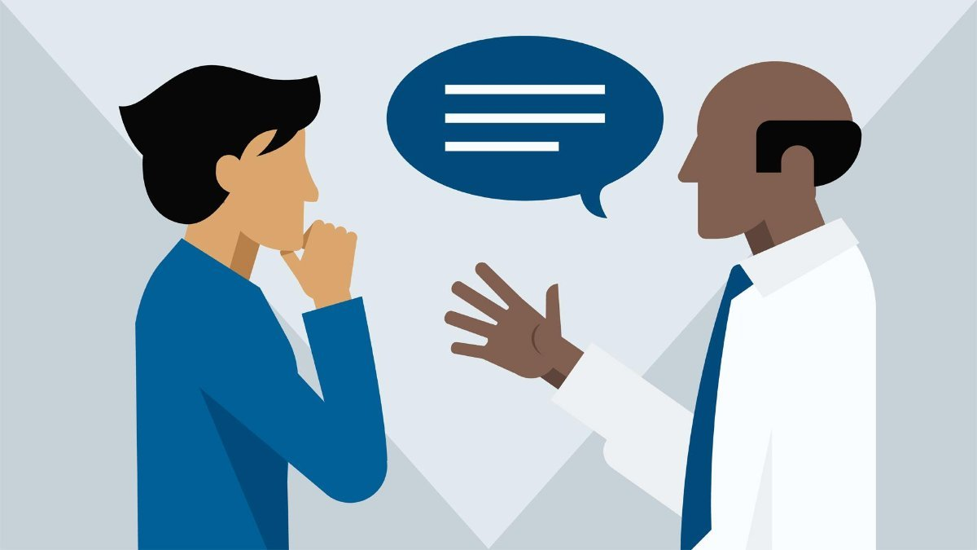
Real Listening vs. Pseudo-Listening⁸
Real listening involves an intention to do at least one of four things:
To understand someone;
To enjoy the company of someone;
To learn something;
To give help or solace to someone.
Pseudo-listening has the intention to meet another need:
Make people think you are interested so they will like you;
Listening to one specific piece of information, because you want to hear what you want to hear;
You are looking for weak points in an argument so you can always be right;
Half-listening because that is what a good, kind/nice person would do.
Notes:
⁸https://www.llas.ac.uk/resources/paper/1303

Slide 17
Communication Techniques⁹
Calling-in (Opening)
Calling out (Closing)
Empowering
Affirming
Inquiry-based
Humanizing
Trauma and target informed
Connecting
Asset-based
Disempowering
Debate; pushing point of view
Insincere interest
Dehumanizing
Does not consider the target; is not trauma informed
Disconnecting
Deficit based
Notes:
⁹Kieffer-Lewis, V. (2019). Building and sustaining an equity centered culture [Power point presentation]. California Guided Pathways Institute #6. Sacramento, CA
Calling-in and calling out are communication techniques that serve different purposes. Both have legitimate uses.

Slide 18
Calling-in¹⁰: “What did you mean by that?”
When there is an opportunity to explore deeper, make meaning together, and find a mutual sense of understanding across difference
When we are seeking to understand or learn more
When we want to help imagine different perspectives, possibilities, or outcomes
Provides for multiple perspectives and encourages paradigm shifts
Focused on reflection, not reaction
Is not just a suggestion with an uptick (Don’t you think you should…?)
Notes:
¹⁰Haslam, R. (2019). Interrupting bias: Calling out vs. calling in. Retrieved from http://www.seedtheway.com

Slide 19
Calling-in Starters¹⁰ (Probing Questions)
I’m curious. What was your intention when you said that?
How might someone else see this differently? Is it possible that someone might misinterpret your words/actions?
What criteria are you using to measure/asses ____?
What do you assume to be true about ____?
How did you decide, determine, conclude…
How is ____ different from ____?
Think: How might we call out the behavior/idea, while calling in the person?
Notes:
¹⁰Haslam, R. (2019). Interrupting bias: Calling out vs. calling in. Retrieved from http://www.seedtheway.com

Slide 20
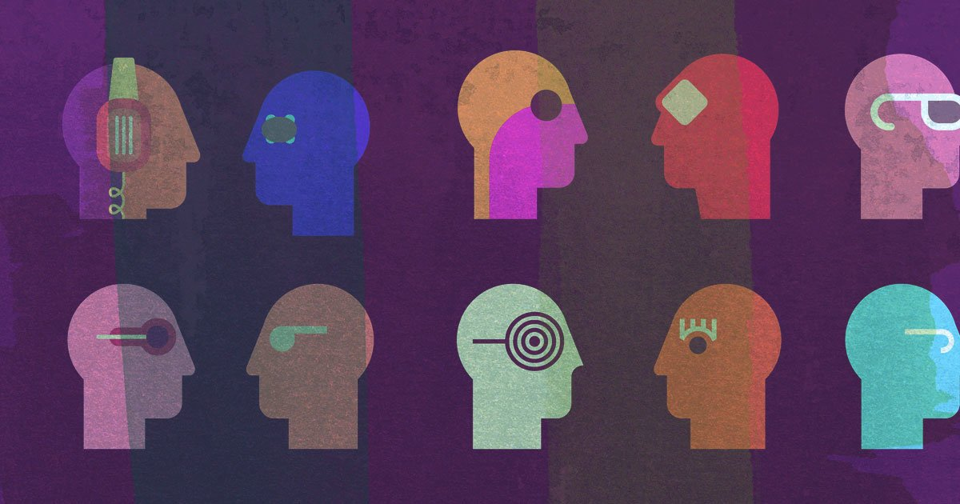
Activity – Practice Calling-in
In pairs, determine who will be partner A and partner B.
Round 1:
Partner A: Say – “Equity is about removing barriers for All students”
Partner B: Use one of the call-in starters to open the conversation.
Partner A: Respond to the call-in opener.
Partner B: Use another call-in starter if needed to go one level deeper.

Slide 21
Activity – Practice Calling-in
Round 2:
Partner B: Say – “Equity is about removing barriers for disproportionately impacted students”
Partner A: Use one of the call-in starters to open the conversation.
Partner B: Respond to the call-in opener.
Partner A: Use another call-in starter if needed to go one level deeper.
Reflection: What did you learn or relearn in this process?

Slide 22
Debrief
What challenges still exist in having conversations about equity?
How did your social location influence your ability to engage in this conversation?

Slide 23
Coded Language
Our conversations about Equity are laced in coded language about race
We need to be proficient in equity literacy
We need to be proficient in racial literacy

Slide 24
Leveling Up
Having a baseline - developing racial literacy, understanding history, and context - is essential to having informed and bold conversations (i.e., moving from opinion to evidence-based).
Dr. Ibram X. Kendi argued¹¹:
The root of racism is self-interest and racist power, not ignorance or hate
Racist ideas justify racist policies
Racial inequities are a result of racist policy (written and unwritten).
Being anti-racist is the opposite of racist, and “not being racist” is racist passivity.
Dr. Robin DiAngelo¹² stated, “Being seen racially is a common trigger of white fragility…white people must face the first challenge: naming our race.”
Notes:
¹¹Kendi, X. I. (2019). How to be an antiracist. New York: One World.
¹²DiAngelo, R. (2018. White fragility: Why it’s so hard for white people to talk about racism. Boston: Beacon Press Books.

Slide 25
Achievement Unlocked
Theory of Racialized Organizations¹³:
“Racialized organizations [are] meso-level social structures that limit the personal agency and collective efficacy of subordinate racial groups while magnifying the agency of the dominant racial group. The ability to act upon the world, to create, to learn, to express emotion-indeed, one’s full humanity-is constrained (or enabled) by racialized organizations.”
”Race becomes ’real in its consequences’ through the organizationally mediated distribution of economic and social resources.”
“Discrimination is often seen as a discrete act somehow separate from otherwise-neutral organizational processes.”
“Individual level learning is important, but the next step is ensuring that anti-racist change is also institutional/systemic.”¹⁴
Notes:
¹³ Ray, V. (2019). A theory of racialized organizations. American Sociological Review. 84(1), 26-53. http://doi.org/10.1177/003122418822335
¹⁴ Welton, A. D., Owens, D. R., & Zamani-Gallaher, E. M. (2018). Anti-racist change: A conceptual framework for educational institutions to take systemic action. Teachers College Record, 120(140314), 1-22.

Slide 26
Questions?

