Slide 1
What’s New at ACCJC?
PRESENTERS
Stephanie Droker, Vice-President, ACCJC
Gohar Momjian, Vice-President, ACCJC
Steve Reynolds, Vice-President, ACCJC
Ginni May (facilitator), ASCCC Area A Representative, Accreditation Committee Chair

Slide 2
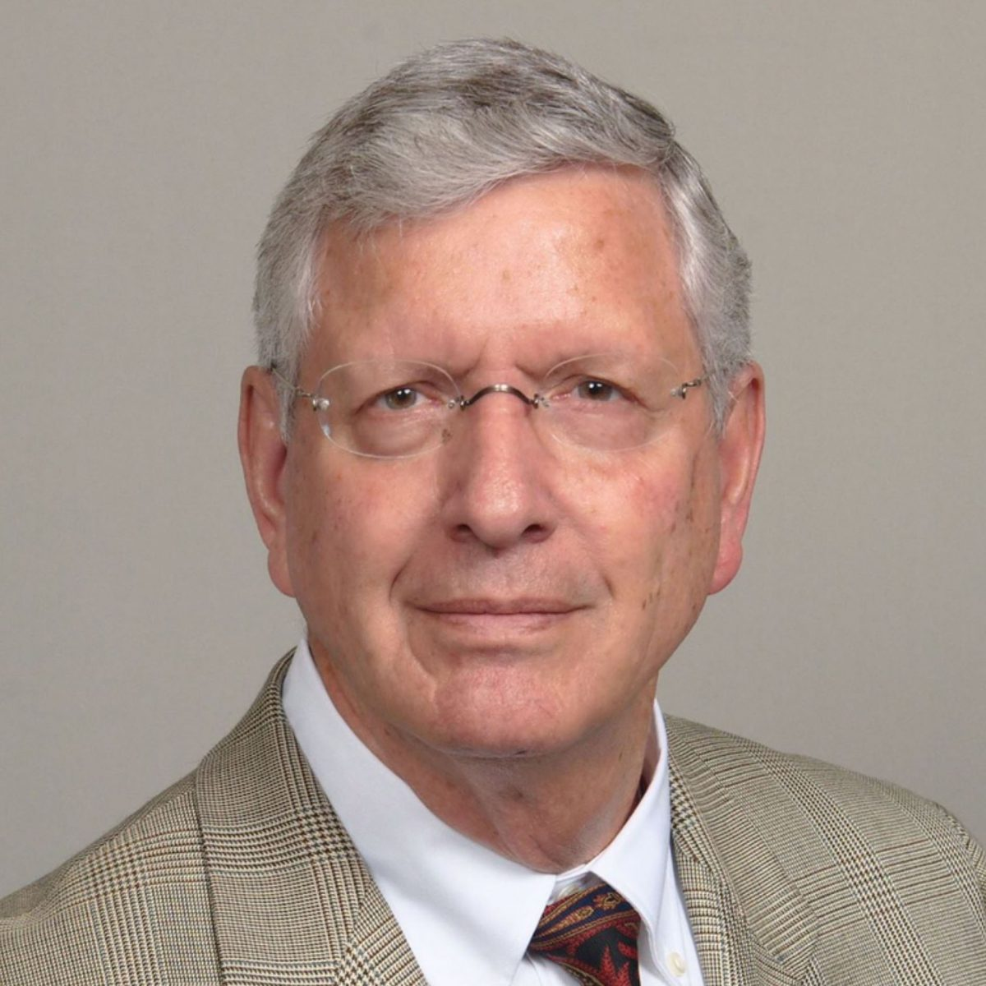
New President, New Vision
Richard Winn, Ed.D.
appointed President in July 2017.
appointed Interim President in December 2016
Vice President of Operations, June 2016
WASC Senior Colleges and University Commission for 12 years, retiring in 2015 as Senior Vice President.

Slide 3
New Staff, New Vision
Stephanie Droker, Ed.D. joined staff 2016
Policy Committee
Substantive Change Committee
Federal regulations compliance
Gohar Momjian joined staff 2017
Evaluation and Planning Committee
Annual reports
Steven Reynolds, Ed.D. joined staff 2017
Educational Programming

Slide 4
New Vision: The Portfolio Model
Caseload of 40-45 colleges, all types
Develop close, collaborative relationships with colleges
Support colleges during each step of review process
Advocate for the college—provide context and knowledge to Commission
Presence during team visits, not as team member
Notes:
Presence during team visits, not as team member
Assist chair as needed
Don’t influence team findings
Ensure findings in the narrative support commendations and recommendations and are relevant to standards
Know ERs, Standards, and policies inside and out

Slide 5
New Vision: Mission and Plan
Mission: The Accrediting Commission for Community and Junior Colleges works with its member institutions to advance educational quality and student learning and achievement. This collaboration fosters institutional excellence and continuous improvement through innovation, self-analysis, peer review, and application of standards.

Slide 6
New Vision: Mission and Plan
ACCJC Core Values:
Integrity
Quality Assurance
Institutional Improvement
Peer Review
Student Learning and Achievement
Collegiality
Strategic Plan & Goals

Slide 7
Strategic Goal
to realize the positive impact of its mission and core values over the next seven years through . . . action steps to re-design
policies and practices in training,
communications,
evaluation,
process and structure, and
operations.

Slide 8
Strategic Plan: New Directions
Goal 1: Align accreditation processes and structures to support the dual purposes of institutional quality assurance and improvement
Outcome 1: Support member institutions’ efforts to increase student achievement
Outcome 2: Create strategies to support institutions in financial risk
Outcome 3: Develop a new taxonomy of standards to enable a more holistic institutional review

Slide 9
The New Taxonomy
Holistic approach
13 (or 14) Standards instead of 128
What happens to the 128?
Adjusting terminology to fit the new vision
“align with Standards”
“peer reviewer” or “peer review team”

Slide 10
Strategic Plan: Continuing Work
Goal 2. Improve educational programming
Outcome 4: Reconstruct peer review team training, including
updates to manuals
online education
operational processes

Slide 11
Strategic Plan: Continuing Work
Goal 3. Enhance communication strategies that reflect integrity, collegiality, and transparency
Outcome 5: Provide greater support to member institutions through transparent, collegial and open communication
Outcome 6: Cultivate relationships to leverage partnerships in support of improving educational quality

Slide 12
Strategic Plan: Continuing Work
Goal 4. Implement strategic plan activities, including processes for comprehensive evaluation, to inform, monitor, and guide progress toward ACCJC mission fulfillment
Outcome 7: improve evaluation instruments develop regular procedures use results of evaluation to improve all activities

Slide 13
And then . . . there’s you!

