Slide 1
What's Your Why? Practical Ways to Infuse Your Story Into Your Classroom Friday, February 19 9:00--10:00 a.m.

Slide 2
Session Description
In Zaretta Hammond's fabulous book Culturally Responsive Teaching and the Brain, the author provides us with many strategies for building learning partnerships with our students focusing on techniques that generate trust in the classroom. In this workshop, we will discuss how we can use our own personal study to generate trust and build relationships with our students.

Slide 3
Land Acknowledgement
We acknowledge the land that American River College occupies today as the traditional home of the Nisenan, Maidu, and Miwok tribal nations. These sovereign people have been the caretakers of this land since time immemorial. Despite centuries of genocide and occupation the Nisenan, Maidu, and Miwok continue as vibrant and resilient tribes and bands, both Federally recognized and unrecognized. We take this opportunity to acknowledge the generations that have gone before as well as the present-day Nisenan, Maidu, and Miwok
https://native-land.ca/
Source: https://arc.losrios.edu/student-resources/native-american-resource-center

Slide 4
Introductions
Dr. Emilie Mitchell
ASCCC Part-time Committee
American River College
Psychology Professor
Faculty Coordinator for ARC Pride Center
Lead Planner on CCC LGBTQ+ Summit
Ted Kagan
ASCCC Part-time Committee
San Diego Community College
Adjunct Instructor - Continuing Education/Emeritus Department

Slide 5
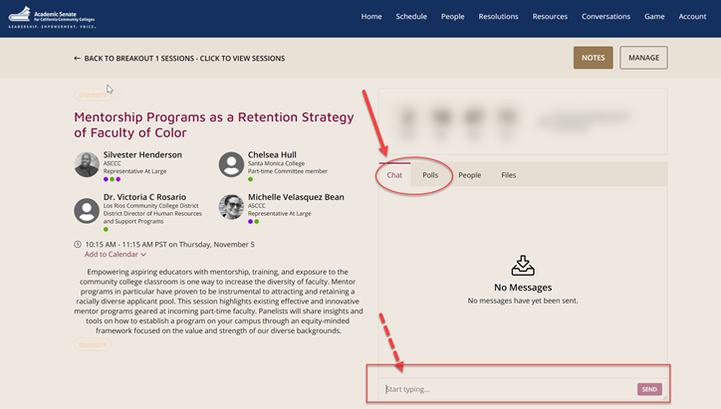
Questions
Use the Pathable platform CHAT box

Slide 6
This Presentation Will:
Give an introduction to Culturally Responsive Teaching and Trust Generators
Discuss being relational in the context of equity-minded and culturally affirming teaching practices
Draw the connection between vulnerability and empathy and between empathy and intimacy
Focus on the importance of building a relationship with our students
Explore storytelling as a means of relationship building
Provide practice in using your story and empowering your students to use their story
Notes:
Ted

Slide 7
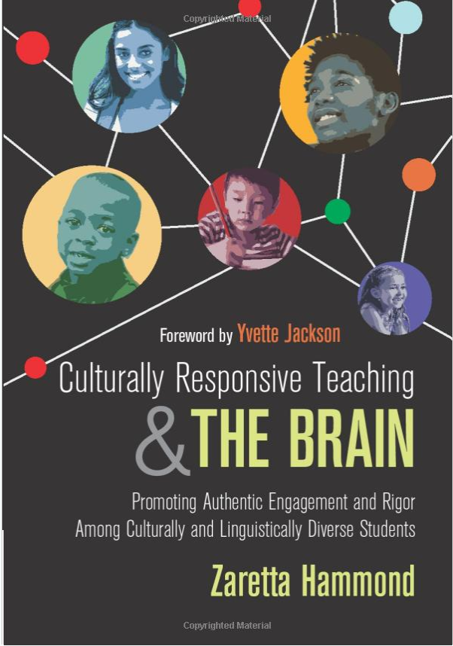
Culturally Responsive Teaching
The educator understands the importance of being in a relationship {with the student} and having a social-emotional connection to the student in order to create a safe space for learning - Hammond pg. 15
Notes:
Emilie

Slide 8
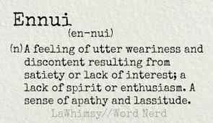
Trust Generators - Building Rapport
Selective Vulnerability - people respect and connect with others who share their own vulnerable moments - Hammond pg. 79
Notes:
Emilie

Slide 9
Equity- Minded and Culturally-Affirming Teaching Practices
Employing Equity-Minded and Culturally-Affirming Teaching Practices and Learning Practices” by Dr. Frank Harris III and Dr. J. Luke Woods:
Be Intrusive (August)
Be Relational (42:52-47:56)
Be Culturally Relevant and Affirming (Oct 5, 1-2pm)
Be Community Focused (Nov 2, 1-2pm)
Be Race Conscious (Dec 7, 1-2pm)
Notes:
Emilie

Slide 10
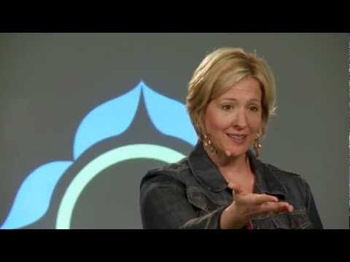
We Are In A Relationship With Our Students!
Intimacy encompases being bonded, feelings of warmth, sharing, and emotional closeness.
Vulnerability Builds Empathy
Empathy Builds Intimacy
Notes:
3.40 Emilie

Slide 11
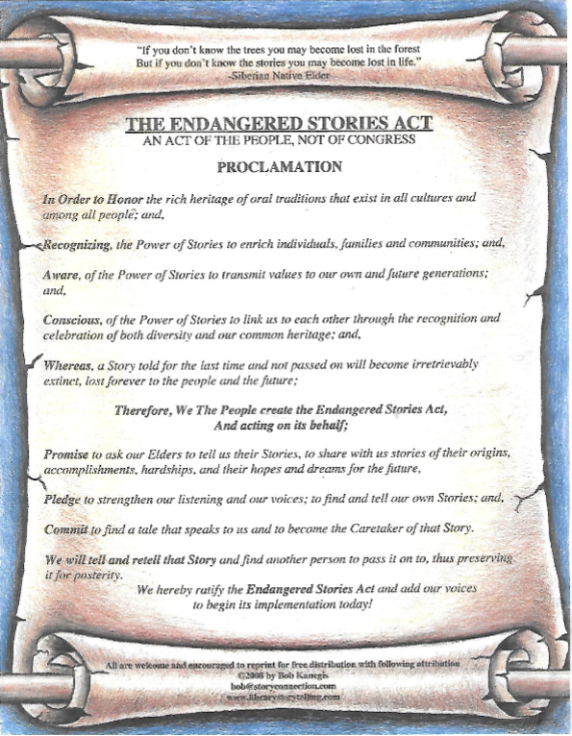
Storytelling
According to the National Storytelling Network, storytelling is an ancient art form and a valuable form of human expression.
Notes:
Ted

Slide 12
Storytelling and Intimacy
Telling Stories - Our Stories - Builds Intimacy
Notes:
Emilie

Slide 13
Stories As A Means to Build Intimacy
“Who I am” stories
“Why I am here” stories
“Vision” stories
Notes:
Emilie

Slide 14
How Can You Use Your Story in the Classroom?
Put ideas in the chat

Slide 15
How Can you Empower Your Students to Use Their Story in Your Classroom?
Put ideas in the chat

Slide 16
For Further Information and Support
Email info@asccc.org
Contact Info:
Ted Kagan tkagan@sdccd.edu
Dr. Emilie Mitchell mitchee@arc.losrios.edu
https://cccqsummit.blogspot.com/

