Slide 1
Who do we teach, what do we teach, how do we teach?

Slide 2
Who do we teach, what do we teach, how do we teach?
Dr. Ygnacio “Nash” Flores, Rio Hondo College
Lance Heard, Mt. San Antonio College
Don Mason, CTE Leadership Committee
Carrie Roberson, ASCCC North Representative, ASCCC Curriculum Committee Chair

Slide 3
This session will be a conversation of what is being taught to first responders in the classroom and in the field regarding antiracism.
We will discuss next steps and how antiracism is being taught in other disciplines.

Slide 4
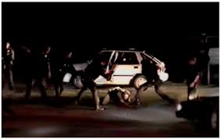
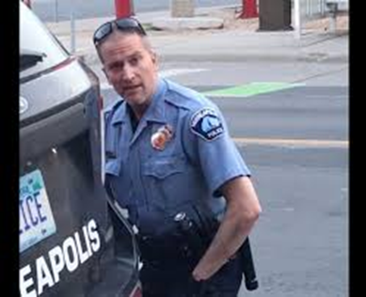
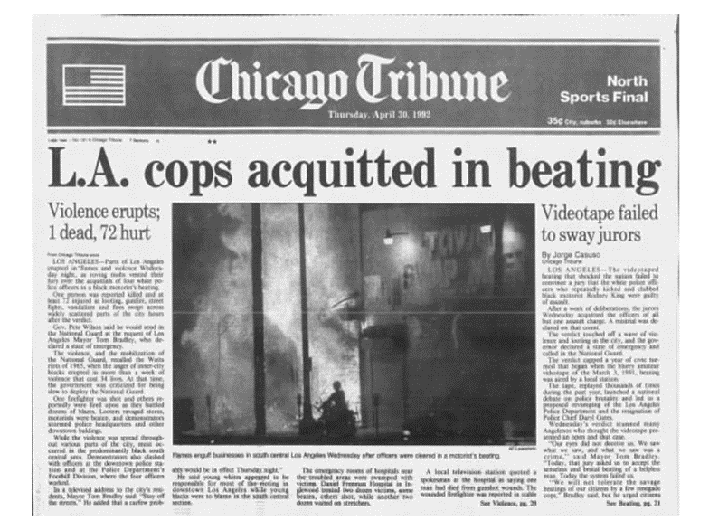
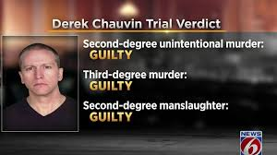

Slide 6
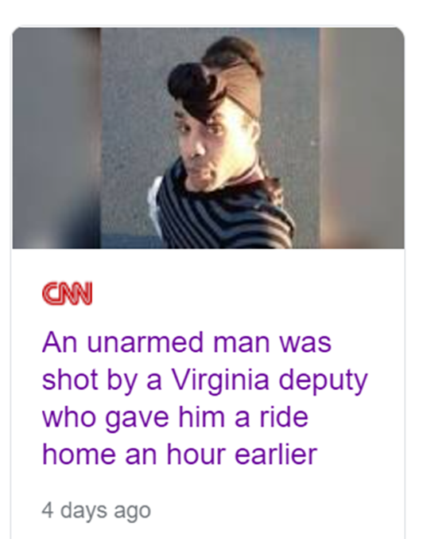
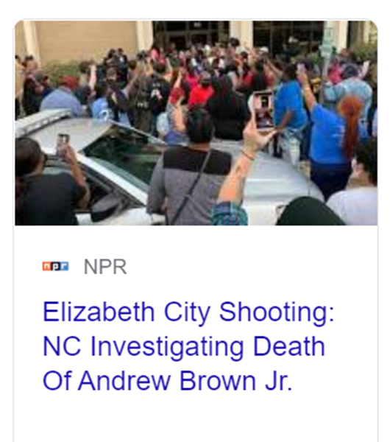
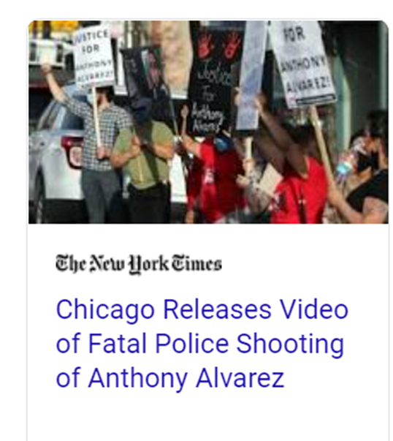

Slide 7
Legal Aspects of Evidence
Criminal evidence, including admissibility, witness competency, privileged communication, hearsay, and collection and preservation of evidence.

Slide 8
Legal Aspects of Evidence
One of the learning outcomes is for students to be able to identify evidence in everyday life and develop the ability to look where evidence could be obtained to solve cases.

Slide 9
Diversity, Equity, Inclusion and Anti-Racism Assignments

Slide 10
Legal Aspects of Evidence
1.Share a recent interesting story from the media about a criminal case. Tell us how it relates to Criminal Evidence.
2.Share at least one personal experience with law enforcement or crime and tell how it relates to course. The personal experience can be something a friend or relative had.

Slide 11
Legal Aspects of Evidence
Students choose the case
Students choose the aspects of the case they are interested in
Students are recognized for their personal perspective and value and recognition is established for the students view
Students choose the story
Students queried for their assessment of the actions of the officers
Reflection of how students would respond under similar circumstances

Slide 12
Diversity, Equity, Inclusion and Anti-Racism Assignments

Slide 13
Legal Aspects of Evidence
This assignment is designed around one of the major course objectives. It is a term paper students research and submit before the end of the semester.
Skills: Upon completion of this assignment, you will be able to demonstrate your understanding of everything you see and hear when you are sitting in a criminal courtroom proceeding.

Slide 14
This the modified the assignment to incorporate the broader issues of race in policing.
Skills: Upon completion of this assignment, you will be able to demonstrate your understanding of how the work police officers do is impacted by their relationship with people in the community.
Knowledge: This assignment will help you identify the rules of evidence and evaluate how fairly they are applied in court.
Task: To complete this assignment use notes you take from interviewing an officer or a detective about their work.

Slide 15
This the modified the assignment to incorporate the broader issues of race in policing.
Criteria for Success: This assignment is graded based how well you describe and identify the legal aspects of a case that can be impacted by
police bias against suspects,
the aspects of an investigation where a person’s rights might not be respected based on police disregard for the rules, or
lack of respect for equal application of the rules of evidence.

Slide 16
Research Paper
Use one of the options and write a paper on how the recent use of force by police in 2020 and the racial justice protests have impacted police work.

Slide 17
Research Paper
Examples
What questions would you ask an officer or detective about how their work has been affected by the shootings, killings and protests?
Include at least one of the incidents that happened in 2020.

Slide 18
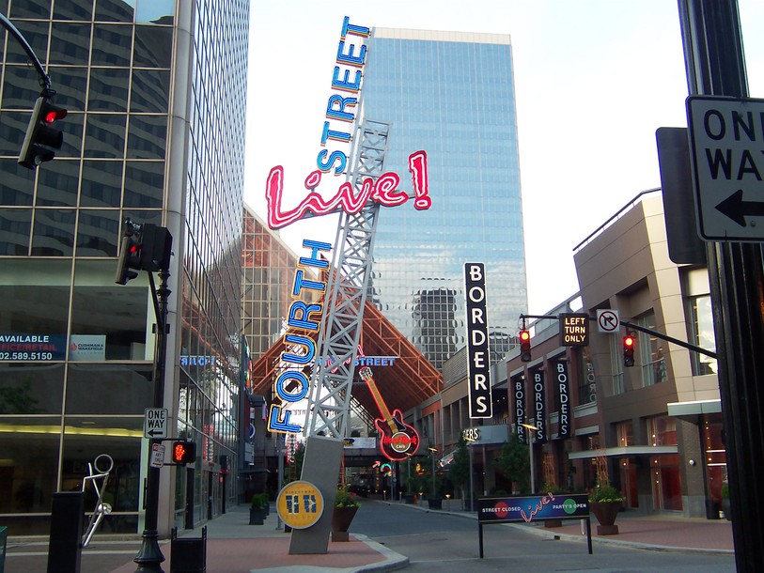
Breanna Taylor March 13, 2020 Louisville, Kentucky
Issues to examine:
How does the request for a search warrant process change, if at all, in light of Taylor being killed during an entry to her home where no drugs were found, she was not armed, and all of the search warrants in the case had the exact same descriptions and justification for no knock entry?

Slide 19
George Floyd May 25, 2020 Minneapolis, Minnesota
Issues to examine:
How does the alleged crime, possession of a counterfeit $20, the fact that the suspect is known to the police, (he is already identified) affect the decision to use force to restrain the suspect or release him and refer the case to detective for follow up and arrest warrant later?

Slide 20
Research Paper
Students choose from among several options
Students development a point of reference to analyze the impact of the relationship between officers and citizens and the ability of the officers to be perceived as helpful or harmful

Slide 21
Diversity, Equity, Inclusion and Anti-Racism Assignments

Slide 22
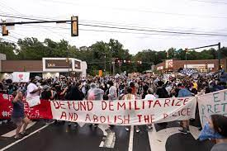
The Police is Not The Military…………

Slide 23
Militarization of Law Enforcement Dr. Ygnacio “Nash” Flores LCDR/MACS USN (Ret)

Slide 24
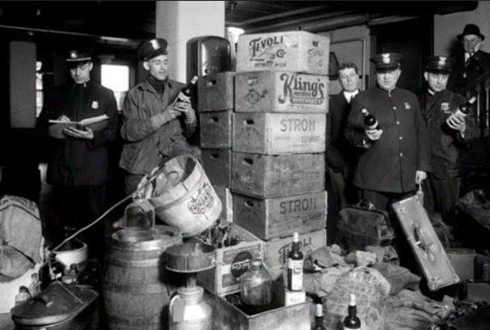
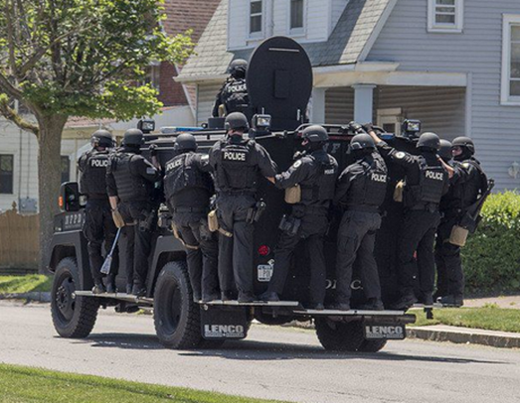
Policing in the United States
From this . . . To this…
Detroit prohibition raid 1920 Police Raid 2007

Slide 25
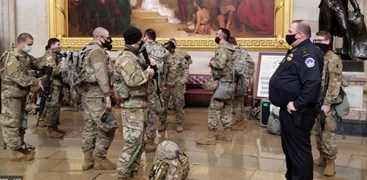
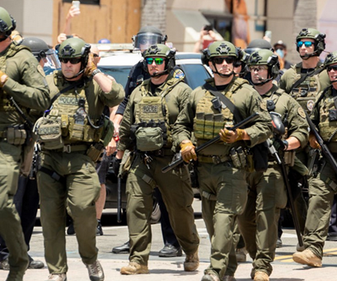
From Protector to Warrior
Militarization of Law Enforcement
Direct – use of military forces
Indirect – law enforcement
assumes characteristics of
military culture & practices
Culture of law enforcement officers as Warriors
Notes:
Capitol Hill photo CBSbews.com
Huntington Beach PD SWAT. Gen.medium.com June 2020

Slide 26
Institutionalization of Discrimination:
Development of Policing in America
Night Watches & Vigilantism
The Insurrection Act of 1807
President could use military when requested by a state or to enforce federal law
Compromise of 1850
Plugged holes in the Fugitive Slave Act
Any black person in a free state could be claimed as an escaped slave by a southerner
Law prevented a meaningful defense
Notes:
1854 President Pierce used Army & Marines to keep order in the Boston slave trial of Anthony Burns

Slide 27
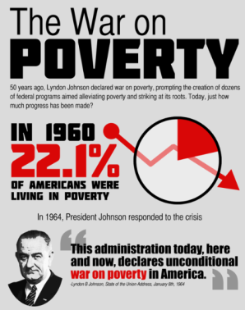
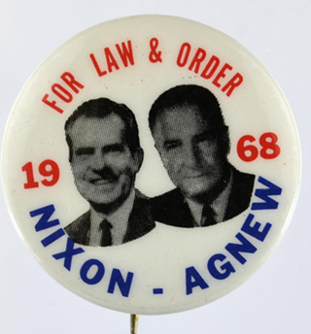
Institutionalization of Discrimination: Disorder becomes a National Political Issue
National Policies in the 1960s
President John’s Administration
War on Poverty to address Crime
Bureau of Narcotics and Dangerous Drugs (BNDD) - Drug Enforcement Agency
Nixon’s 1968 presidential campaign focused on crime by exploiting fear
General feeling American values and traditions under attack
Pandered to silent majority
Linked drugs, crime, counterculture, and race to American problems
Notes:
War on poverty. 2americasandgreatsociety.weebly.com
War on poverty. 2americasandgreatsociety.weebly.com

Slide 28
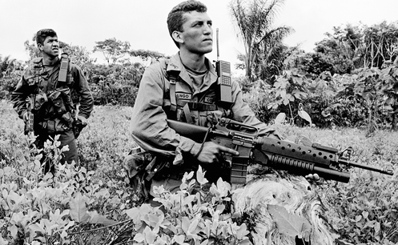
Institutionalization of Discrimination: Disorder becomes a National Political Issue
National Policies in the 1970s – 1980s
President Nixon’s Scare Strategy of 1971
Drug abuse Public Enemy No. 1
Campaign Against Marijuana Production (CAMP)
President Reagan’s War on Drugs 1982
Mass Incarceration
President G. Bush
Hard on Crime - 1988 Crime Bill – Established Byrne Grants – Billions used to fund law enforcement programs
Notes:
Nixon’s Scare Strategy of 1971. Massive PR campaign to scare the public about crime – G. Gordon Liddy, Drug Abuse – Public Enemy No. 1
Office of Drug Abuse Law Enforcement (ODALE) – supplanted the BNDD
High profile stories over actual enforcement
Large scale raids, wrong addresses, collateral damage
Set trend for hiring aggressive officers with poor performance and protecting officer misconduct
1972 – 1073 ODALE conducted 1,439 raids
With ODALE’s expiration Nixon folded federal drug enforcement agencies into the Drug Enforcement Administration (DEA)
War on Drugs – rollingstone.com

Slide 29
Institutionalization of Discrimination: Disorder becomes a National Political Issue
National Policies in the 1990s – 2000s
President Clinton’s Administration continued DOJ-DoD relationship
President G.W. Bush
Strengthened DOD support to War on Drugs
Global War on Terrorism
President Obama continued strengthening DOJ-DOD relationship
Notes:
Nixon’s Scare Strategy of 1971. Massive PR campaign to scare the public about crime – G. Gordon Liddy, Drug Abuse – Public Enemy No. 1
Office of Drug Abuse Law Enforcement (ODALE) – supplanted the BNDD
High profile stories over actual enforcement
Large scale raids, wrong addresses, collateral damage
Set trend for hiring aggressive officers with poor performance and protecting officer misconduct
1972 – 1073 ODALE conducted 1,439 raids
With ODALE’s expiration Nixon folded federal drug enforcement agencies into the Drug Enforcement Administration (DEA)
War on Drugs – rollingstone.com

Slide 30
Institutionalization of Discrimination: Victims of the “Wars on…”
African American & Minority Communities
Counter-Culture Communities
Those Different
Notes:
Nixon’s Scare Strategy of 1971. Massive PR campaign to scare the public about crime – G. Gordon Liddy, Drug Abuse – Public Enemy No. 1
Office of Drug Abuse Law Enforcement (ODALE) – supplanted the BNDD
High profile stories over actual enforcement
Large scale raids, wrong addresses, collateral damage
Set trend for hiring aggressive officers with poor performance and protecting officer misconduct
1972 – 1073 ODALE conducted 1,439 raids
With ODALE’s expiration Nixon folded federal drug enforcement agencies into the Drug Enforcement Administration (DEA)
War on Drugs – rollingstone.com

Slide 31
Institutionalization of Discrimination: Media’s Role
Radio Shows
Car 54
Dragnet
TV Shows & Movies
Dragnet, TJ Hooker, Hawaii Five-O
Dirty Harry
Law & Order, Criminal Minds
CSI, NCIS, Homeland
Newsprint – Pros and Cons
Internet – a Different Truth
Notes:
Nixon’s Scare Strategy of 1971. Massive PR campaign to scare the public about crime – G. Gordon Liddy, Drug Abuse – Public Enemy No. 1
Office of Drug Abuse Law Enforcement (ODALE) – supplanted the BNDD
High profile stories over actual enforcement
Large scale raids, wrong addresses, collateral damage
Set trend for hiring aggressive officers with poor performance and protecting officer misconduct
1972 – 1073 ODALE conducted 1,439 raids
With ODALE’s expiration Nixon folded federal drug enforcement agencies into the Drug Enforcement Administration (DEA)
War on Drugs – rollingstone.com

Slide 32
Warrior Mentality is Problematic
Transitioning from Warriors to Guardians
Rebranding
Training and education
Recruitment and retention
Societal drivers behind the Warrior Cop
Defense Industrial Complex
Police Industrial Complex
Prison Industrial Complex
Notes:
Defense Industrial Complex
$740+ billion National Defense Authorization Act for FY 2021
Police Industrial Complex
$115+ Billion annually (departmental budgets) (Vera.org)
$500+ Million in surplus military equipment (2011)
The homeland security market for state and local agencies is projected to reach $19.2 billion by 2014
Police Industrial Complex
$115+ Billion annually (departmental budgets) (Vera.org)
$500+ Million in surplus military equipment (2011)
The homeland security market for state and local agencies is projected to reach $19.2 billion by 2014

Slide 33
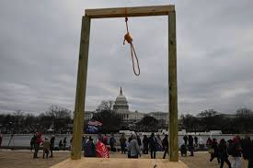
This was America…….January 6, 2021

Slide 34
This is America…….Let’s Teach Them!
How do we teach equity?
How do we teach inclusion?
Are we comfortable teaching the uncomfortable?

Slide 35
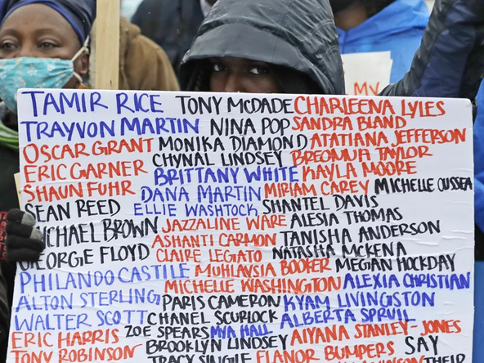

Slide 36
On Behalf of the Presenters, we thank you for your attendance and participation!

