Slide 1
Counseling AND Articulation Faculty: Critical Partners in CurriculuM Development
Joseph Bielanski, Berkeley City College
Bernie Day, Foothill College
Tiffany Tran, Irvine Valley College
ASCCC Curriculum Institute
July, 2016

Slide 2
Brief Assessment

Slide 3
Overview
Role of Curriculum Committee
10+1 curriculum development
Role of Articulation Officer
Role of Counseling Faculty
Resources
Examples
New Course
New Program
Q&A
Notes:
Joseph

Slide 4
Curriculum Committee
Role
Review new and revised curriculum (courses, certificates, degrees)
Keep up-to-date with the State Chancellor’s Office Program Course Approval Handbook
Keep up-to-date with local practices
Membership
Faculty from each discipline area - including Counseling Faculty
Articulation Officer
Dean/Vice President of Instruction
Curriculum Specialist
Report curriculum actions to:
District Curriculum Committee (multi-college district)
College Academic Senate
College Department Chairs group
Governing Board and CCCCO for approval
Notes:
Joseph

Slide 5
10+1 Curriculum Development
1. Curriculum: including establishing pre-requisites and placing courses within disciplines;
2. Degree and certificate requirements;
3. Grading policies;
4. Educational program development;
5. Standards or policies regarding student preparation and success;
Counselors/Articulation Officers
Notes:
Tiffany

Slide 6
10+1 Curriculum Development
6. District and college governance structures;
7. Faculty roles and involvement in accreditation processes, including self-study and annual reports;
8. Policies for faculty professional development activities;
9. Processes for program review;
10. Processes for institutional planning and budget development; and,
Other academic and professional matters.
Counselors/Articulation Officers
Notes:
Tiffany

Slide 7
The Articulation Officer
Role varies widely among CCCs
Continually evolving
Different CCC reporting structures:
Instruction
Student Services
Counselor, teacher, administrator
University liaison
ADT expert
Magician and problem solver
Fearless student advocate
ASSIST, C-ID, IGETC, CSU, UC expert
Curriculum coach & developer
Notes:
Bernie - Historical: (link between counseling, advising, admission liaison and curriculum)
Multi-faceted: Overseeing Course and program approval, pertaining to multiple university curricular requirements , legislation, CCCCO level, program requirements, C-ID)
Instruction: How many in room have AO’s reporting to them?
Historical: (link between counseling, advising, admission liaison and curriculum)
Multi-faceted: Overseeing Course and program approval, pertaining to multiple university curricular requirements , legislation, CCCCO level, program requirements, C-ID)
Instruction: How many in room have AO’s reporting to them?
Maintains all transferable courses in ASSIST database
Proposes and obtains articulation for all courses
UC/CSU transferability
IGETC and CSU GE
C-ID
Course-to-course, GE and major preparation with individual colleges and universities
Represents the college as the liaison with receiving institutions
Informs faculty, administrators, and students regarding curriculum changes
Ensures catalog accuracy regarding articulation and transfer information.
Advises instructional faculty about curriculum needs
Develops or revises curriculum as appropriate with faculty
Serves on appropriate committees (e.g. Curriculum, GE, academic policies)
Advocates for students, faculty, curriculum, institution

Slide 8
AO Primary Responsibilities
Maintaining all transferable courses in ASSIST database;
Proposing and obtaining articulation for all courses;
UC/CSU transferability
IGETC and CSU GE
C-ID
Course-to-course, GE and major preparation with individual colleges and universities
Representing the college as the liaison with receiving institutions;
Informing faculty, administrators, and students regarding curriculum changes;
Advising instructional faculty about curriculum needs;
Developing or revising curriculum as appropriate with faculty;
Serving on appropriate committees (e.g. Curriculum, GE, academic policies); and,
Advocating for students, faculty, curriculum, institution.
Notes:
Bernie

Slide 9
ASCCC Resolution (1998)
"Resolved that the Academic Senate recommend to local senates that the positions of Articulation Officer and Transfer Center Director be faculty positions, and Resolved that the Academic Senate urge local senates that the positions of Articulation Officer and Transfer Center Director be full-time or, in cases of smaller colleges, at least a fifty percent assignment.”
Notes:
Bernie

Slide 10
Curriculum LEADERSHIP
99% of articulation officers serve on their college Curriculum Committee.
76% of Articulation Officers are voting members.
AO reporting structure
18% report to the CSSO
22% report to CIO
40%+ report to Dean of Counseling or other
AO assignments
44% full time
34% are assigned half time+ but less than full time
Source: CCCCO Articulation Addendum Report Results (2014)
Notes:
Bernie

Slide 11
Big Picture Contributions
Board of Governors
ACCJC
CSU GE and IGETC Reviewers
CSU General Education Advisory Committee
C-ID Advisory Committee
ICW
SACC
CIAC
CCCCO Regional Representatives
Notes:
Bernie

Slide 12
Food for Thought
"We have articulation experts among us. They speak in a code that leaves us bewildered but certain that all is well because they come across as so knowing and so confident. “I don't have time to figure out what was just said,” we may think. “I have papers to grade and office hours to hold. I am an expert in my field and our articulation officer is an expert in his.”
"As you dive into seemingly murky articulation waters, be sure to bring your tools, get your articulation officer on speed dial, and ask questions until you fully understand the answer.”
Articulation for Non-experts: Understanding the Processes and the Jargon (2011) David Morse, ASCCC President
Notes:
Bernie

Slide 13
Successful Collaboration: Articulation Officers and Curriculum Chairs
Frequent communication
Collaboration
Consensus
Compromise
Trust
Curriculum committee
CIO

Slide 14
CIAC: California Intersegmental Articulation Council
Intersegmental advocacy group
Collaborates with ASCCC, UC, CSU, CCCCO, ICAS, C-ID
Guidelines and policies
Notes:
Bernie

Slide 15
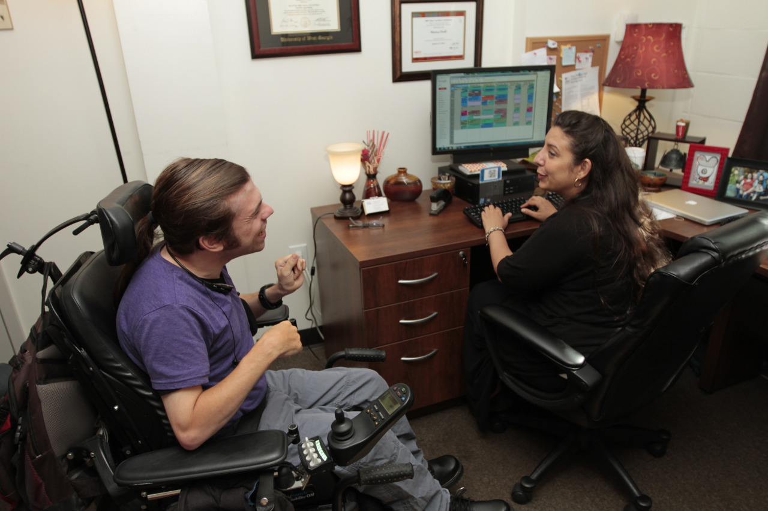
Counseling Faculty
Professionally trained to diagnose the difficulties students face in pursing and achieving their educational goals, to prescribe solutions for those difficulties, and to support students as they inch or stride toward success.
^{Crucial:} understanding students’ stated goals within the context of human development and the inevitable changes that occur.
Counseling faculty understand that students’ lives and goals change as a result of their unfolding educational experiences or personal situations.
The Role of Counseling Faculty and Delivery of Counseling Services in the California Community Colleges. ASCCC (Spring 2012)
Notes:
Tiffany

Slide 16
Counseling Faculty
Roles: teaching; providing personal, academic and career counseling to diverse clientele;
Vital understanding of student needs and the challenges (academic, career, personal);
Current knowledge of all college programs;
Explain and enforce college policies;
Maintain expertise in UC, CSU and independent/out-of-state college admission/requirements; and,
Awareness of other local college programs and requirements.
Notes:
Tiffany

Slide 17
Counseling Faculty: Curriculum leaders
"Counselors can also provide valuable input regarding course development and student need. With regard to transfer-level courses, counselors can indicate whether trends appear in course requests, especially concerning general education requirements that have limited course offerings or are difficult for students to register for. Counselors can provide information of an anecdotal nature about student need as well as documented evidence of students’ movement within the college: what courses they take, what courses they want, and what they look for and need. Further, counselors can share information on UC and CSU transfer pathways and show trends based on students’ educational goals that provide a glimpse into what is needed to petition for graduation. Finally, counselors might help to establish whether the course could fulfill general graduation or transfer requirements.”
Sofia Ramirez-Gelpi, Allan Hancock College, ASCCC Curriculum Committee member
Terrie Hawthorne, MSW, Moreno Valley College, ASCCC Curriculum Committee member
Best Practices for the Development of New Courses ASCCC Rostrum (February 2015)
Notes:
Tiffany

Slide 18
The Big Picture
Counseling faculty have the holistic understanding and knowledge of courses, programs and college policies and how they can affect student success.
Notes:
Tiffany

Slide 19
Example: New Course – SOC 5
Notes:
Joseph

Slide 20
New course – SOC 5
New course example
Sociology course
Articulation officer
Provide faculty contacts at UC and CSU campuses.
Locate comparable courses at UC and CSU campuses.
Provide sample outlines at other community colleges.
Recommend course be added to IGETC/CSU GE.
Counseling faculty
Assist with best time to schedule course.
Recommend course be added to program.
Recommend course be included to Ethnic studies requirements.
Notes:
Joseph

Slide 21
New Program Development
Associate Degree for Transfer
Evaluating appropriate core courses (where options are available);
Evaluating appropriate List A, B and/or C courses;
Assessing options based upon common CSU transfer institutions and lower division major preparation requirements for associated majors;
Assessing course options based upon common requirements at UC and independent institutions;
Explaining how to incorporate double-counting major and GE requirements; and,
Obtaining C-ID and major articulation approvals in order to submit the degree application.
Notes:
Bernie

Slide 22
New Program Development: Example
ADT Political Science:
List B: Select 2 courses (6 units) from the following:
Any courses not selected above, any CSU transferable political science courses, and/or other courses that are articulated as lower division preparation for the political science major at a CSU, or any CSU transferable introductory course in the social sciences (i.e., articulated as filling CSU GE Area D).
Hundreds of course options based upon TMC List B
AO evaluates the comprehensive list:
Determines that only 13 courses are included within lower division major requirements at 23 CSU and 9 UC campuses;
Helps develop a realistic and reasonable course list that prepares students for transfer.
Notes:
Bernie

Slide 23
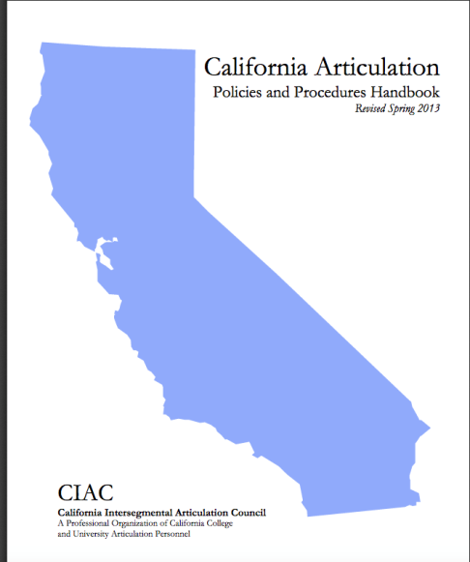
Resources
CCCCO Program and Course Approval Handbook
http://extranet.cccco.edu/Portals/1/AA/ProgramCourseApproval/Handbook_5th%20Ed_DRAFTv5_22_13.pdf
California Articulation Policies and Procedures Handbook Revised Spring 2013 http://ciac.csusb.edu/articulationHandbook.html
ASSIST.org
Notes:
Bernie

Slide 24
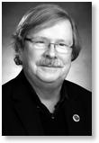
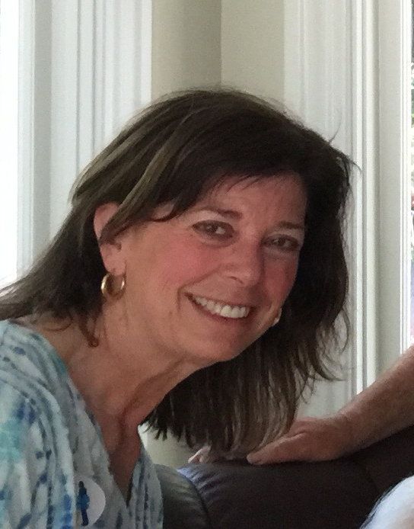
Q&A
Joseph Bielanski, Berkeley City College
jbielanski@peralta.edu
Bernie Day, Foothill College
daybernie@fhda.edu
Tiffany Tran, Irvine Valley College
ttran76@ivc.edu
Notes:
Joseph, Bernie and Tiffany

