Slide 1
Working with Your Regional Consortia
Karen Daar, Los Angeles Valley College
Lorraine Slattery-Farrell, ASCCC South Representative
Julie Pehkonen, Chair, Inland Empire/Desert Regional Consortium

Slide 2
Breakout Description
This breakout will examine the program review process for CTE and the roles of regional consortia and advisory boards. Presenters will discuss how to effectively work with your regional consortia, advisory boards, and DSN.

Slide 3
The Role of Regional Consortia in Curriculum Process

Slide 4
Title 5 §55130(b)(8)(E)
New and substantially revised programs require the recommendation of the Regional Consortia

Slide 5
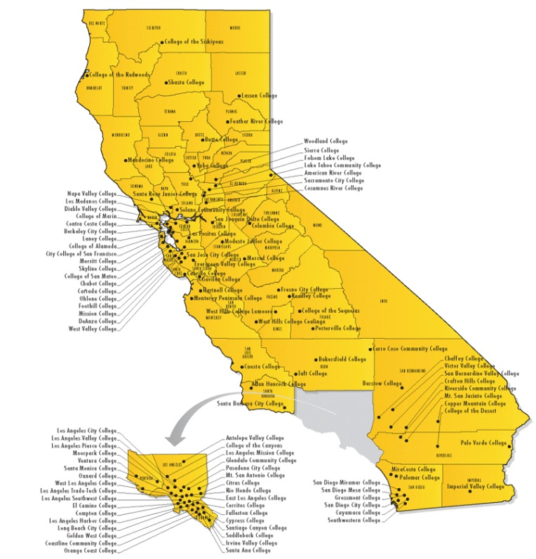
Regional Consortia Consider
Labor Market Data
Undue Impact on other colleges

Slide 7
Who Makes the Recommendation?
Typically a subcommittee of the CTE Deans

Slide 8
What are consortia looking for?
Primarily … to ascertain the need for the proposed program in regard to other community colleges in the area, as specified by Title 5, section 55130 (b)(8)(E).

Slide 9
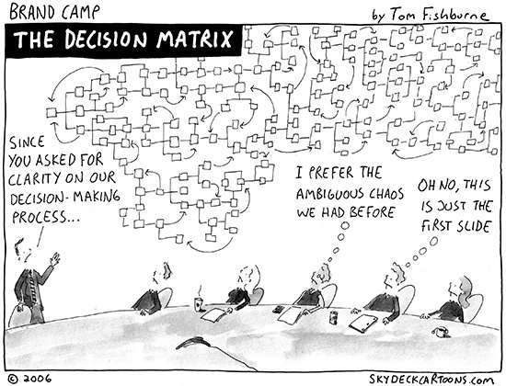
What is the Process?

Slide 10
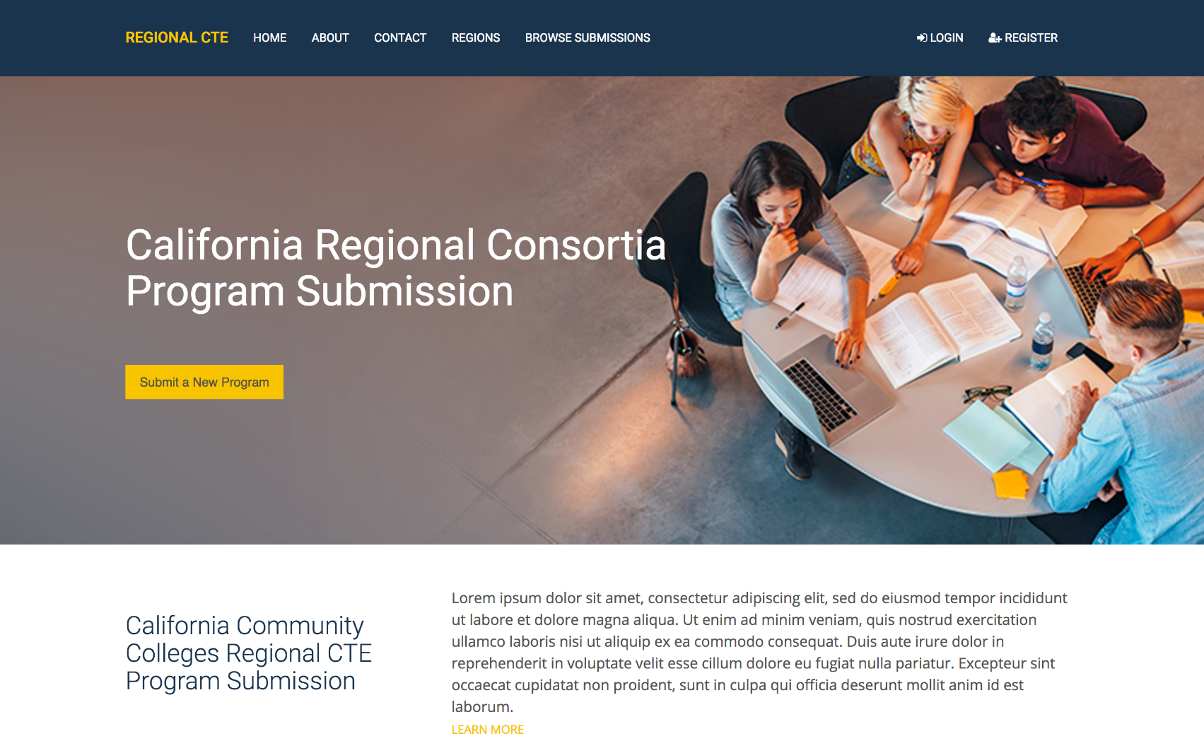
This site is under development. Actual site will go live soon.
Notes:
Home Page

Slide 11
Step 1: Create a user account (register)

Slide 12
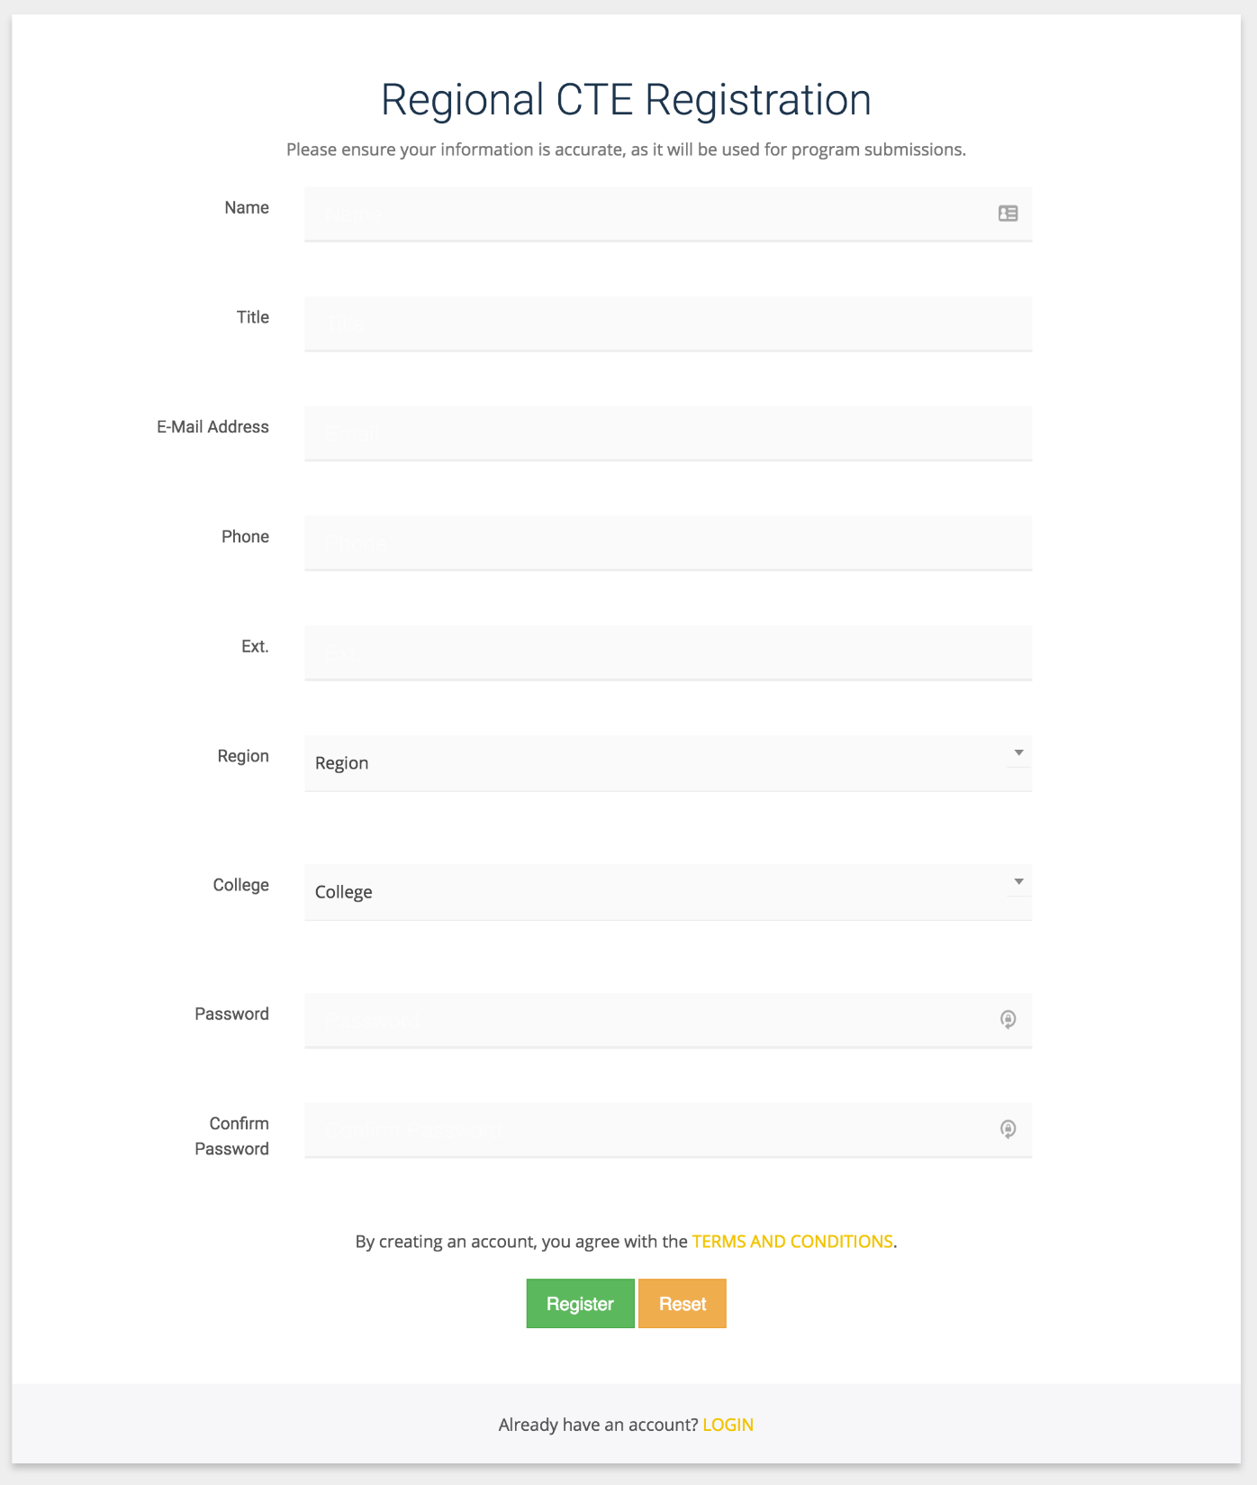
Why Register?
Notes:
Register Page

Slide 13
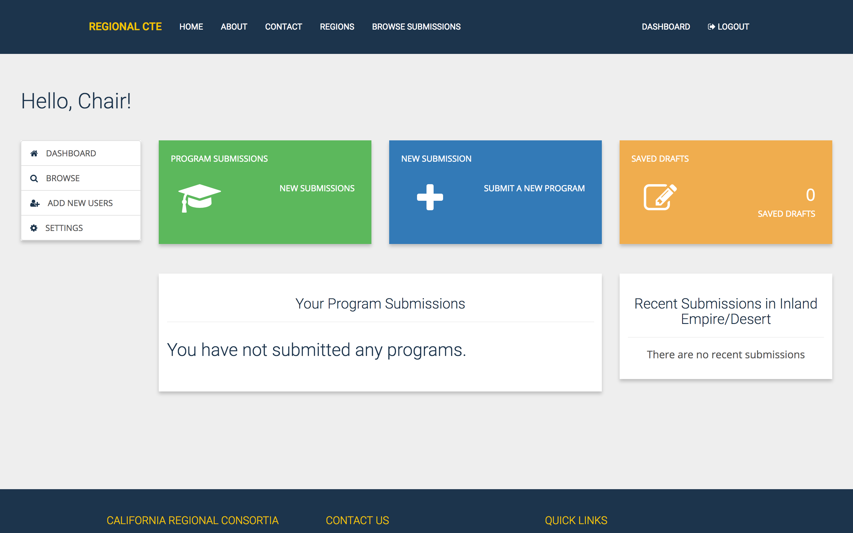
Notes:
User Dashboard. The only additional feature that the chair has is the ability to add new users.

Slide 14
Notes:
Login Page

Slide 15
Step 2: Request a LMI report from the Center of Excellence

Slide 16
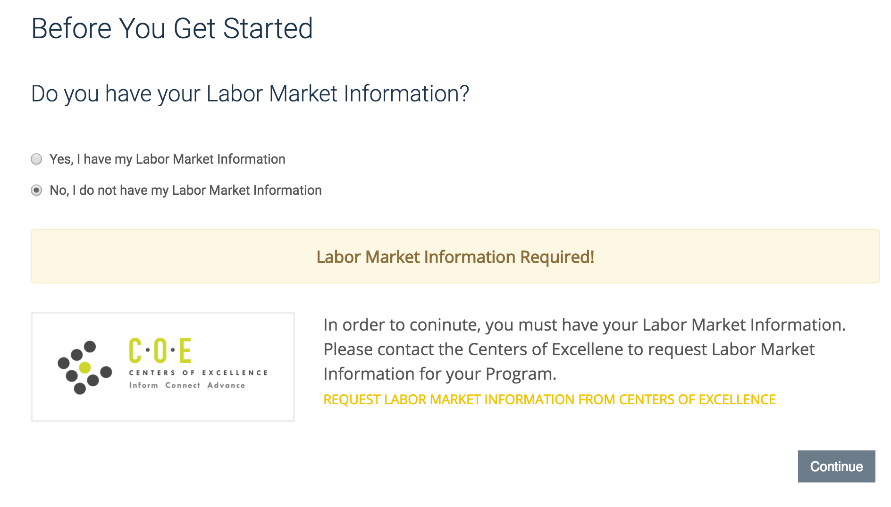
Notes:
Submit Form Pt 1.

Slide 17
Step 3: Submit a request to your regional consortium to review your program and recommend approval (actual site will be live soon)

Slide 18
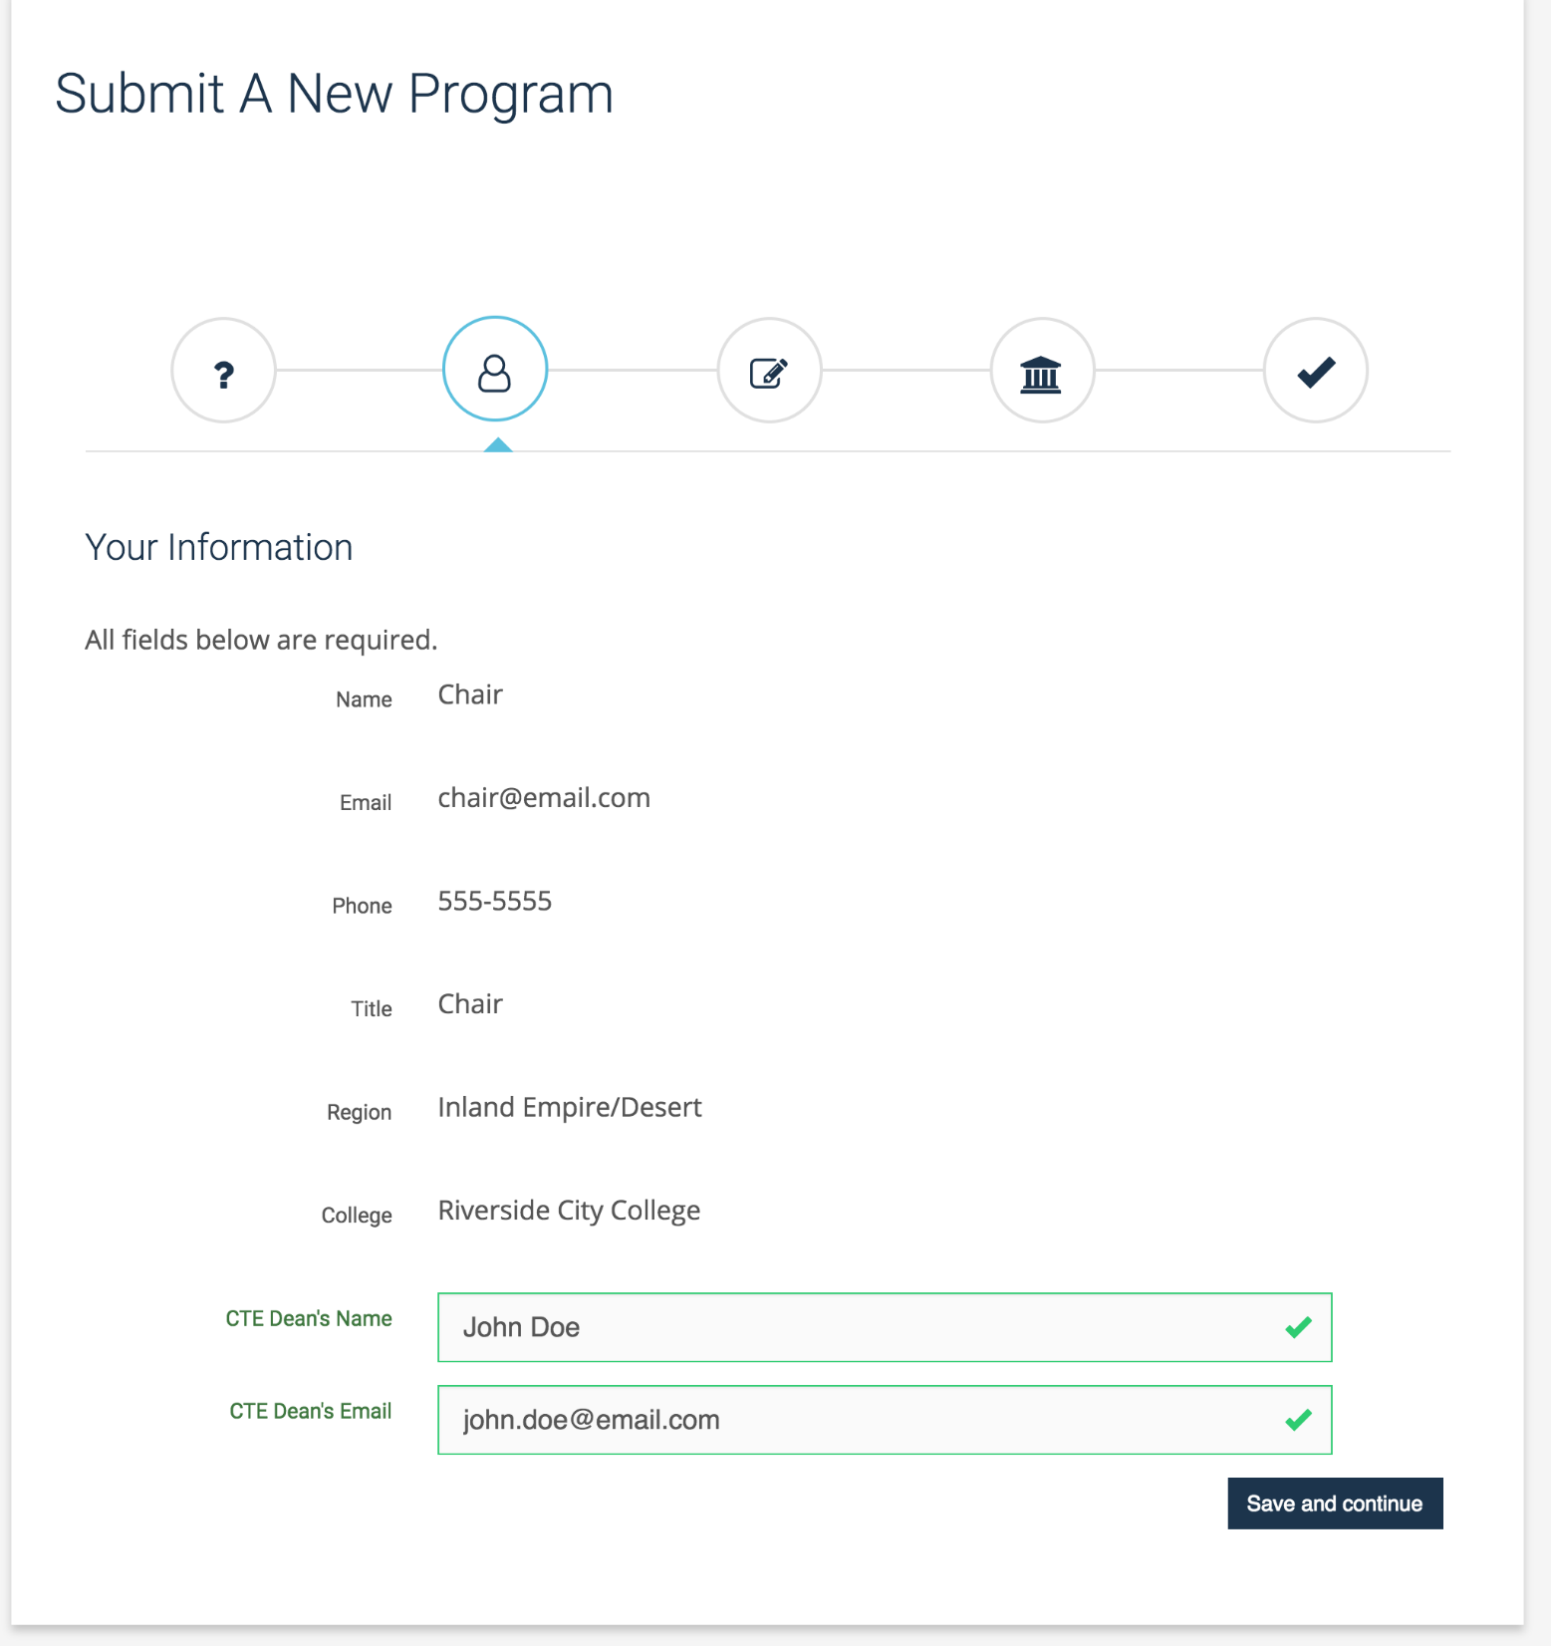
Notes:
Submit Form Pt. 2

Slide 19
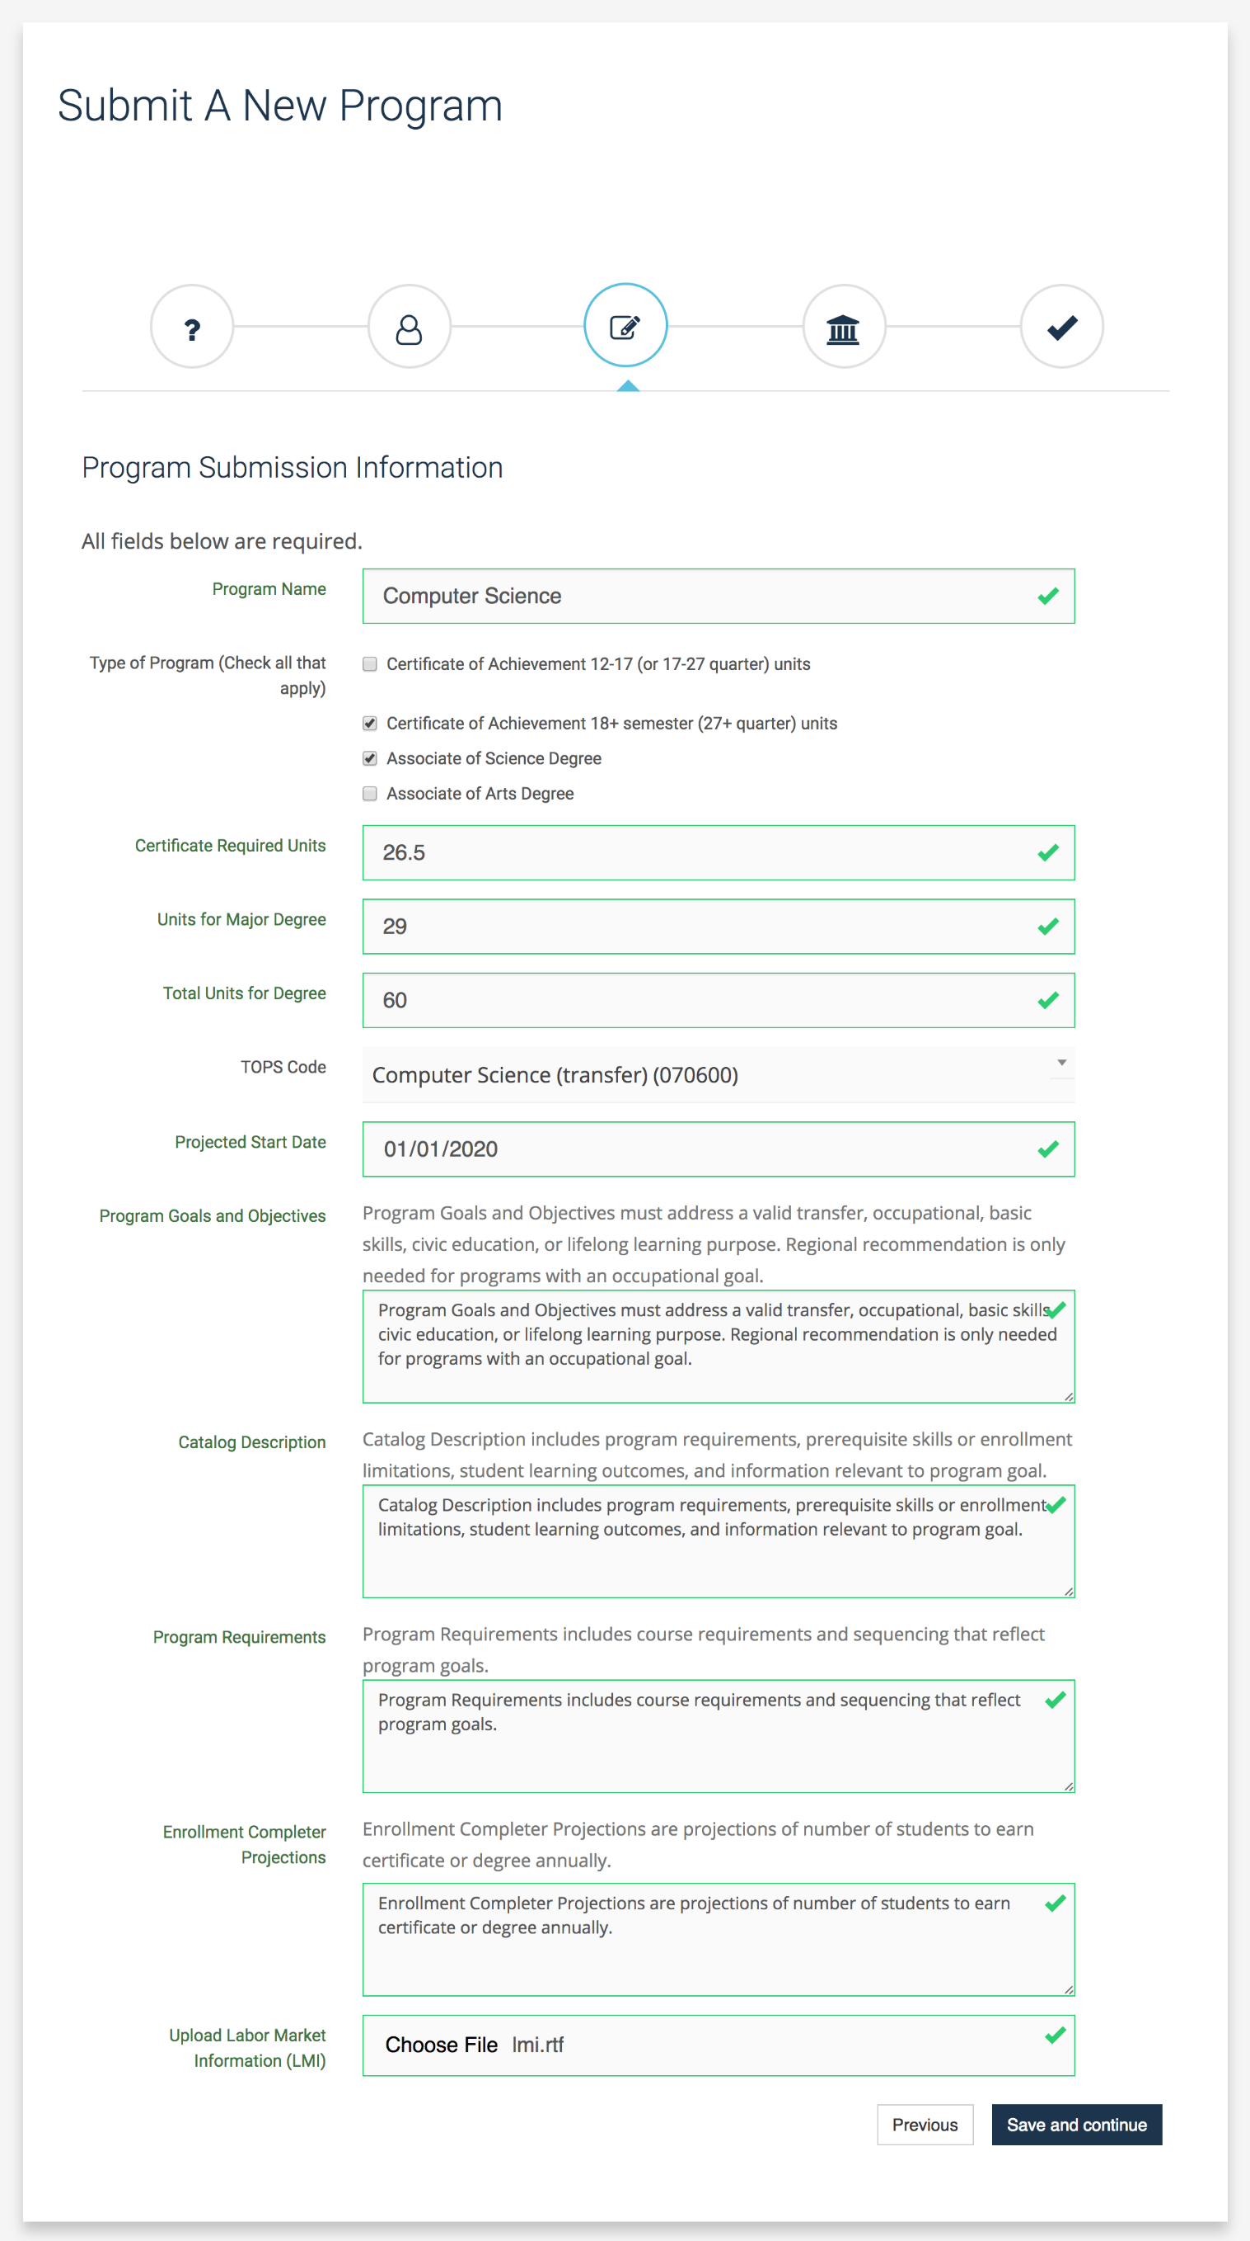
These questions are the same on your submission to the CCCCO.
Notes:
Submit Form Pt. 3

Slide 20
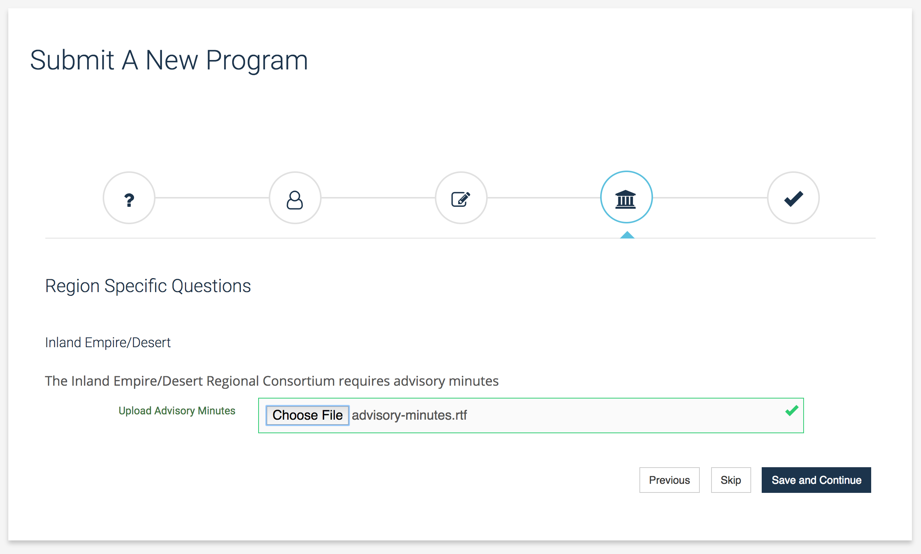
Some regions require additional information (not all)
Notes:
Submit Form Pt. 4

Slide 21
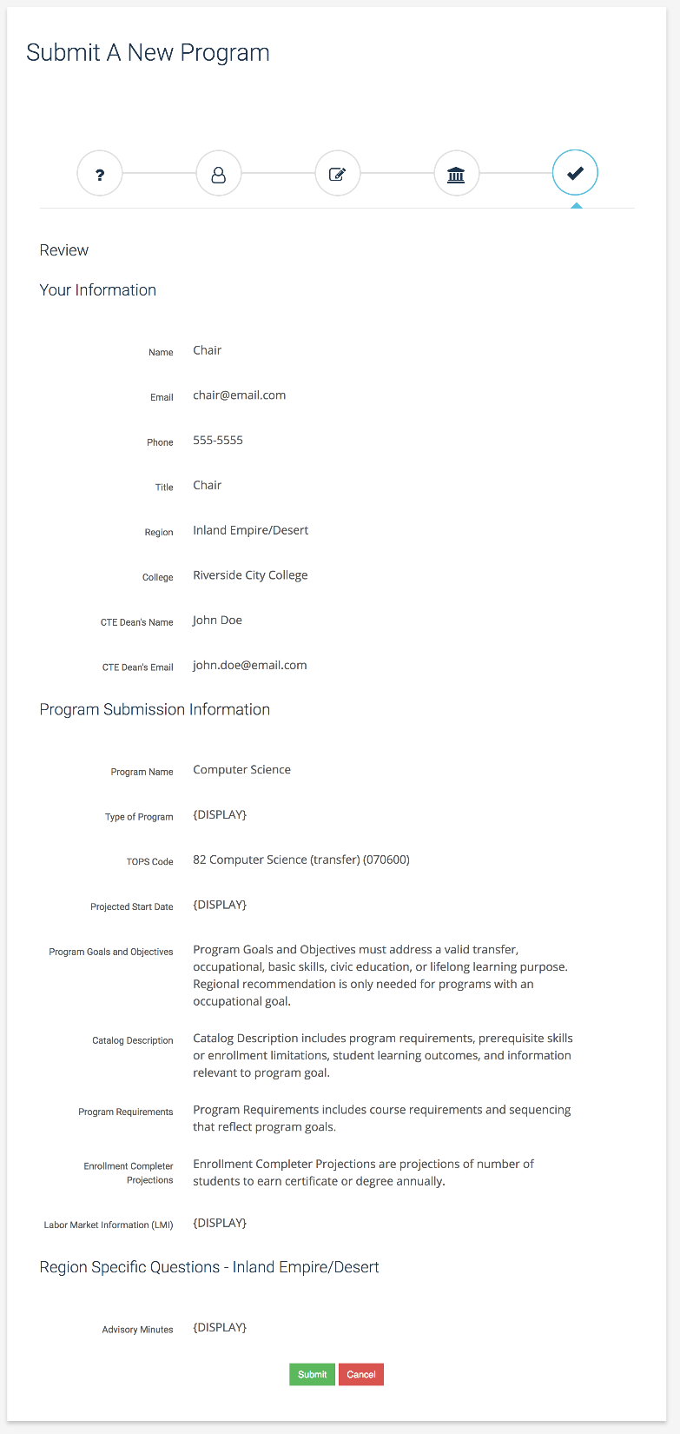
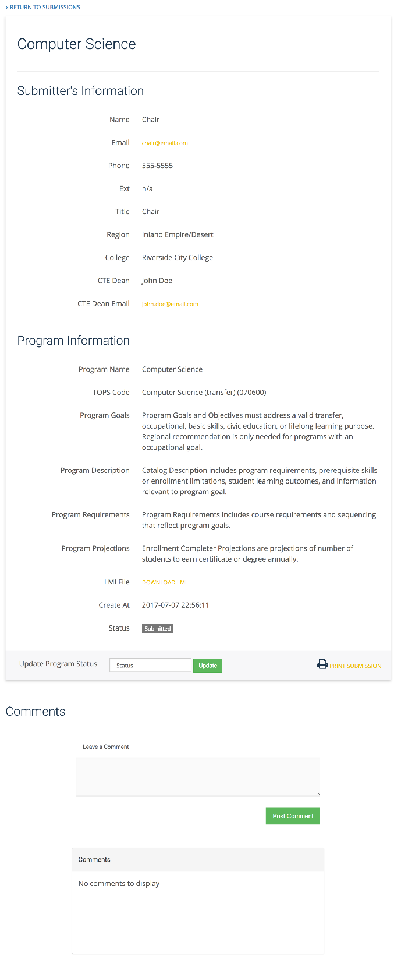
Review your submission before submitting
Check the status of your submission
Notes:
Submit Form Pt. 5

Slide 22
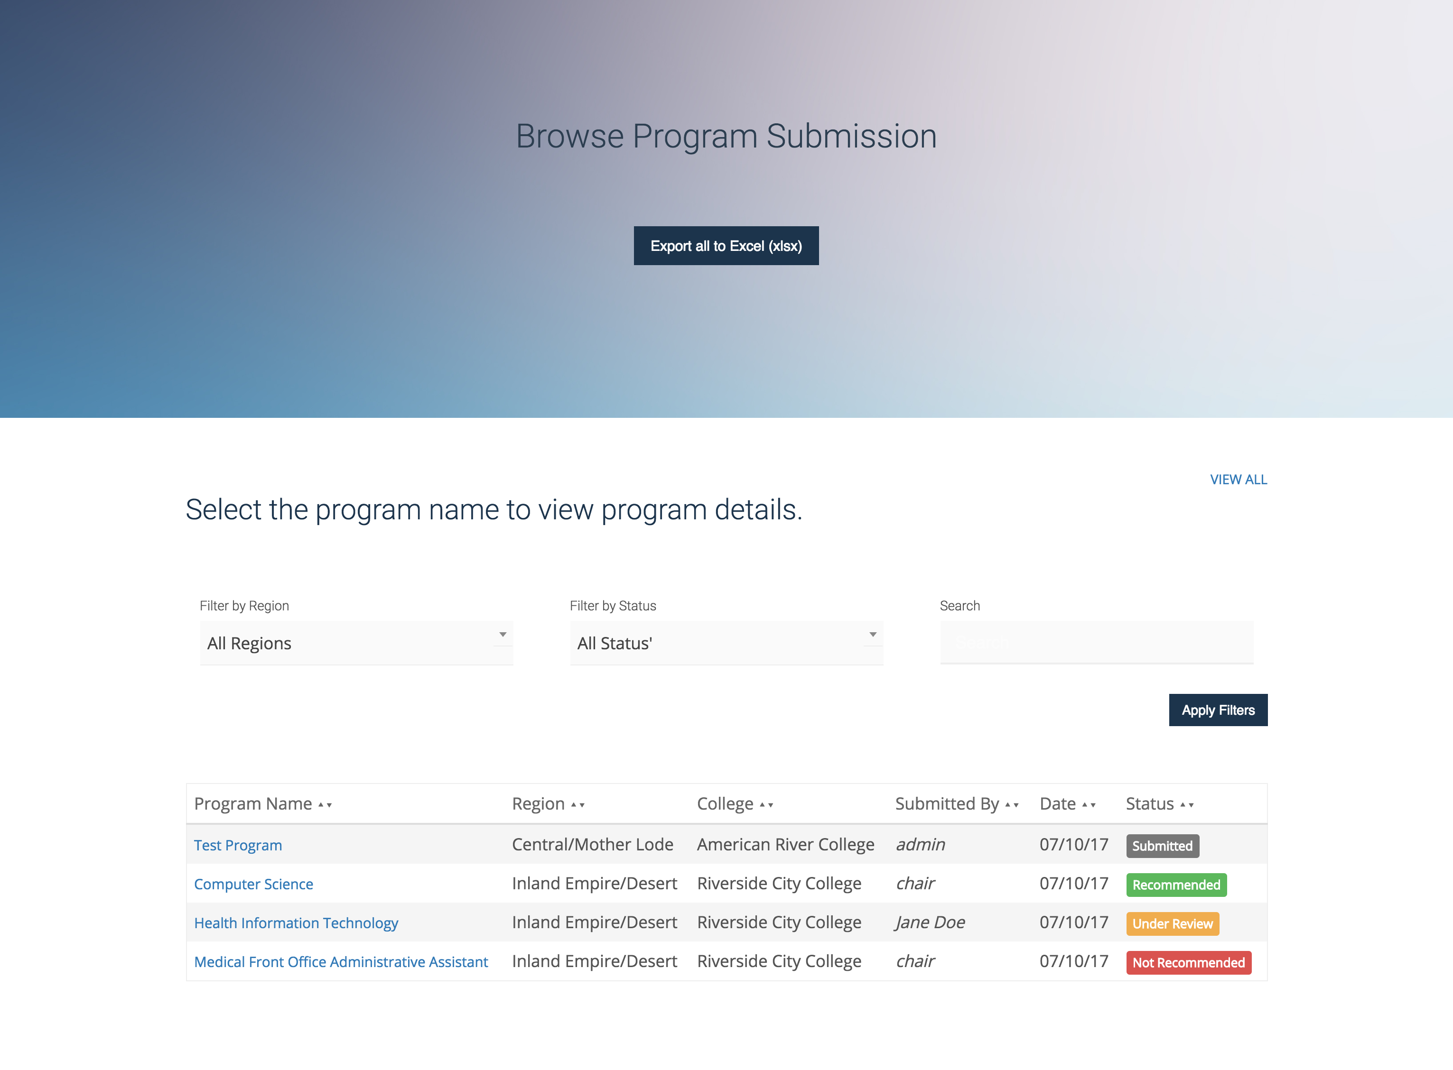
Browse and view program submissions (not just your own)
Notes:
Browse Submitted Programs

Slide 23
For more information about your region’s process, go to:
Region | Website:
Bay Area Region | http://www.baccc.net/Home/program-endorsement-guidelines
Central/Mother Lode Region | http://crconsortium.com/program-and-course-approval/
Inland Empire/Desert Region | https://desertcolleges.org/cte/program-process.php
Los Angeles/Orange County Region | http://www.laocrc.org/educators
North/Far North Region | http://nfnrc.org/home/information-hub/program-proposal-meetings/
San Diego/Imperial Counties Region | http://myworkforceconnection.org/committee-sub/program-approval-process/
South Central Coast Region | http://sccrcolleges.org/partners

Slide 24
Who are the DSNs and how can they help identify regional needs?

Slide 25
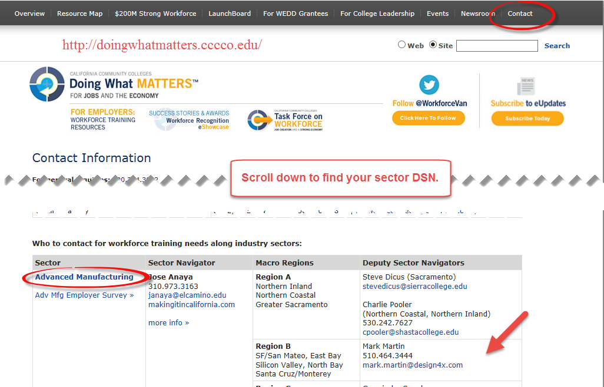

Slide 26
Industry projections at the regional level (i.e., specific projects, expansions, etc.) that might impact the local workforce.
Occupations on the decline.
Support cross-sector CTE education programs.
Facilitate conversations and surveys with respective industries.
Identify and disseminate skills, credentials and certificates that regional employers need.
Facilitate faculty development opportunities.
Coordinate Regional Advisory programs.
Convene multi-college stakeholders in a sector.
Assist in aligning K-12 pathways with CC programs and aligning CC programs with industry needs.
What training is more more applicable to K-12.

Slide 28
Thank you!
Karen Daar: daarkl@lavc.edu
Julie Pehkonen: Julie.Pehkonen@rcc.edu
Lorraine Slattery-Farrell: lfarrell@msjc.edu

