Slide 1
Writing New Courses – Effective Practices for a High Quality Integrated Course Outline
Presenters:
Carol Kimbrough, Hartnell College
Diane Hurlbut, Irvine Valley College
2016 ASCCC Curriculum Institute

Slide 2
DESCRIPTION
Writing a quality course outline of record that clearly demonstrates both the scope and rigor in all aspects of a course is important for many reasons. This breakout provides guidance on how to write a course outline of record that communicates to fellow faculty and to the public that the course meets the appropriate expectations of rigor.

Slide 3
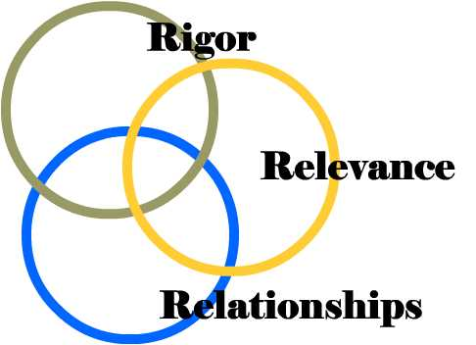
Redefined Problem Statement
What is academic rigor?
How do we establish and uphold academic rigor on our campus?
Based on a belief that academic rigor is a multi-faceted concept that encompasses curricular, institutional, student and faculty behaviors which reflect a core belief system.

Slide 4
Academic Rigor is Multi-Faceted

Slide 5
Academic Rigor and the COR

Slide 6
Course Outline of Record (COR)
A legal document containing required elements specified in §55002
Legal contract between faculty, student, and college
Basis for articulation agreements and statewide course identification number (C-ID)
Ensures quality and consistency of course delivery for faculty
Ensures instructional integrity, content and rigor across all section offerings
Identifies a body of knowledge that distinguishes one course from another
Justifies unit credit
Approval: Curriculum Committee, Board of Trustees, Chancellor’s Office

Slide 7
Elements of the COR
Course Number and Title Catalog Description Prerequisites/ Corequisites/ Advisories Units Total Contact Hours Course Content Objectives/Outcomes Instructional Methods Methods of Assessment Grading criteria | Out-of-Class Assignments Examples of Reading & Writing Assignments Textbooks Repeatability Options Open Entry/Open Exit CCCCO Data Elements (e.g. TOP and SAM Codes, CB codes) Discipline Assignment(s) (SLOs) (Enrollment limits)

Slide 8
§55002 Standards & Criteria for Courses
Standards for Approval:
Grading Policy - demonstrated proficiency in the subject matter (not attendance)
Units – a minimum of 3 hours of student work per week per unit (prorated)
Intensity – critical thinking, independent study outside of class time
Prerequisites and Corequisites – student will be highly unlikely to receive a satisfactory grade without knowledge/skills not taught in the requisite course
Basic Skills Requirements – if target course requires competence in communication or computational skills, eligibility for enrollment in associate degree credit courses in English and/or mathematics as prereq or coreq.
Difficulty – critical thinking and application of concepts at college level
Level – learning skills and vocabulary appropriate for college level

Slide 9
Where Do I Begin?

Slide 10
What Do I Want Students to Learn?
Course Objectives
Should be stated in terms of what students will be able to do: “upon completion of this course, the student will be able to. . . . .”
Should clearly connect to achievement of the course learning outcomes (SLOs).
Should be concise but complete: ten might be too many; one is not enough.
Should use verbs that show active learning

Slide 11
SLOs vs. Objectives: What’s the Difference?
Objectives might be thought of as the “nuts and bolts” of a subject. Outcomes are what we expect students to be able to do with the nuts and bolts in terms of knowledge, skills and abilities.
While objectives state what students will learn, outcomes demonstrate the specific observable and measurable product of that learning – the higher order application of knowledge and skills.
Outcomes usually encompass a gathering together of smaller discrete objectives through analysis, evaluation, and synthesis into more sophisticated skills and abilities.

Slide 12
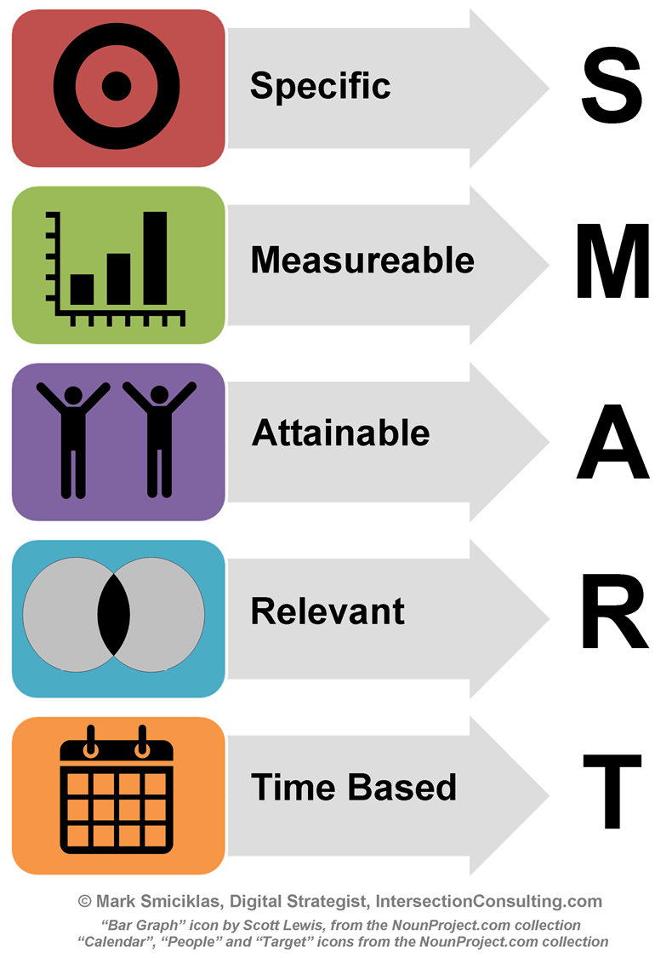
Objectives & SLOs

Slide 13
Objectives
Theory, principles, and concepts must be adequately covered.
Critical thinking must be evident throughout the COR but particularly in the objectives, methods of instruction and methods of evaluation.

Slide 14
Bloom’s Taxonomy
Critical Thinking:
Analyze
Synthesize
Evaluate

Slide 15
Writing Objectives -With Rigor
Before | After
Know the significant art achievements of Renaissance through Modern Europe | Compare and contrast the art works from various historical periods to ascertain their stylistic aesthetic and historical relationships.
Understand the skills needed to create a theatrical event for children. | Create and perform a theatrical event for children that demonstrates appropriate choice of style, language and pace.
Know the major developmental theories and scientific methods used to study development. | Defend or dispute the major developmental theories used to study human development.
Describe the physical, cognitive, and socioemotional stages of development of children. | Distinguish and predict physical, cognitive, and socioemotional stages of children of different ages, including newborns, infants, preschool children, elementary-age children, and adolescents.

Slide 16
Course Content
A listing of all topics to be taught in the course by all instructors
In outline form, with sub-headings that contribute to main topics
Detailed enough that any faculty meeting minimum qualifications to teach the subject area could teach this course and meet course objectives
Content is aligned with course objectives
Supports requisite entry skills
Lab content is usually separate from “lecture” content in lec/lab combinations
Instructors have some flexibility in how much time they spend on each item, but they MUST cover them all
If time permits, instructors MAY cover additional material (but not at the expense of the content listed in the COR)

Slide 17
Content is Aligned With Objectives
A reviewer should be able to find a match between an objective and the content that supports that objective.

Slide 18
Example of Alignment
Objective | Content
Distinguish and predict physical, cognitive, and socioemotional stages of children of different ages, including newborns and infants. | Infancy Sensory and perceptual capacities Physical development Patterns of growth Brain development Development of motor skills Cognitive development Piaget’s Sensorimotor stage Early learning, concept formation, and memory Language development Socioemotional development Attachment Emotions and temperament Erikson’s stages

Slide 19
Instructional Methods
How will you achieve your course objectives?
The proposed learning environment should be appropriate to support the course objectives.
What is instructor doing?
What will students be doing and experiencing with respect to the instructor, each other, and the environment
Instructional methods should evoke independent study, critical thinking, and application of concepts at a college level.

Slide 20
Example
Objective : The student will be able to: | Instructional Methods
1) demonstrate mastery in debate skills. | -lecture topics supporting argumentation and debate; types of debates. -demonstration: testing for fallacies. -in-class videos of debates followed by guided group discussion and analysis. -demonstration: analysis and critique of debate skills. -research projects (reading and writing): research to support in-class debate topics. -in-class practice debates against an opponent. -individual assistance and group feedback of debate performances.

Slide 21
Methods of Assessment
Title 5 does not mandate a comprehensive list of methods for evaluation. Therefore faculty have the freedom to choose assignments following their own expertise and creativity
COR must specify types/examples
Must be appropriate for and specific to course objectives
Must effectively evaluate students’ critical thinking ability and require them to work independently
“The grade is based on demonstrated proficiency in subject matter and the ability to demonstrate that proficiency.”

Slide 22
Integrated Examples
Example of Course Objectives The student will be able to: | Methods of Instruction | Methods of Assessment
Define and apply general theatre terminology. | Lecture presentations. Classroom demonstrations and discussions using the language of theatre. | Essay or objective exams. Written report or analysis of theatre performance.
Identify and analyze various components of a theatrical performance. | In-class reading of dramatic scripts followed by instructor-guided discussion, interpretation and analysis. Attendance at required theatrical performances. | Written report or analysis of theatre performance. Essay or objective exams. Group project demonstrating skill performance.
Evaluate the effectiveness of theatrical techniques in performance. | In-class and out-of-class video presentations; class discussions with instructor-guided interpretation and analysis | Group projects to develop theatrical techniques via group presentation.

Slide 23
Class Assignments
Assignments should be designed to support the course content and objectives.
Per title 5, assignments should be expected to take a typical student 32-36 hours to complete per unit of lecture.
Assignments should be aligned with objectives and contribute to students reaching those objectives.

Slide 24
Class Assignments
The assignments section of the COR should be detailed enough to give instructors, students, and reviewers a clear understanding of the rigor of student work that is expected.
Should not be so restrictive that it limits the academic freedom of individual instructors, however.
Alternate assignments may be included in lieu of a field trip or theatre performance.
Assignments must be described sufficiently to document independent work, critical thinking, and a level of difficulty consistent with college-level work.

Slide 25
Assignments: Examples
Course Objectives The student will be able to: | Assignments
Define and apply general theatre terminology. | Review the playbills of several local classical plays and lead a class discussion, identifying the various theatre elements commonly associated with these plays.
Discuss the impact of death in our Western culture, and how we deal with dying, death, loss and bereavement. | Conduct an interview with an individual who has experienced the loss of a family member (spouse, parent, child) within the last year. Provide answers to scripted questions and write an evaluation of the interview process and your conclusions.
Distinguish predictable physical, cognitive, and socioemotional stages of children of different ages, including newborns, infants, preschool children, elementary-age children, and adolescents. | Perform a preschool observation at the college child development center. Perform an observation of elementary-age children at a local school setting. Conduct a scripted interview with a teen between the age of 14-16.

Slide 26
Textbooks
Any course that is part of CSU GE Breadth or IGETC MUST have a required textbook.
The primary text plays a central role in the articulation of a course
Should be clearly recognized by the discipline as an authoritative, college-level, major work.
Outside reading assignments may reference the required text and provide average # of pages per week.
For textbooks with a publication date more than five years old, a brief justification should be included for articulation purposes. For example: classic text, Shakespeare, Mozart, etc.
Do all instructors have to use the textbook listed on the COR? What about academic freedom issues?

Slide 27
Putting It All Together

Slide 28
An example of Integration
Course Objectives The student will be able to: | Methods of Instruction | Methods of Evaluation | Assignments
A. Distinguish representative examples of architecture, sculpture, painting, and other artistic media. B. Analyze the formal elements of works of art and architecture. C. Relate stylistic trends to specific dates, periods, cultures, and artists. D. Critique the use of media, materials, and techniques applied in artistic production. E. Apply relevant art historical vocabulary and methodologies to analyze representative examples of artistic media. F. Explain how works of art and architecture relate to the social, religious, political, and economic contexts in which they were produced. | A. Slide lectures B. Large and small group discussion C. Documentary films and movie clips on art and artists D. Art museum and gallery visits will be required. | A. Measure understanding of textbook concepts and class lectures with performance on objective and essay exams. B. Written essays and/or research projects to be graded on the student’s ability to describe style, iconography, context, and meaning of works of art and architecture. C. Assess level of research skills, comprehension of subject matter and use of art historical methodology through evaluation of research paper. | A. Read assigned textbook chapters (approx. 40-50 pages per week). B. Museum and gallery visits will be the basis of written exercises in which students discuss and analyze works of art. C. Written assignments may include short analysis papers, response papers, reviews of films or exhibitions and abstracts of assigned articles. D. Reading from supplemental art history reader and/or scholarly journals will be assigned. E. Students will complete a research paper based on a work or works of art viewed at a local museum.

Slide 29
Resources

Slide 30
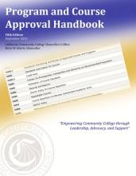
Useful Resources!
ASCCC: The Course Outline of Record: A Curriculum Reference Guide (2008) http://www.asccc.org/sites/default/files/publications/Curriculum-paper_0.pdf
Program and Course Approval Handbook (PCAH), 5th Edition
http://extranet.cccco.edu/Portals/1/AA/ProgramCourseApproval/Handbook_5thEd_BOGapproved.pdf

Slide 31
Resources
California Community Colleges Curriculum
http://www.ccccurriculum.net/
Chancellor’s Office Curriculum & Instruction Division
http://extranet.cccco.edu/Divisions/AcademicAffairs/CurriculumandInstructionUnit/Curriculum.aspx
Title 5 http://ccr.oal.ca.gov
Click on Title 5 Education
Click on Division 6. California Community Colleges
Click on Chapter 6. Curriculum and Instruction
California Intersegmental Articulation Council Resources
http://ciac.csusb.edu/resources.html (course outlines)

Slide 32
Questions??
Thank you for joining us!

