Slide 1
Your Articulation Officer: Getting Out of the Office and into the Classroom
Corinna Evett
Transfer, Articulation, and Student Services Committee Member, Facilitator
Leonor Aguilera
Santiago Canyon College, Articulation Officer/Counseling Faculty
Tiffany Tran
Irvine Valley College, Articulation Officer/Counseling Faculty

Slide 2
Overview
Transfer student data
What are transfer requirements for CSU/UC?
Articulation activity
Strategies to improve your course articulation
Articulation resources
Timeline to articulate courses
Q & A

Slide 3
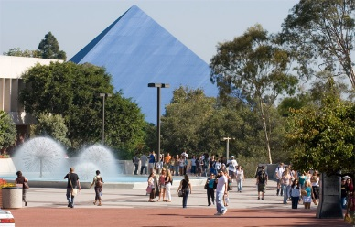
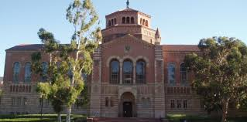
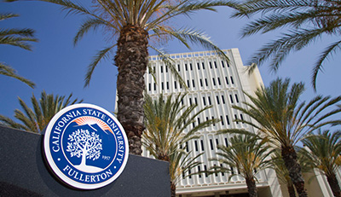
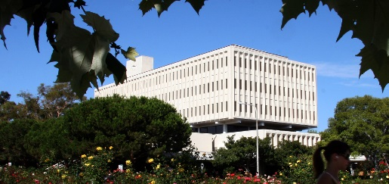
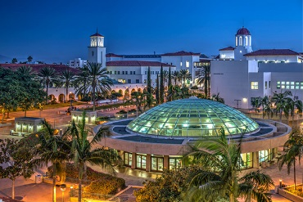
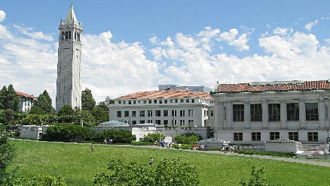
Transfer Data
CSU 2015-2016 –CCC Transfers (unduplicated)
Applications Received 110,197
Admitted 82,215
Denied 27,982
UC Fall 2015- CCC transfers (unduplicated)
Applications Received 29,821
Admitted 20,921
Denied 8,900
Why are students being denied?

Slide 4
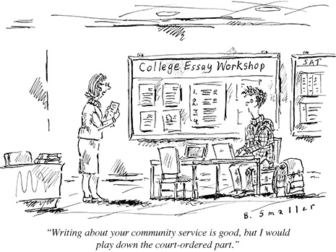
What are the Transfer Requirements for UC?
UC Transfer Requirements:
60 transferable units
General Education – including English/math
IGETC
7 Course Pattern
Major requirements and/or
Electives
Competitive GPA

Slide 5
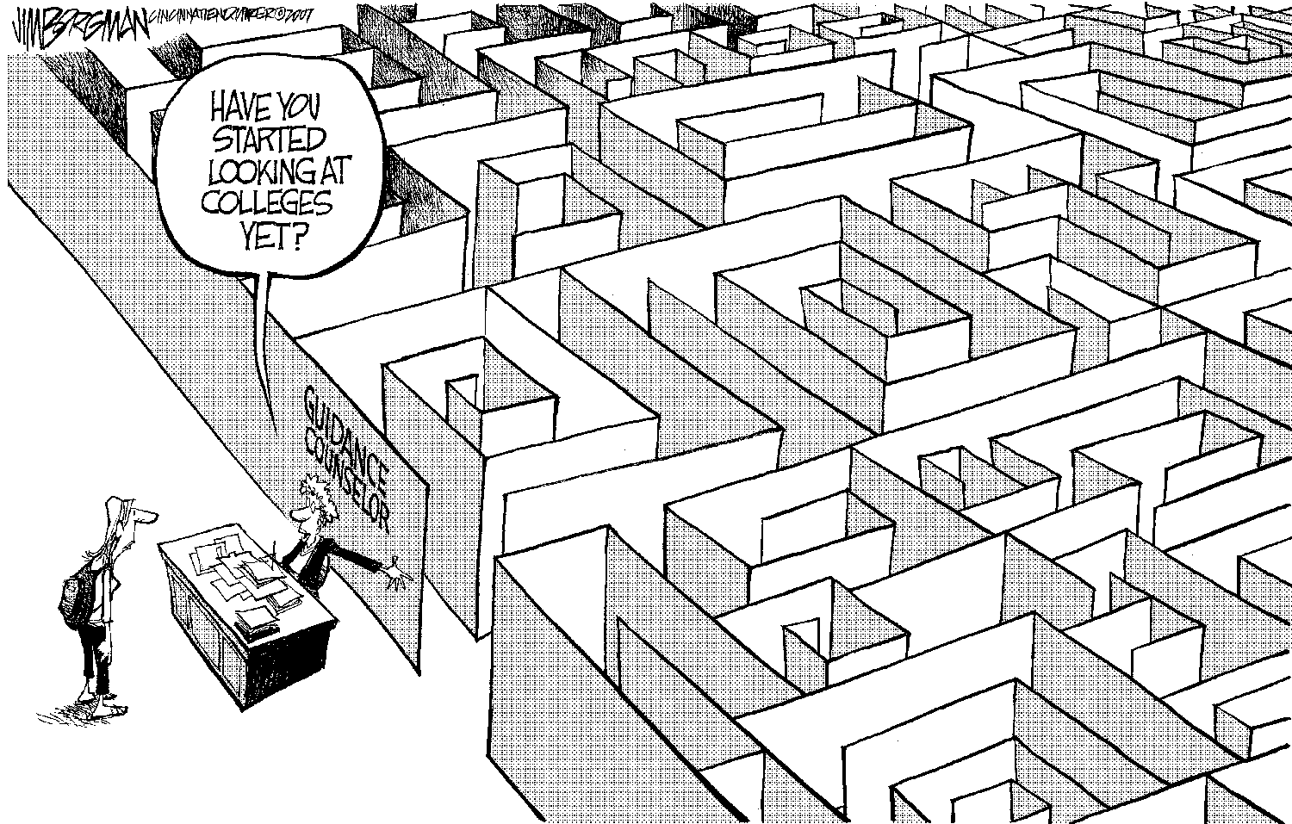
What are the Transfer Requirements for CSU?
CSU Transfer Requirements:
60 transferable units
General Education – 30 units
IGETC
CSU GE Breadth
Major Requirements
Electives
Competitive GPA

Slide 6
Of the five transfer requirements four of them directly deal with articulation.
CSU/UC Transfer Requirements:
GPA
60 transferable units
General Education
Major Requirements
Electives

Slide 7
Baccalaureate-Level/Transferable Course
California State University (CSU)
CSU, Executive Order (EO) 167 –Transfer Credits
CSU Baccalaureate Level Document
UC Transfer Course Agreement (UC TCA)
Need to submit to UC reviewers during the summer
Comparable course at UC
UC TCA guidelines

Slide 8
Understand IGETC and CSU GE Breadth Guidelines
CSU GE Breadth Requirements
Submitted once a year in December
Guiding Notes for General Education Course Reviewers
IGETC Requirements
Submitted once a year in December
IGETC Standards-Version 1.7 (June 2, 2016)

Slide 9
CSU GE Areas – 39 units of general education
Area A: English Language Communication and Critical Thinking
Area B: Scientific Inquiry and Quantitative Reasoning
Area C: Arts and Humanities
Area D: Social Sciences
Area E: Lifelong Learning and Self Development

Slide 10
IGETC – 37 units of general education
Area 1: English Communication
Area 2: Mathematical Concepts and Quantitative Reasoning
Area 3: Arts and Humanities
Area 4: Social and Behavioral Sciences
Area 5: Physical and Biological Sciences
Area 6: Language Other than English – UC requirement only

Slide 11
Lower-Division Major Prep. Articulation
Major Requirements
Research on ASSIST.ORG
Obtain course syllabus from the four-year college/university
Review university’s website and catalog

Slide 12
Articulation Activity Where does this course apply
Major Requirement?
General Education?
Humanities or Social Science in GE pattern?
HIST 20, American History Through the Civil War
3 Units: 3 hours lecture
This course is a study of the history of the United States from its colonial origins through the Reconstruction period. The survey will focus on the major themes, ideas, attitudes, institutions, and elements that are part of the American national development through the mid-19th century. Special emphasis is given to the European antecedents; the forging of an American culture within the colonial context; the political, social, and economic development within the framework of a national experience and identity; and the problems of cultural expansion and divergent growth reflected in the Civil War.

Slide 13
Articulation Activity Where does this course Apply
AJ 2, INTRODUCTION TO ADMINISTRATION OF JUSTICE
3 Units: 3 hours lecture
Major Requirement?
General Education?
Humanities or Social Science in GE pattern?
This course offers an introduction to the history and philosophy of the administration of justice system as it has evolved over time. The course studies in-depth the American system of criminal justice and its various subsystems; the roles and role expectations of criminal justice agents; theories and concepts of crime, crime causation, punishment, rehabilitation, victimization, and disparity in treatment of offenders; local and federal court systems; and ethics, education, and training for professionalism in the criminal justice system.

Slide 14
Articulation Activity Where does this course apply
Bio 55, INTRODUCTION TO ECOLOGY: THEORY AND APPLICATION
3 Units: 3 hours of lecture
Major Requirement?
General Education?
Physical or Life Science in GE pattern?
This course offers an introduction to the history and philosophy of the administration of justice system as it has evolved over time. The course studies in-depth the American system of criminal justice and its various subsystems; the roles and role expectations of criminal justice agents; theories and concepts of crime, crime causation, punishment, rehabilitation, victimization, and disparity in treatment of offenders; local and federal court systems; and ethics, education, and training for professionalism in the criminal justice system.

Slide 15
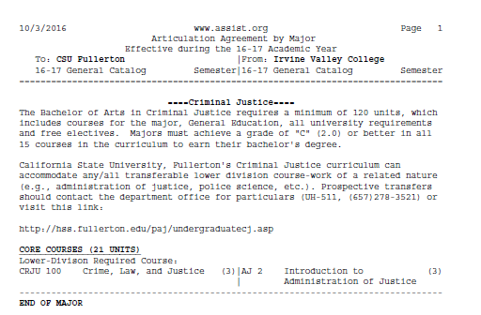
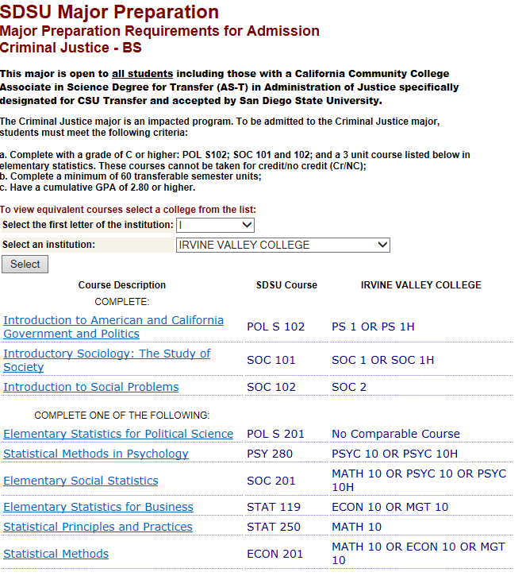
Criminal Justice Example

Slide 16
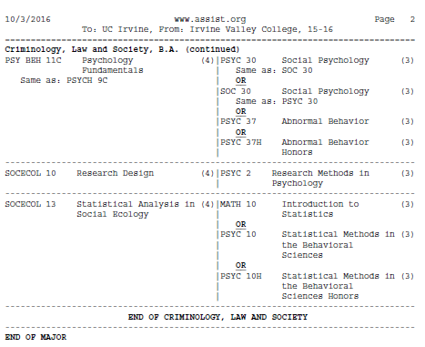
Statistics Example

Slide 17
Articulation Strategies
Update course outline on a regular basis
Update textbook
Submit for C-ID approval
Research comparable transfer courses
CSU/UC
Community Colleges
Interact with discipline experts at UC/CSU/feeder transfer schools
Know your Articulation Officer – support your articulation officer

Slide 18
Articulation Resources
CSU Baccalaureate Level Document
UC Transfer Course Agreement
CSU GE Breadth Requirements – E.O. 1100 (Feb., 16, 2015)
IGETC Standards-Version 1.7 (June 2, 2016)
ASSIST.ORG
CCC Transfer Counselor Website

Slide 19
Sources
CSU Data
http://calstate.edu/as/index.shtml
UC Data
http://admission.universityofcalifornia.edu/counselors/transfer/profiles%20/index.html
California Intersegmental Articulation Council (CIAC) Access to UC, CSU and CCC catalogs and CCC course outlines
http://ciac.csusb.edu/index.html

Slide 20
Questions & Answers

Slide 21
Corinna Evett
Transfer, Articulation, and Student Services Committee Member, Facilitator
Leonor Aguilera
Santiago Canyon College, Articulation Officer/Counseling Faculty
Tiffany Tran
Irvine Valley College, Articulation Officer/Counseling Faculty

