Slide 1
From Locally Developed ZTC Pathways to Statewide OER Degrees
ASCCC CURRICULUM INSTITUTE
Thursday, JULY 9, 2020
2:45 pm – 4:00 pm
Notes:
AT

Slide 2
Overview
Welcome!
A Brief History of Textbook Affordability/OER in the CCCs
ZTC > OER Challenges
Identifying OER needs
Mapping OER
Notes:
AT

Slide 3

Welcome!
Amanda Taintor, ASCCC OERI Regional Lead
Jennifer Paris, ASCCC OERI Regional Lead
Photo by Anand Dandekar from Pexels
Notes:
AT

Slide 4
Acronyms
CCC = California Community College
CSU = California State University
UC = University of California
ASCCC = Academic Senate for California Community Colleges
CA-OERC = California Open Educational Resources Council
C-ID = Course Identification Numbering System
Notes:
AT

Slide 5
Historical backdrop
SB 1052/1053, CA-OER Council, and Open Source Digital Library
  SB 1052 and SB 1053 (Steinberg, 2012) were approved for the California public higher education systems to create an online library of open educational resources and open textbooks
  SB 1052 authorized creation of CA-OER Council with the goal of identifying OER materials for 50 high impact courses across UC, CSU, and CCCs
  SB1053 authorized development of a CA Open Source Digital Library
Notes:
AT

Slide 6
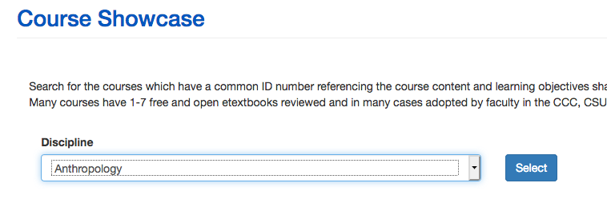
Resulting in…….
Identified available free and open digital texts for 50 high impact courses
Created and administered a rigorous review process
Established COOL4Ed.org as a repository for free and open digital texts and their reviews
Notes:
AT
As a result of SB 1052 and 1053,
CA-OERC…

Slide 7
AB 798 (Bonilla, 2015)
College Textbook Affordability Act
Up to $3 million may be used in CSU and CCCs for the following:
        Professional development for faculty; faculty may be compensated for PD.
              PD for staff whose work supports providing students with OER
              OER curation activities
              Curriculum modification
              Technology support for OER adoption efforts
Notes:
AT

Slide 8
The Zero-Textbook-Cost (“ZTC”) Degree Program
Created in 2016 in AB 1602 (Higher Education Trailer Bill)
Provides grants to community college districts for “developing and implementing associate degrees and career technical education certificate programs earned entirely by completing courses that eliminate conventional textbook costs by using alternative instructional materials and methodologies.”
Decreasing costs may also help with increasing equity, access, and success for students who might not otherwise afford materials.
Notes:
AT

Slide 9

“Zero Textbook Cost (ZTC) Degrees”
… community college associate degrees or CTE certificates earned entirely by completing courses that eliminate conventional textbook costs by using alternative instructional materials and methodologies, including open educational resources ...
CA Education Code Section 78052(a)
Notes:
AT – Share when these funds started, when they ended – or are set to end. And that there is proposed additional funding in current trailer bill language. Expand a little on how this modified the dialogue at colleges and in the system.

Slide 10
Senate Bill 1359 (Block, 2016)
Requires California Community Colleges and California State Universities and requests the University of California system to clearly highlight, by means that may include a symbol or logo in the online campus course schedule by January 1, 2018 for courses that exclusively use digital course materials that are free of charge to students and therefore not required to be purchased.
Notes:
AT - “Clearly highlight, by means that may include a symbol or logo in a conspicuous place on the online campus course schedule, the courses that exclusively use digital course materials that are free of charge to students and may have a low-cost option for print versions.”

Slide 11
OER in the Colleges – January 2019
Individual colleges received ZTC grants (23 Colleges)
All colleges required to have implemented designation in class schedule to identify courses with no associated text costs (SB 1359)
ASCCC OER Task Force >>> ASCCC OER Initiative
  Emphasizing resources that serve the state’s needs
Notes:
AT

Slide 12
Impact of ZTC Funding
Provided funded colleges resources to plan and/or implement a robust ZTC effort
Grew college-based conversations on textbook cost barriers
Facilitated college data collection efforts
Created awareness in multiple disciplines about student total cost of degree/certificate
Notes:
JP

Slide 13
Local ZTC > Statewide OER Challenges
The focus of ZTC funding was on a pathway to a certificate or degree at a college
Possibility of duplicative work
Concerns over sustainability
Distinctions between ZTC and OER often blurred
Notes:
JP

Slide 14

Identifying OER Needs
Image by Hebi B. from Pixabay
Notes:
JP

Slide 15
Identifying OER Needs - Surveys
OER Awareness >> Discipline-based OER Use
Cohort 1 (Fall 2018) - Child Development/Early Childhood Education, Communication Studies, Computer Science, English, Math, Psychology, Sociology
Cohort 2 (Spring 2019) – Accounting, Art History, Biology, Business, Economics, Geography, History, Nursing, Office Technology, Political Science
Cohort 3 (Fall 2019) – Anthropology, Music, Philosophy
Notes:
JP

Slide 16
Identifying OER Needs
Letters of Interest / Letters of Intent to Submit
Request for Proposals
  What do you need to make moving to OER possible?
Conversations
Random searches
ZTC pathways
Cool4Ed
Notes:
JP

Slide 17

Is the solution there, but I can’t see it?
Image by “Selling of my photos with StockAgencies is not permitted” from Pixabay
Notes:
JP

Slide 18
OER Degrees
How do you identify OER for a degree that works for 114 colleges?
How do you identify OER for general education courses that transfer?
114 colleges in 72 districts – and only some of the multi-college districts share curriculum
Notes:
JP

Slide 19
Identifying Comparable Curriculum
Course Identification Numbering System (C-ID; c-id.net)
  A set of descriptors used to identify common courses
Associate Degrees for Transfer (ADTs)
  Degrees established through legislation that guarantee transfer into the California State University System (CSU)
  Most of the courses in the ADTs are described by C-ID
  Transferable general education patterns – for the CSU and the University of California – have been existence for decades
Notes:
JP

Slide 20
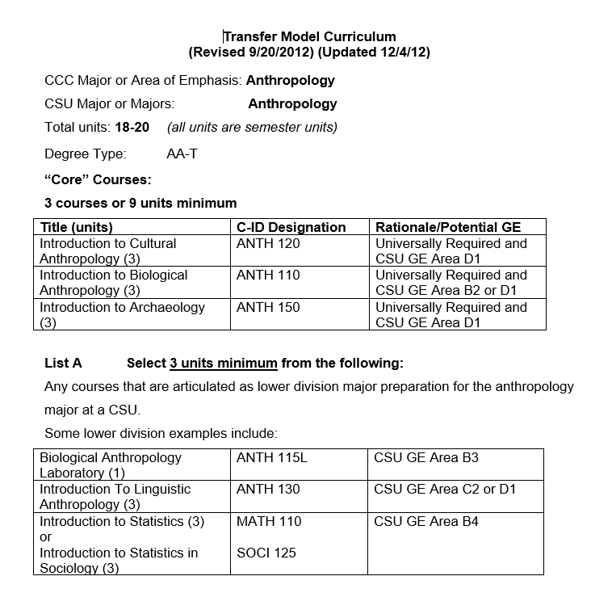
Transfer Model Curriculum (TMC)
Notes:
JP

Slide 21
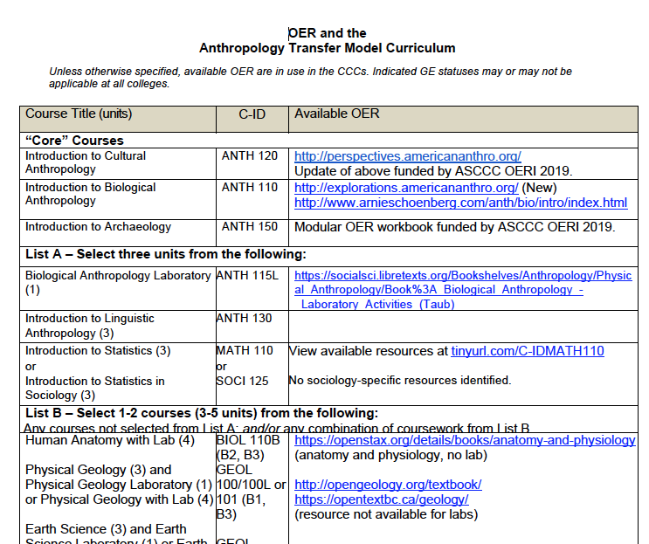
Notes:
JP

Slide 22
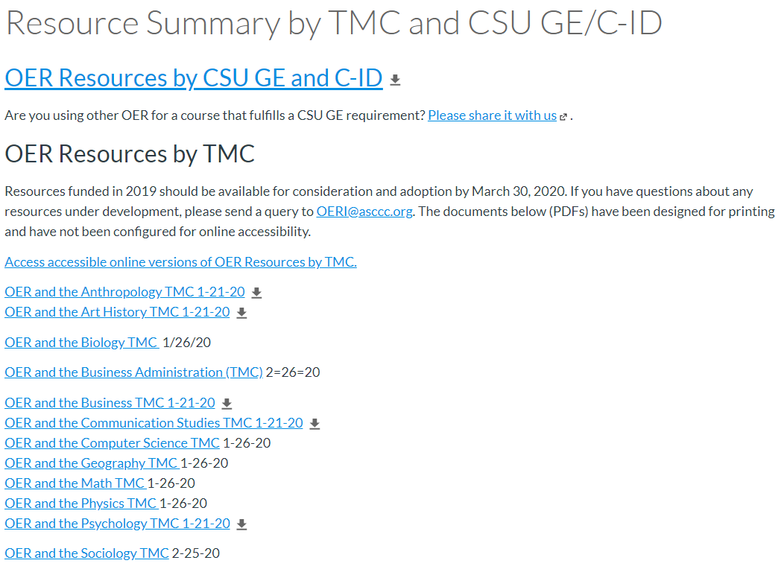
Notes:
JP

Slide 23
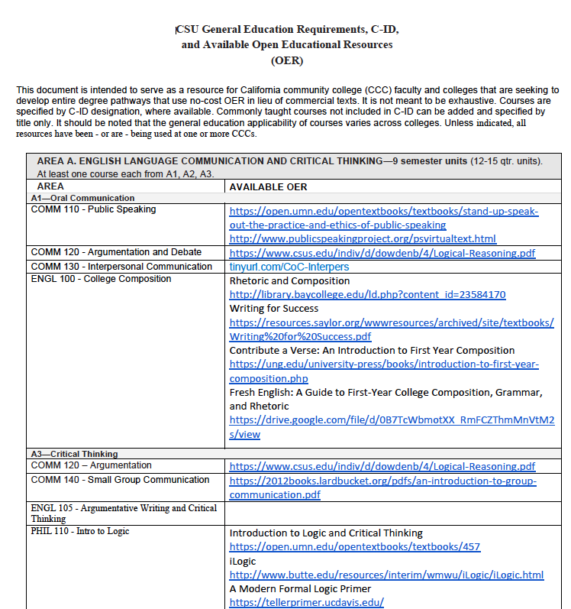
Notes:
JP

Slide 24
Next steps?
Confirm “holes”
Establish mechanisms to prioritize work
Encourage establishment of local OER degree goals
Determine how to support local efforts
Notes:
JP

Slide 25

Photo by Pixabay from Pexels

