Slide 1
Dual Enrollment: Nuts, Bolts, and CTE
Dianna Chiabotti, Napa Valley College
Mayra Cruz, Area B Representative ASCCC, CTE Leadership Committee
Notes:
Session description:
Much of the focus of dual enrollment has been to increase FTES while increasing completion of Associate Degrees for Transfer, but dual enrollment in career education courses is increasing. Learn the basics of dual enrollment while also diving in deeper about the partnerships necessary, implementation, and impacts for K-12 schools, community colleges, and, of course, students.

Slide 2
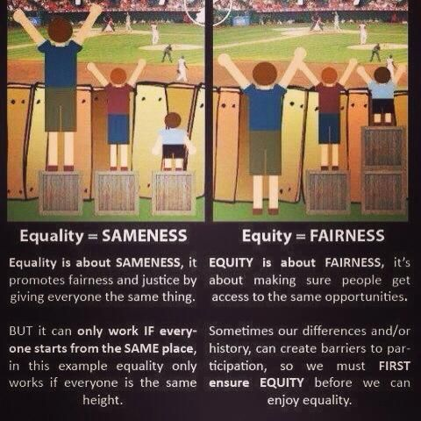

Slide 3
The Equity Imperative
Achievement gaps continue to persist for students from Latinx, Black & African, Native American and other ethnic groups
California is a “majority minority” state – closing achievement gaps is necessary to California’s future
Many of our students are first generation college students
Many of our students come from non-English speaking homes

Slide 4
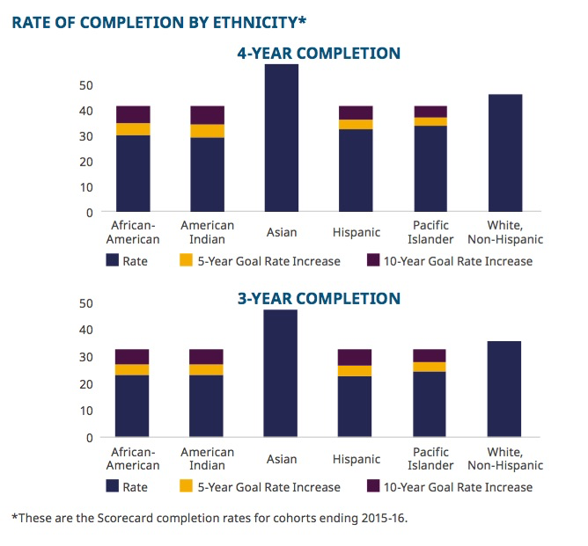
The Reality
Notes:
A critical data point is to study locally the student equity gaps.
The Vision for Success Goal 5, calls for a reduction and elimination of the Equity gaps (reduction of 40% over 5 years and elimination over 10 years.
Colleagues, for how long have we been addressing this equity gap? Has the needle moved? And it is time.
The 2017 State of the System Report presents this data on the screen. The rates of completion must be improved for Latinx, African American and American Indians. Perhaps locally identified gaps in other groups that must be addressed too.
The local dissagregation of the student data by race and ethnicity as well as by gender is adopted as an ongoing practice in the cycle of continuous improvement.
Resource: Student equity data 2017 SOS Report http://californiacommunitycolleges.cccco.edu/Portals/0/Reports/2017_SOSReport_ADA-final.pdf

Slide 5
The Reality
Our students are the “unprepared.”
It’s in our best interest as a system and as a state to proactively work with our K-12 partners to help prepare high school students for college and/or careers.

Slide 6
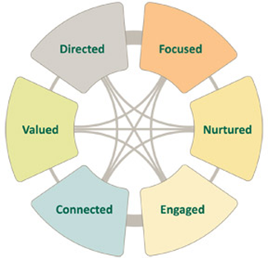
Student Success Factors
Notes:
Dual enrollment and student success
6 Student Success Factors
The RP Group conducted a review of leading studies on best practices and conducted a series of interviews with community college practitioners in the field and researchers. The results of the review are six factors that contribute to the success of students.
Directed Goal
Focused On track
Nurtured Relationships
Engaged Active participation
Connected Being part of
Valued Recognition

Slide 7
One Way to Address Equity is . . .
Dual Enrollment

Slide 8
Definition of Dual Enrollment
California Education Code grants community colleges the ability to admit special part-time or full-time students to provide educational enrichment.
Education Code
K-12 §48800 - §48814
Community Colleges §76001 - §76002

Slide 9
Definition continued . . .
The general purpose of dual enrollment is:
Advance scholastic or vocational work
Smooth transition to college through greater exposure
Requires
High school recommendation and parental consent
Students can receive
College credit
High credit (depends on K-12 district)
College AND high school

Slide 10
What is Dual Enrollment?
A high school student taking a college course.
Regardless of location
Regardless of instructional modality

Slide 11
College and Career Access Pathway
CCAP

Slide 12
CCAP – key points
There must be an MOU between the K-12 District and the CCC District
Class can be closed
Must have the specific purpose of serving students who may not already be college bound or who are underrepresented in higher education.

Slide 13
CCAP . . . there’s more
Many many many many nuances . . .
Applies only to public schools (can’t do with private high schools)
High school CCAP courses must not reduce access to adults at the college
If the college course has a wait list it “shall not be offered” in a CCAP.
And there is more…….

Slide 14
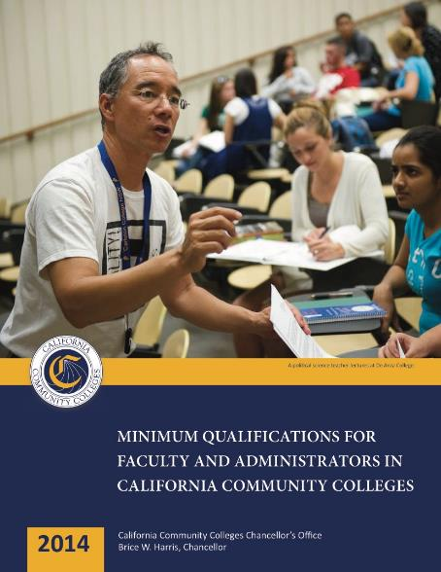
Minimum Qualification
All college courses must be taught by someone who meets minimum qualifications
Notes:
http://californiacommunitycolleges.cccco.edu/Portals/0/FlipBooks/2014_MQHandbook/2014_MQHandbook_ADA.pdf

Slide 15
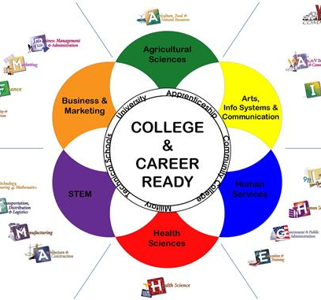
Dual Enrollment: Pathway to College and Career
Dual Enrollment: Pathways to College and Careers
Strengthen the talent pipeline to employment
Support students to stay on track, maintain momentum and complete a college award
Best if there is a strong partnership with high school districts (CCAPs require it.)
Notes:
Students must thrive and more than survive in a changing world.
“There is evidence of success among dual enrollment programs in improving dropout rates and helping to move more students onto a college-bound track.” https://www.advanc-ed.org/source/dual-enrollment-pathway-college-and-career-readiness

Slide 16
Opportunities & Benefits for Students
Complete high school and college credits at same time
Introduction to/preparation for college life for a smoother transition to college
More time for career and/or college major exploration
Address skills gaps and improve study skills/academic knowledge
Increased confidence and motivation to persist
Students learn the benefits of a college education

Slide 17
Challenges
Programs vary in purpose– intentional college/career pathway programs vs. “chasing FTES”
Programs vary in degree of “formality” – formal memorandum of understanding, support systems in place
Programs vary in degree of faculty engagement –faculty are partners vs. “the administration does its own thing”

Slide 18
Development of Guiding Principles
Dual enrollment (regular & CCAP) is not a smorgasbord
Decide on guiding principles for regular and CCAP
Think about what will benefits high school students most (classes the high school doesn’t offer, CCAP courses for below college level, and….)
Career Education Pathways – what is a good fit? Can they be entry level job ready when they graduate high school?
Do not be afraid to be unique!!

Slide 19
Examples of Successful Programs
Notes:
Participate share examples and suggestions.

Slide 20
Resources
A Guide to Launching and Expanding Dual Enrollment Programs for Historically Underserved Students in California. Retrieved from https://www.asundergrad.pitt.edu/sites/default/files/DualEnrollmentGuideJune2014.pdf
Santa Barbara City College. Retrieved from http://www.sbcc.edu/dualenrollment/
Get focused! Stay Focused! Retrieved from http://www.getfocusedstayfocused.org/
Career Ladders Project: HS to College Transition Web Resources. Retrieved from
http://www.careerladdersproject.org/high-school-to-college-transition-tools/early-college-experiences-and-transition-support/

Slide 21
Resources
CCCCO Dual Enrollment/CCAP
http://extranet.cccco.edu/Divisions/AcademicAffairs/DualEnrollment.aspx
CCCCO DE/CCAP Partnership Agreement Guidelines. Retrieved from http://extranet.cccco.edu/Portals/1/AA/MCHS/Dual%20Enrollment/AB_288_College_and_Career_Access_Pathways_Apportionment_Eligibility_Guidelines_3-11-16.pdf

Slide 22
For more information contact:
Dianna Chiabotti
DCHIABOTTI@napavalley.edu ‎
Napa Valley College
Mayra Cruz
cruzmayra@deanza.edu
Area B Representative ASCCC

