Slide 1
We HAVE lots of Systems – Why is Integration Critical for Curriculum to Ensure Collective Impact?
Mitch Shively
VP Business Development
eLumen, Inc.

Slide 2
Curr Mgmt
LMS
SIS
2

Slide 3
What IS the System of Record for Curriculum Data?
The college’s curriculum management system is the System of Record for curriculum
The SIS is important, especially for anything related to registration, scheduling, etc.
It is the Curriculum System that “owns”
Versions
Effective and Approval dates
Shared governance workflows
Many non-enrollment data fields important to the CCCCO and the College (Method of Instruction, Method of Assessment, etc.)
Versions of Catalog rights
Accreditation evidence
Most SIS don’t have a “home” (i.e. data elements) for the majority of this critical data
The college’s curriculum system of record should inform the SIS

Slide 4
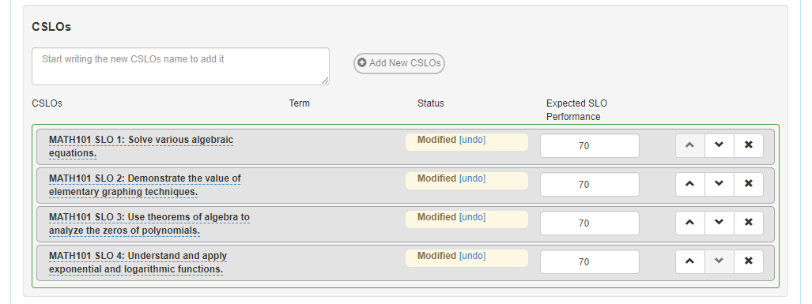
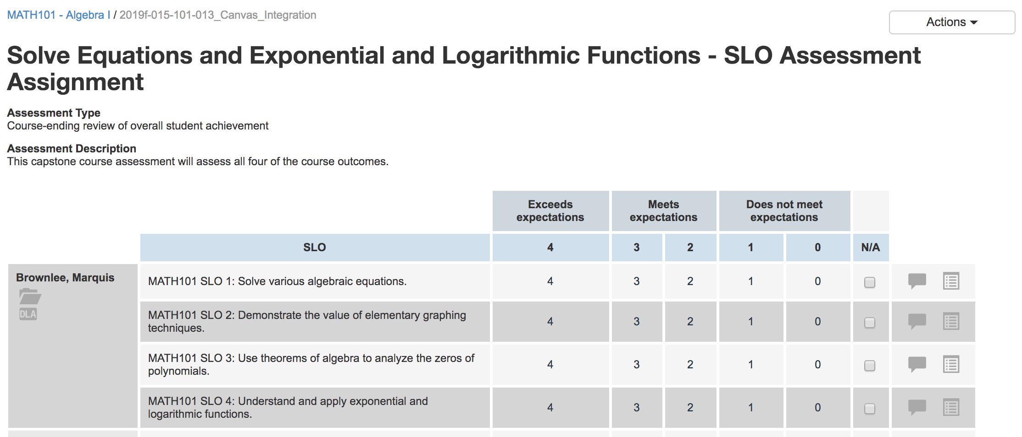
Curriculum MUST Drive Assessment
We need to ensure that this relationship is maintained, even enforced!
Why do we Assess it all if not to determine efficacy of Curriculum, as measured by achievement of Learning Outcomes?
Many Curriculum Systems support SLOs as “blobs of text” vs. “atomic actionable data!

Slide 5
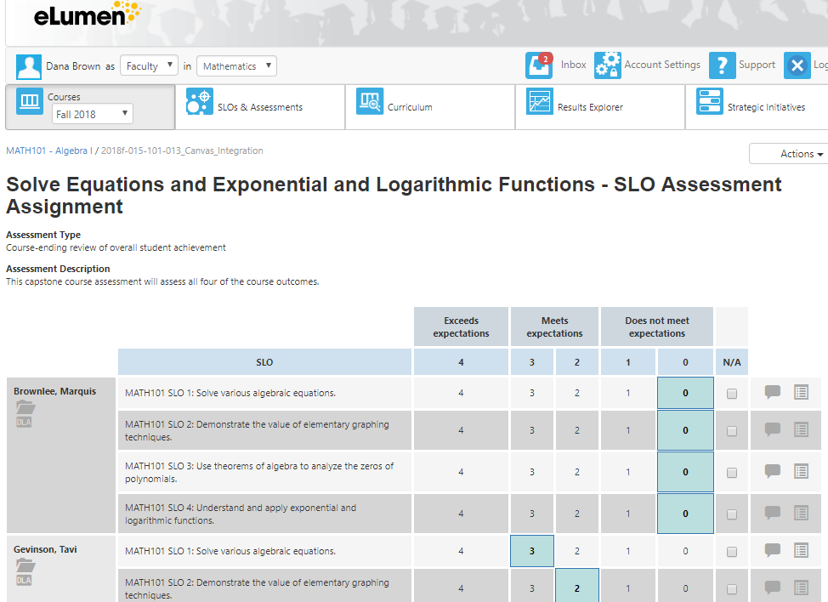
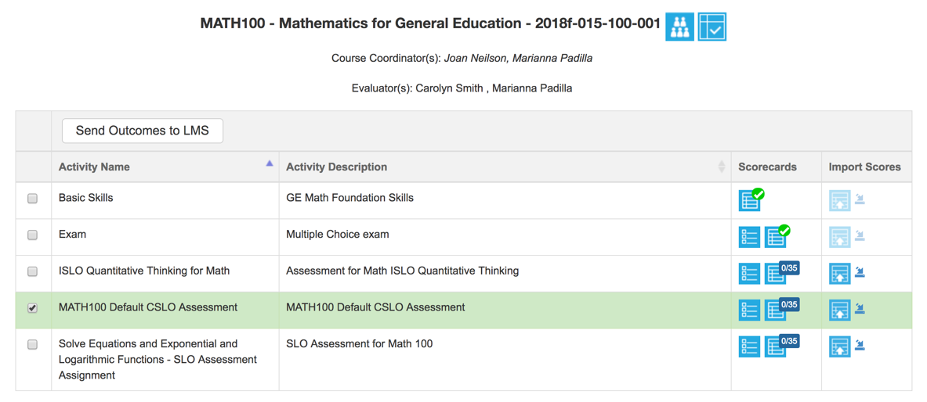
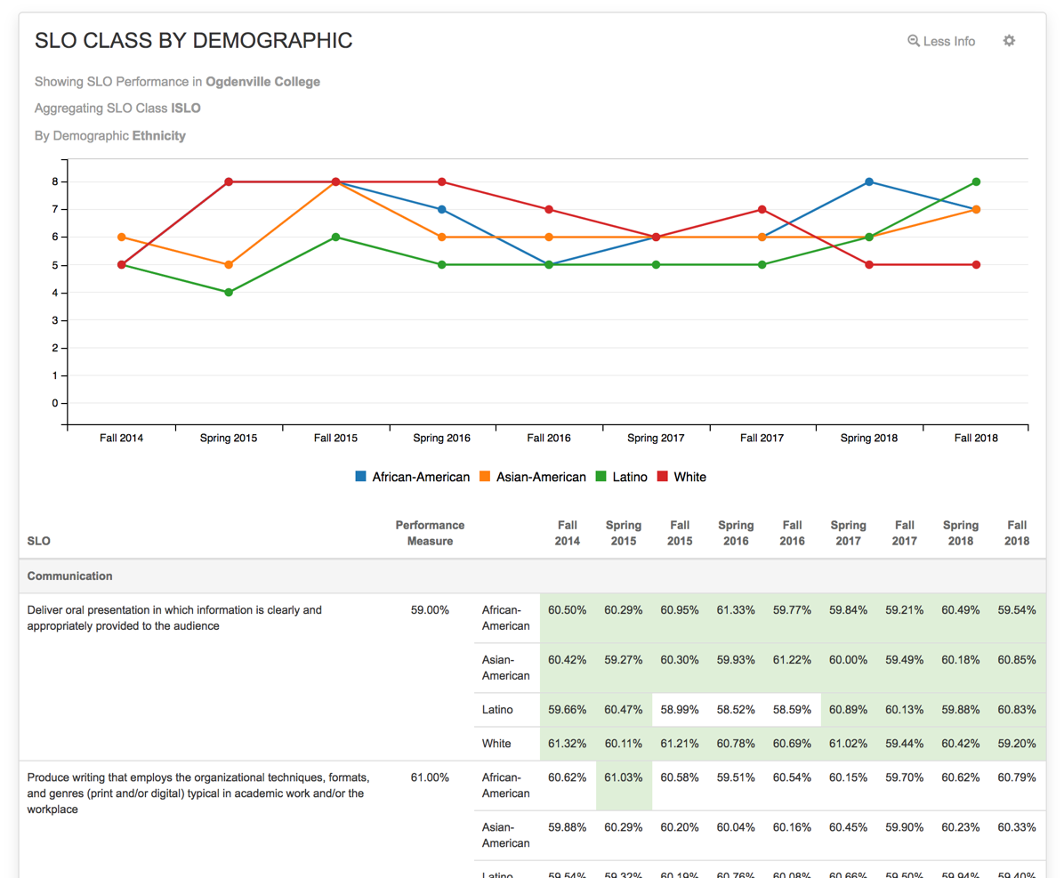
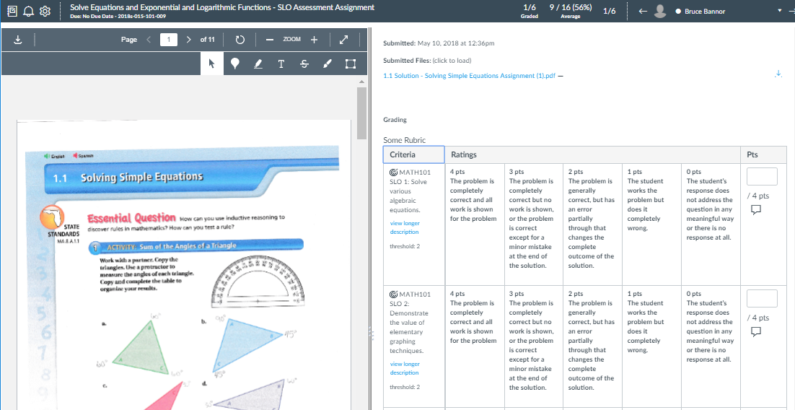
…Even if I Want to Assess Exclusively in Canvas!

Slide 6
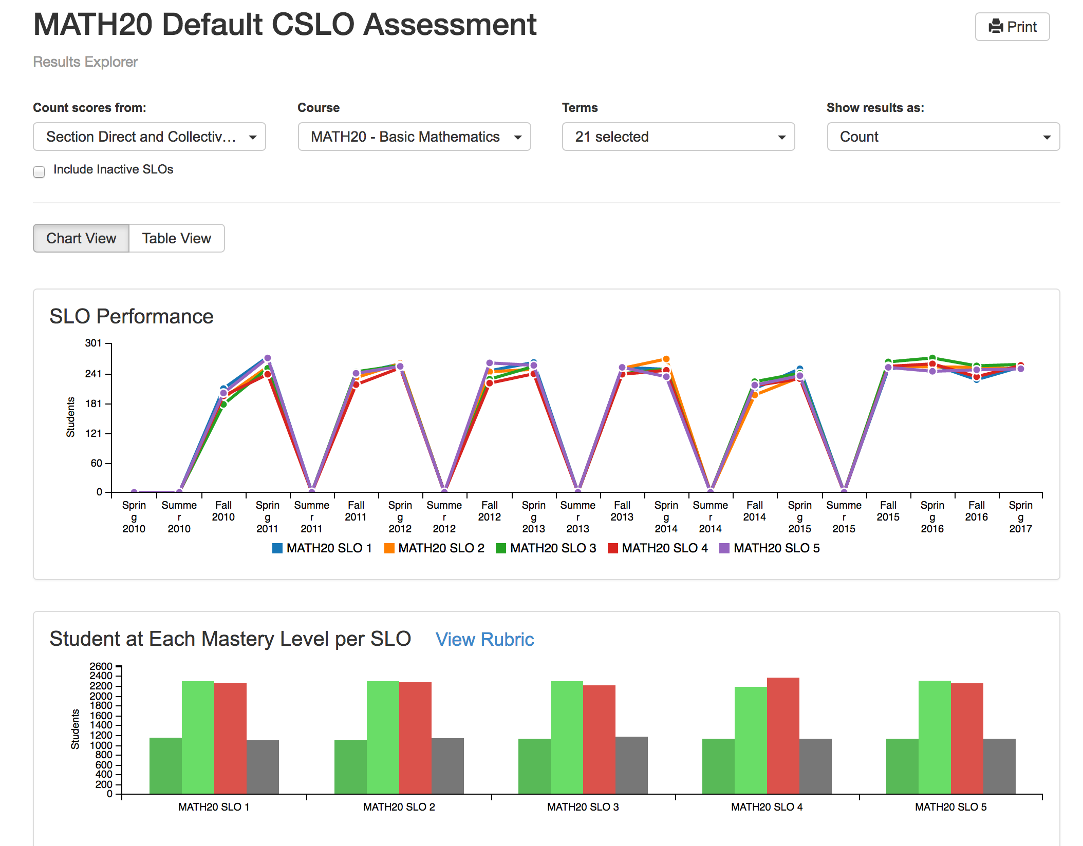
eLumen Tracks Outcomes Much More Robustly than Canvas
Canvas, like most Learning Management Systems, is mostly Course Section oriented
Outcomes analysis is strictly limited to within a Course Section – Longitudinal aggregation or term to term comparisons cannot be done within Canvas
eLumen aggregates results over time
This visualization is available to Faculty in real time
Visualizations can be adjusted to include more or fewer terms
Aggregation can include multiple Courses, Departments, etc. (see “Course” filter at left)
Can be toggled for “Table” view, showing data instead of visualization
No 3rd party reporting, Data Extraction, Data Warehousing or Visualization Software is required – This IS eLumen!
eLumen “rolls up” Section level Outcomes to PSLO’s and ISLO’s

Slide 7
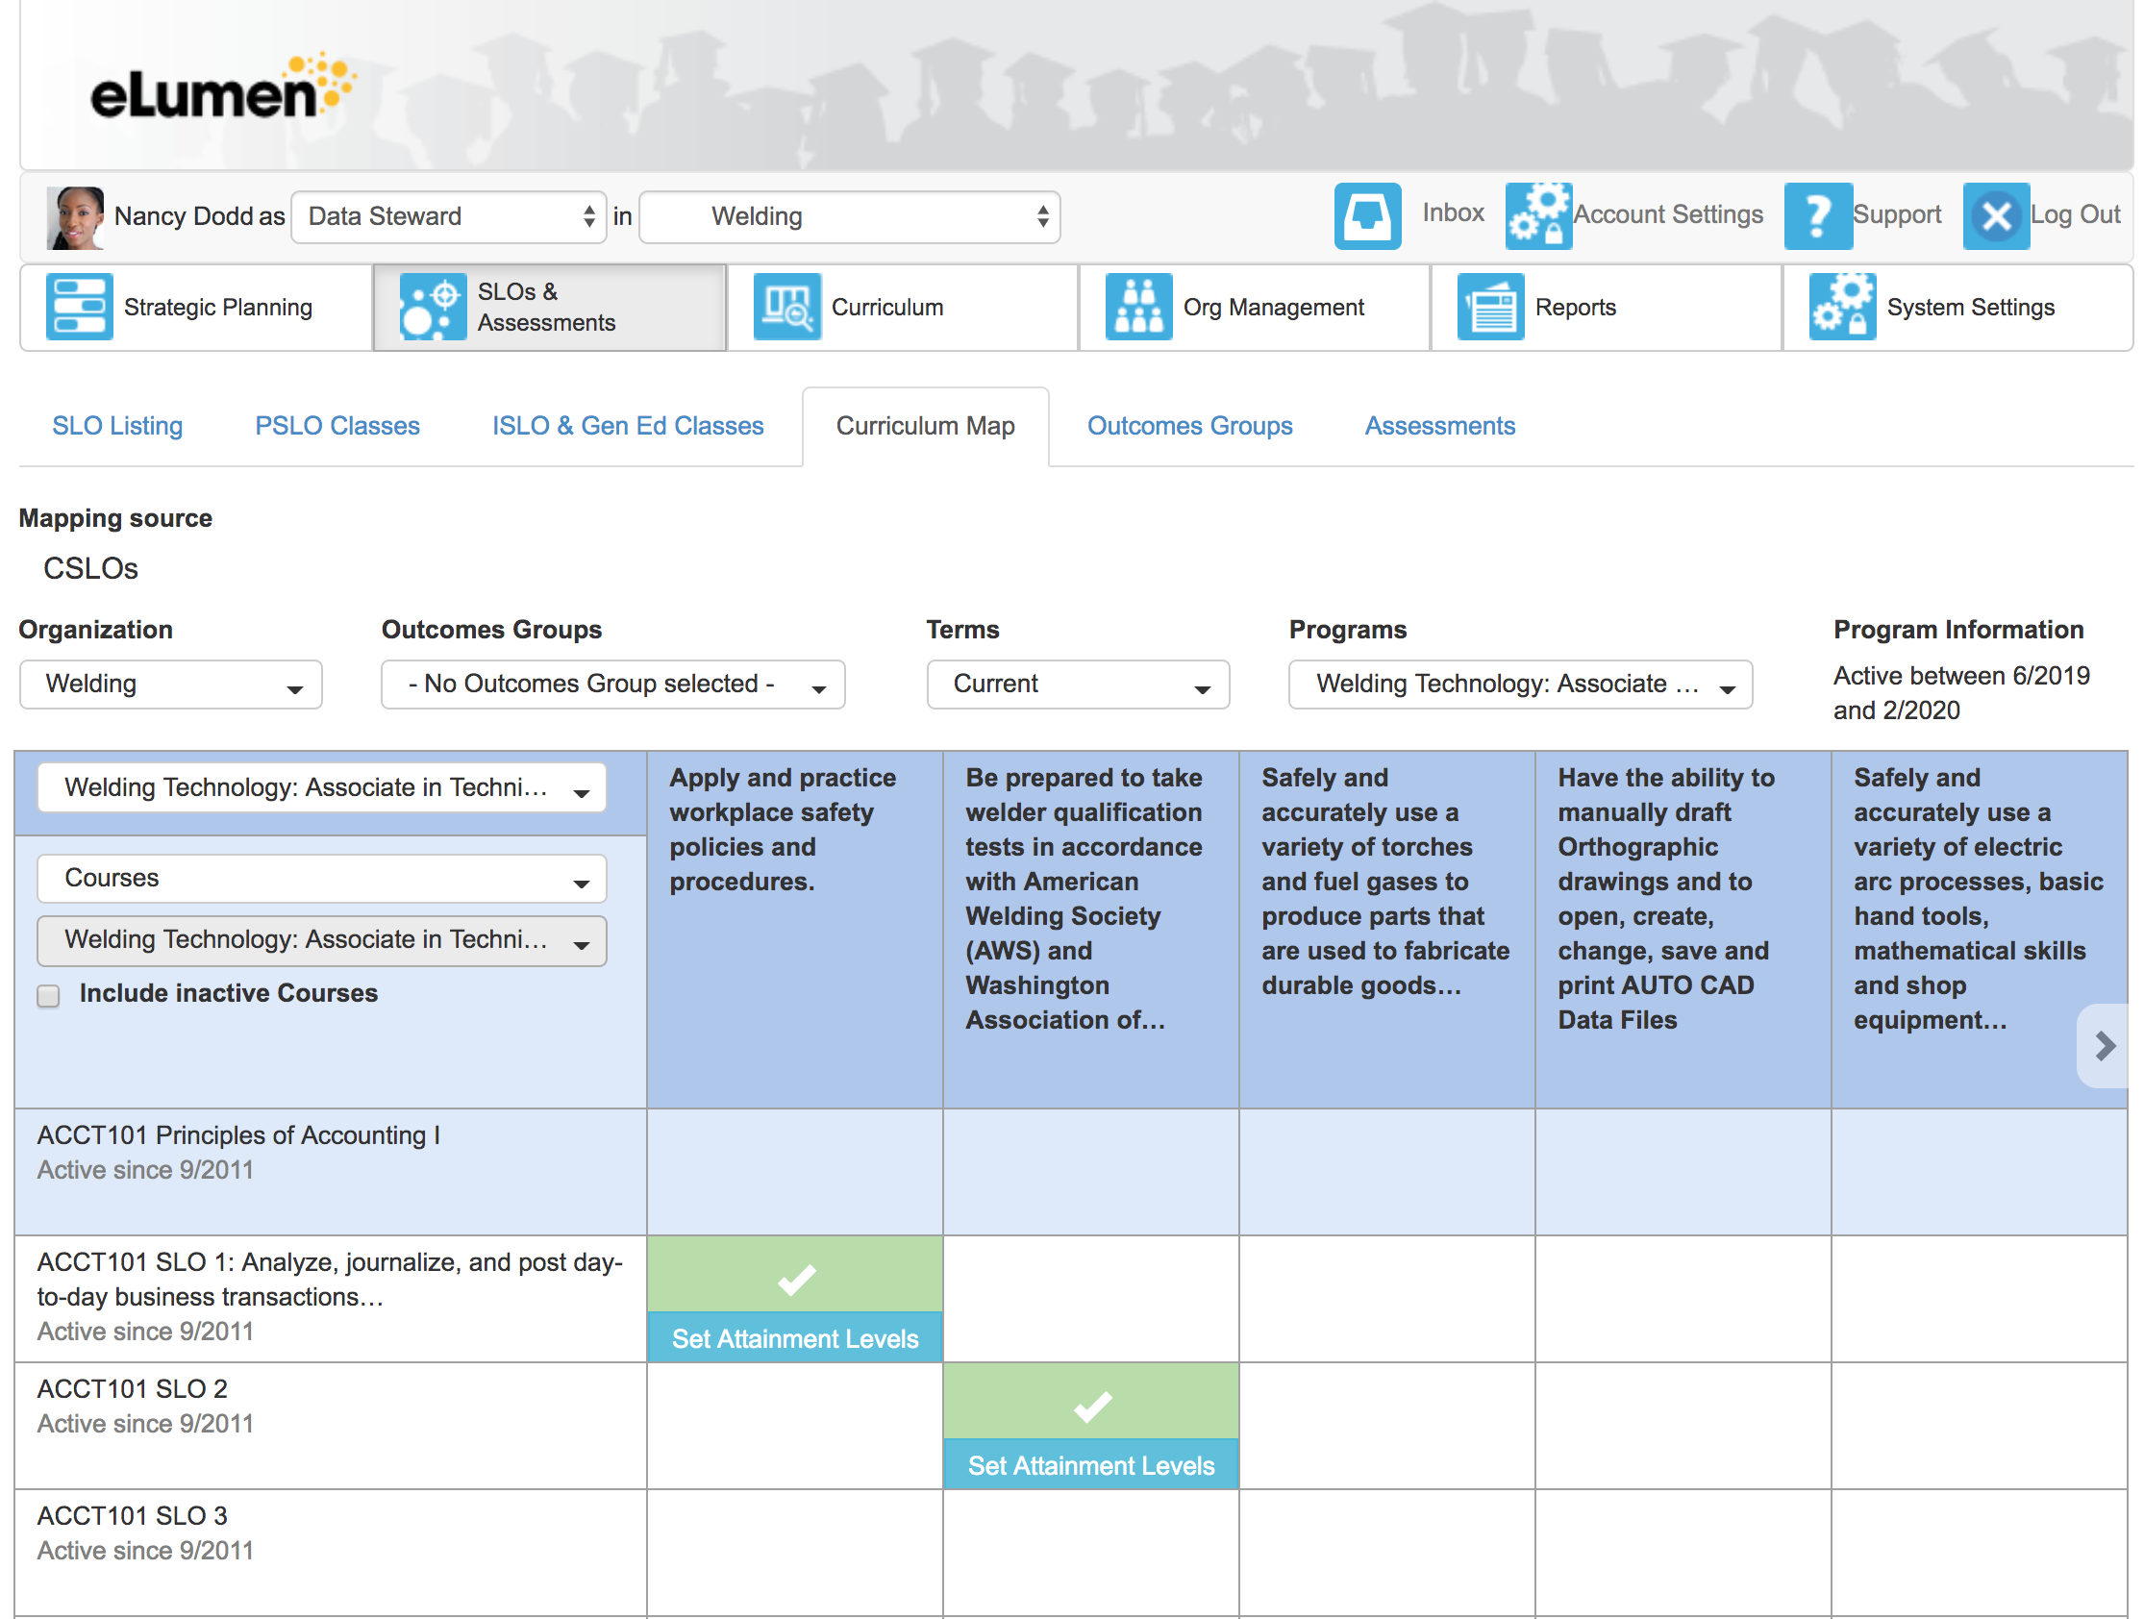
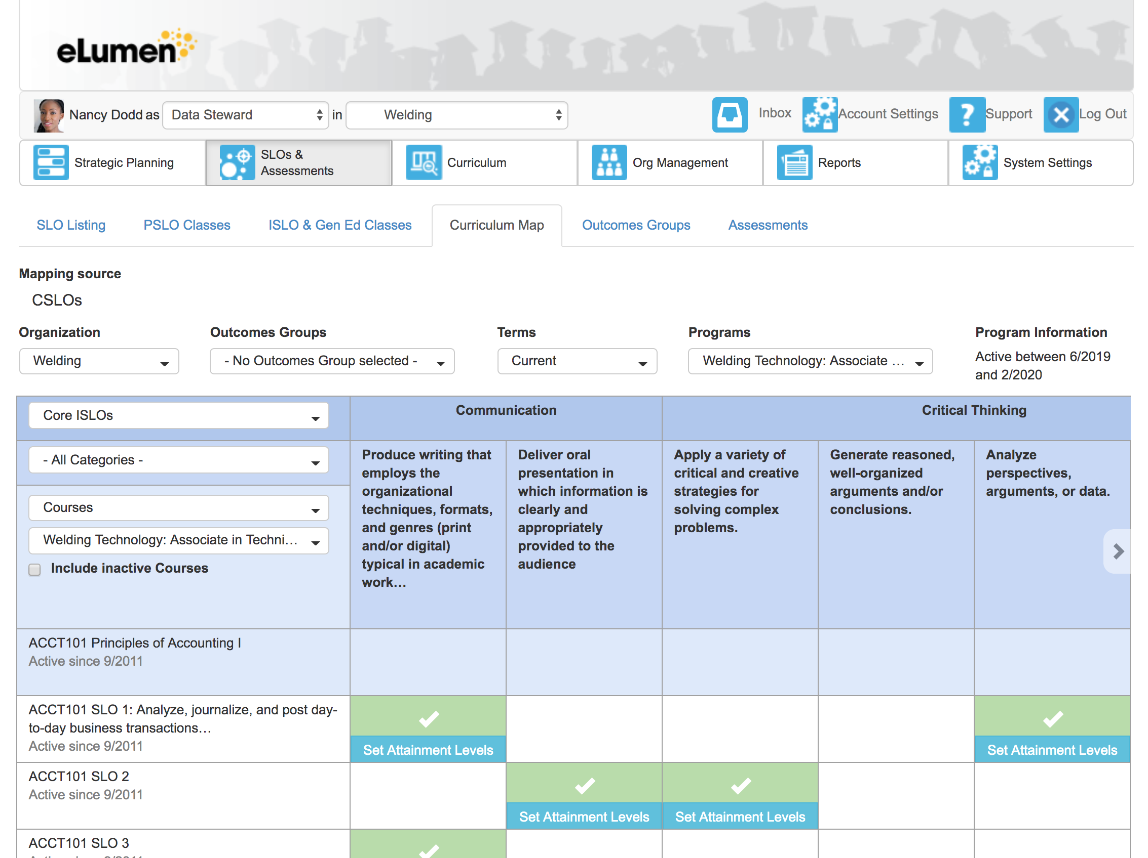
Curriculum Maps Aren’t Just Static Spreadsheets on Someone’s Office Wall
They underpin the “data science” eLumen uses to aggregate and disaggregate Outcomes so that you can gain useful insights and make data-driven decisions
CSLO/PSLO Mapping
CSLO/ISLO Mapping

Slide 8
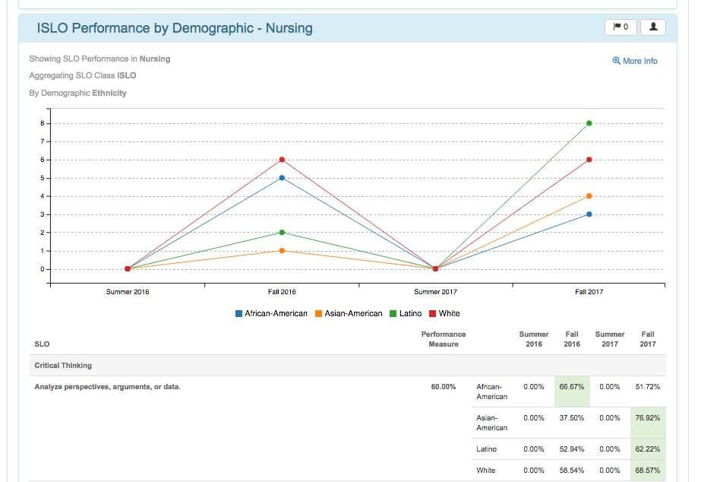
eLumen Tracks Outcomes Much More Robustly than Canvas (cont’d)
With eLumen, you define the Demographic elements you’d like to aggregate/disaggregate over.
Ethnicity
Gender
Veteran Status
Cohort
… (you decide)
eLumen “handles the math” and presents visualizations and data to support Equity Initiatives
eLumen is fully FERPA compliant and exposes no PII in the process
Canvas has no notion of “demographics” in its data model (it’s not needed in a LMS!), much less the ability to report out meaningful information

Slide 9
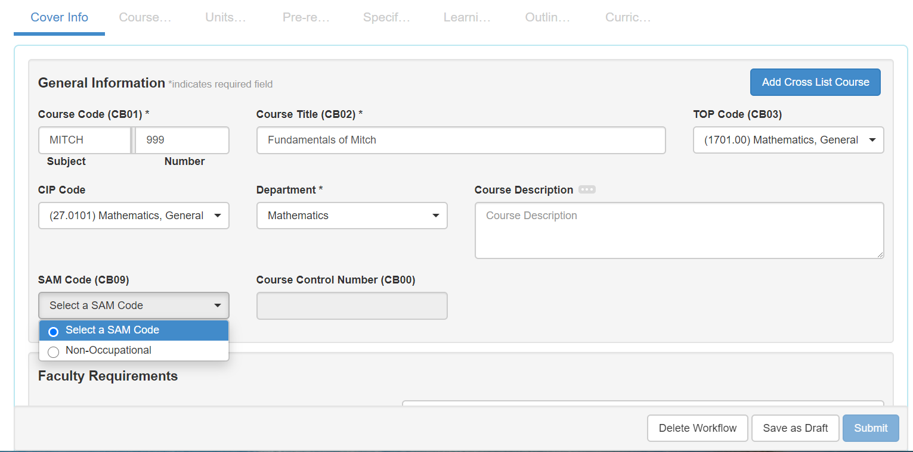
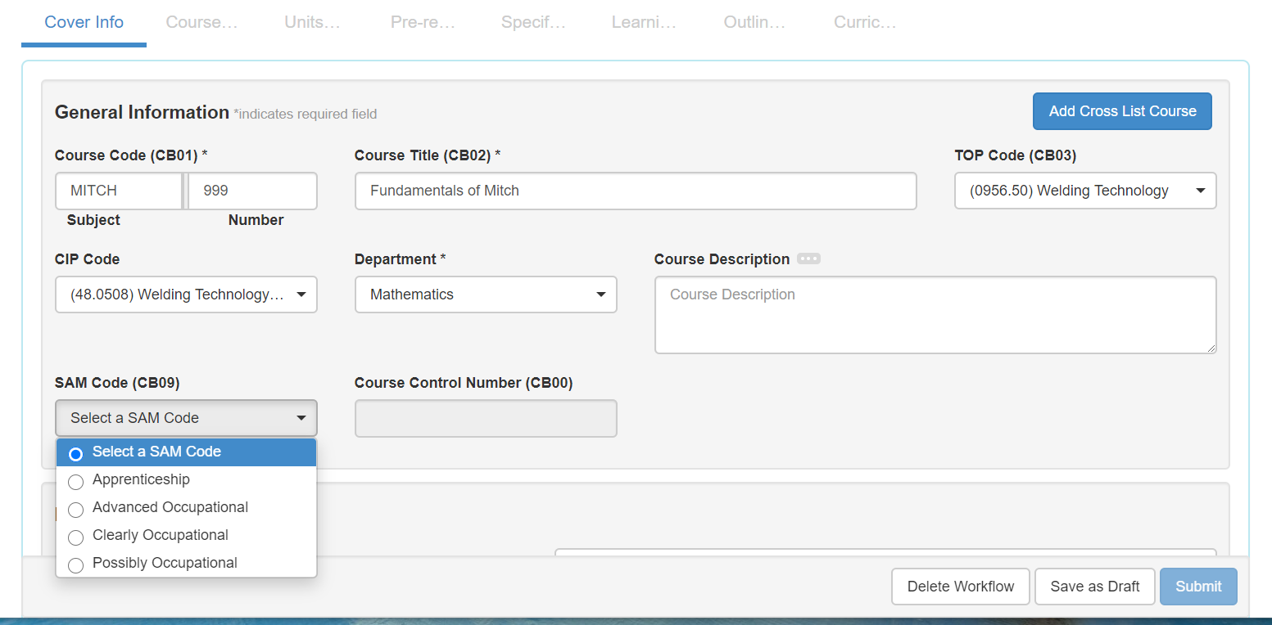
…Plus, PCAH Validation Rules are Built Right In to the System
…and you can add other “combination field” validation rules of your own!

Slide 10
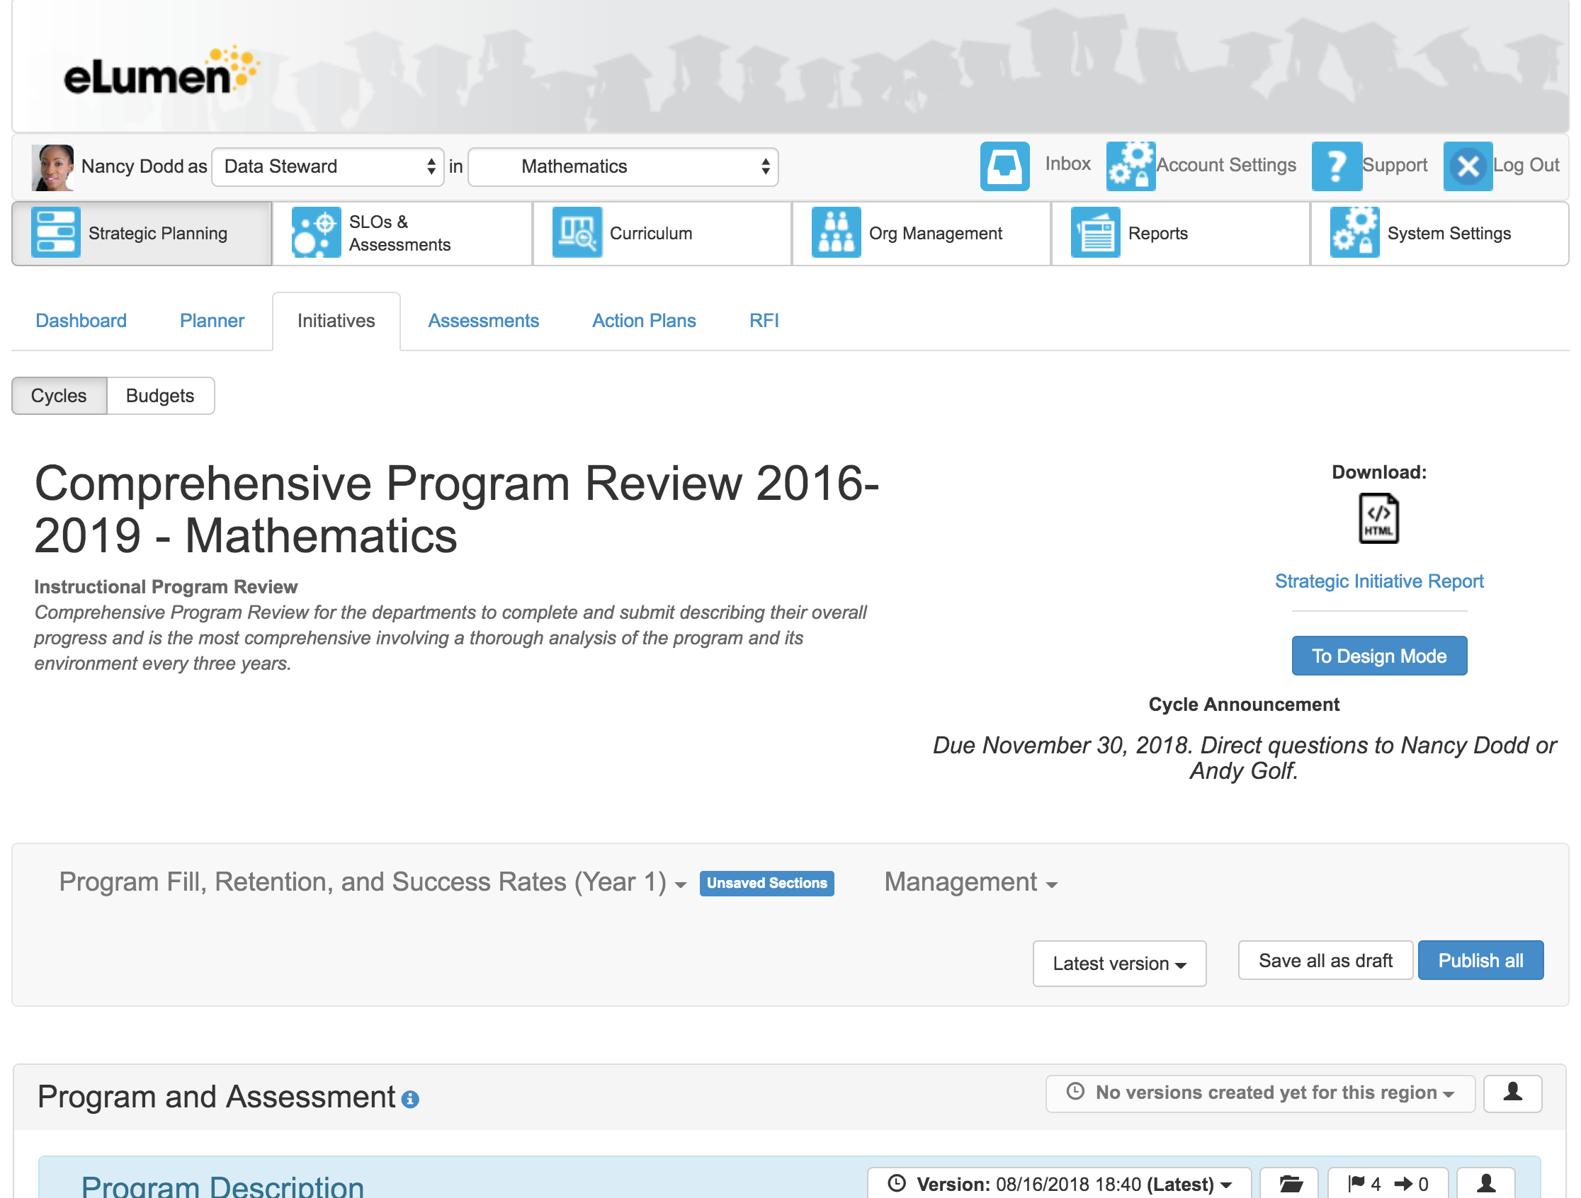
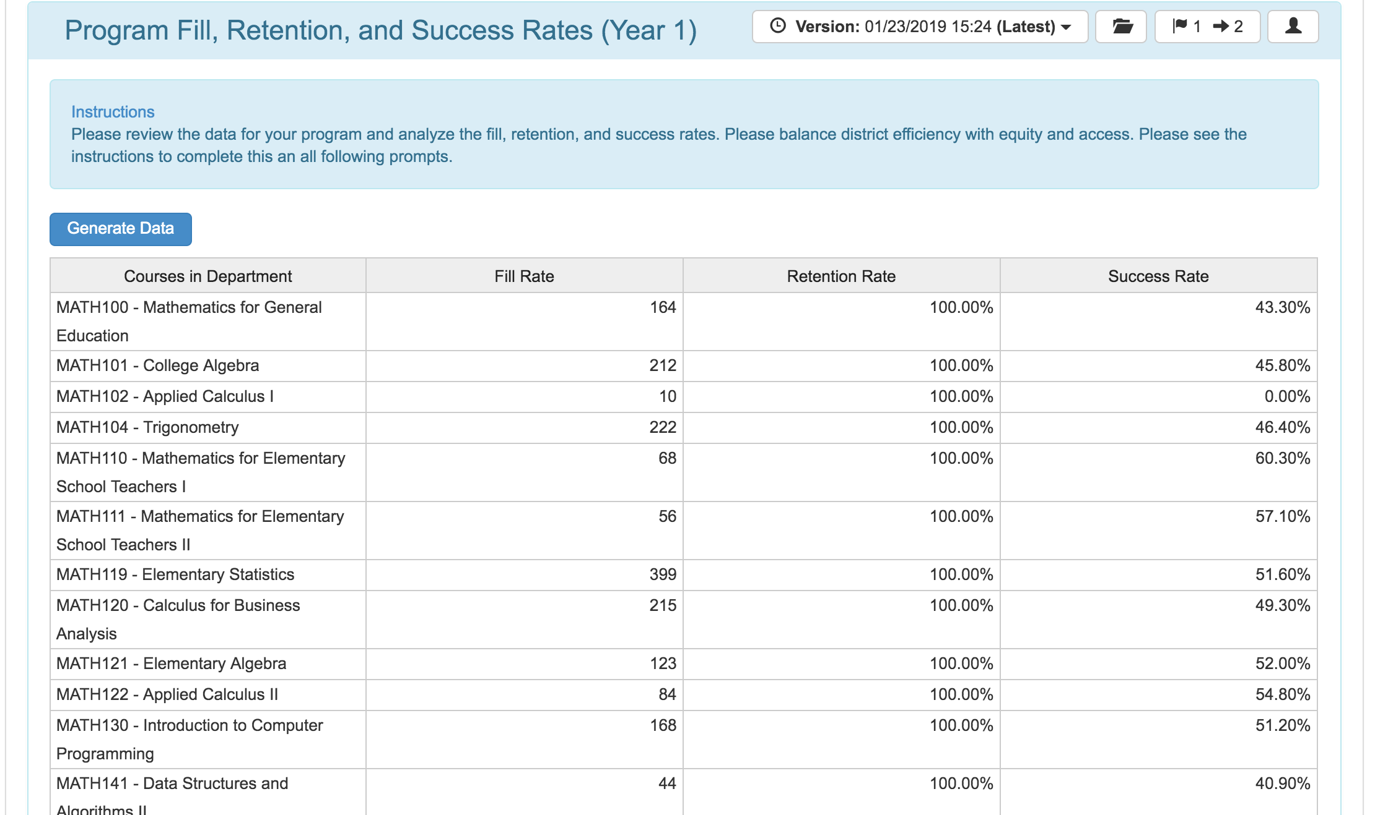
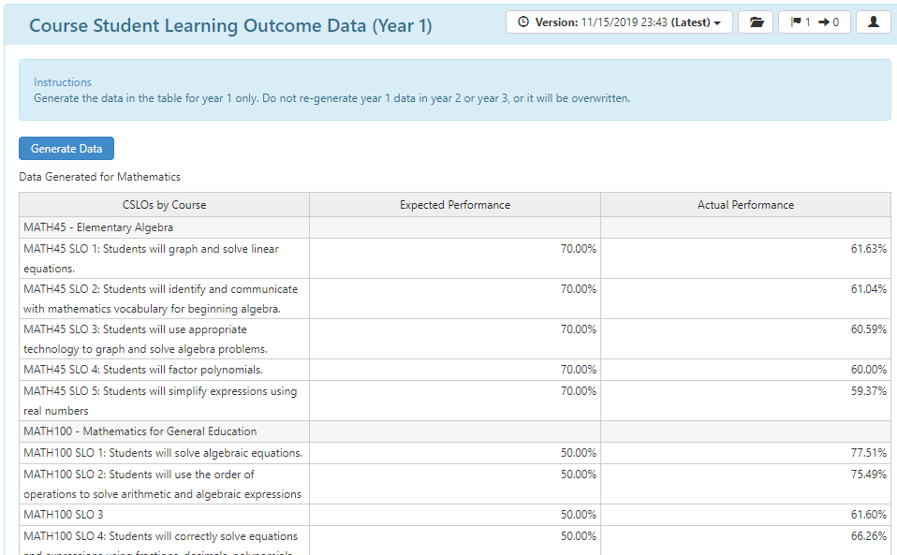
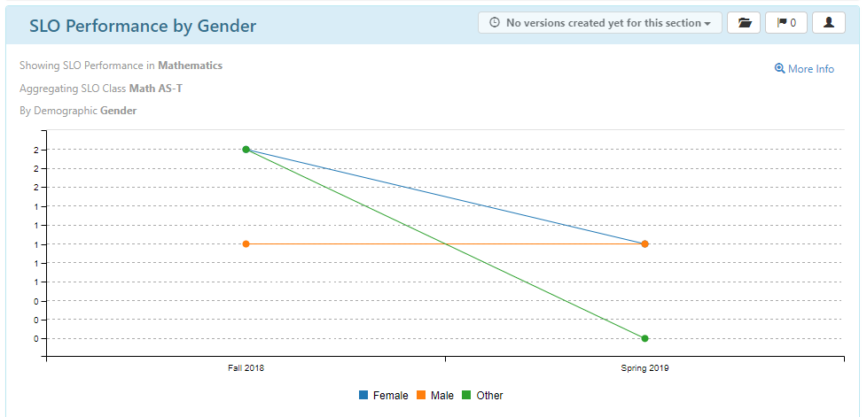
Integration Enables Data Informed Continuous Improvement
Assess Outcomes
Analyze Results
Propose and Budget Actions
Implement Approved Actions
Define/Revise Curriculum

Slide 11
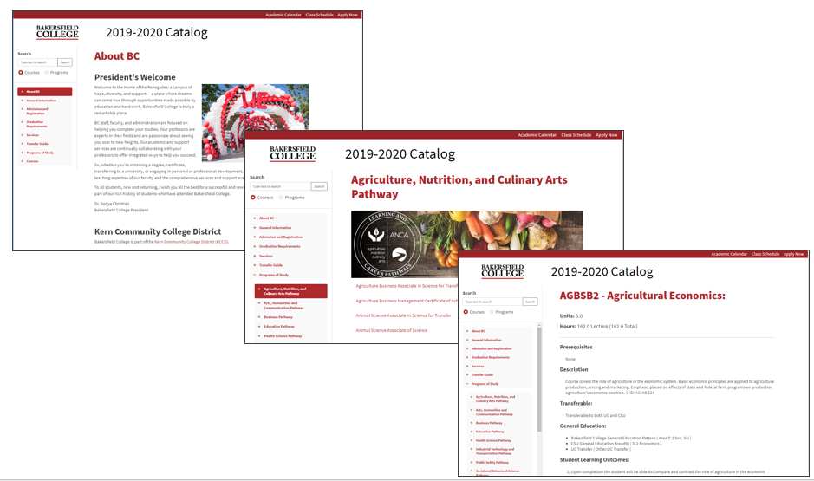
Approved Curriculum Directly Feeds Catalog
Curr. Mgmt.
Approved Courses
Approved Programs
Catalog Builder
Catalog Templates
Navigation
College Catalog
Online Catalog
Multiple Editions
Front Matter
Minimal Sources of Errors

Slide 12
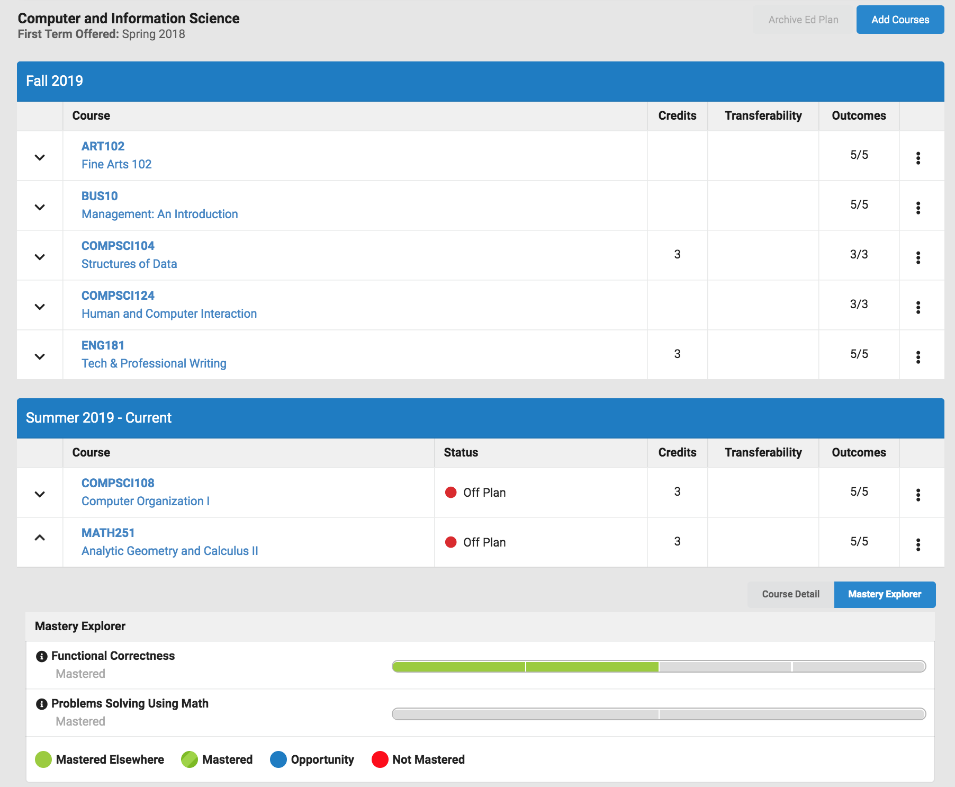
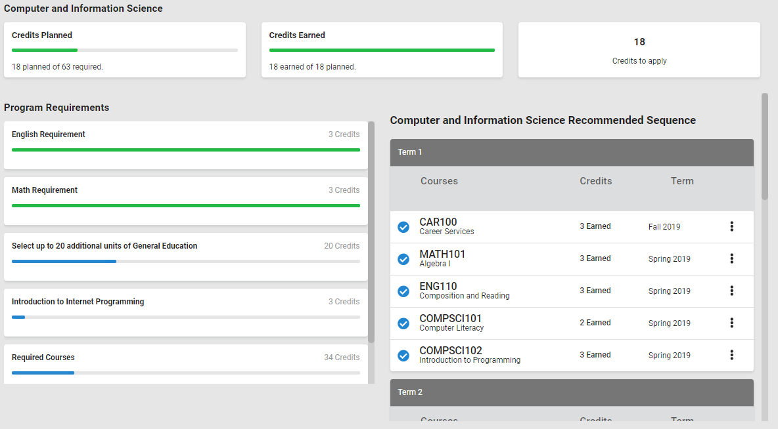
Organically (i.e. NO SCRIBING!) Feed:
Real-time Student Education Plan

Slide 13
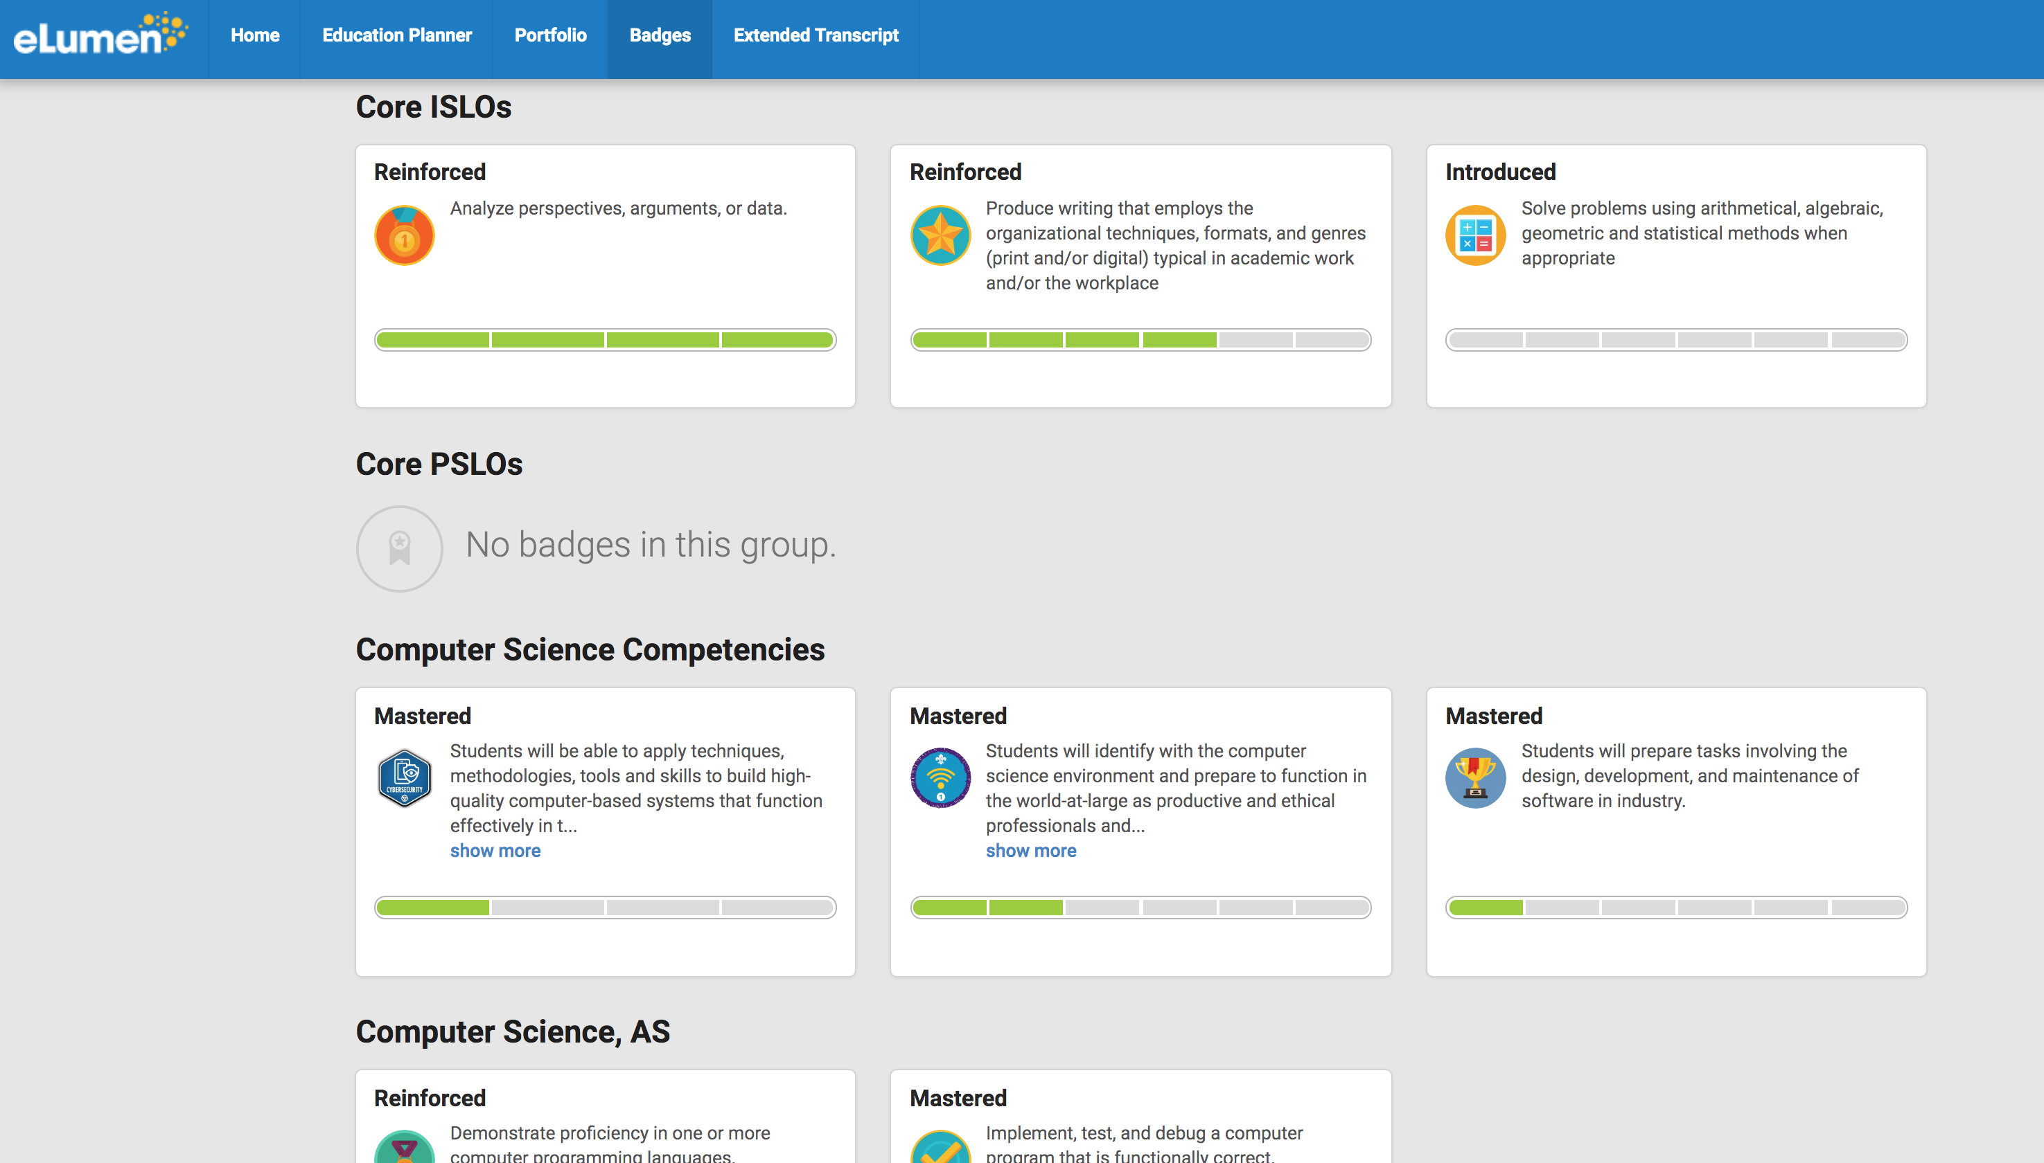
ENABLE Badging via Easily Configured, Automated Rules
…Badges are not awarded after the fact, requiring someone to spend hours combing through records…
They are automatically provisioned as LO Assessment occurs!

Slide 14
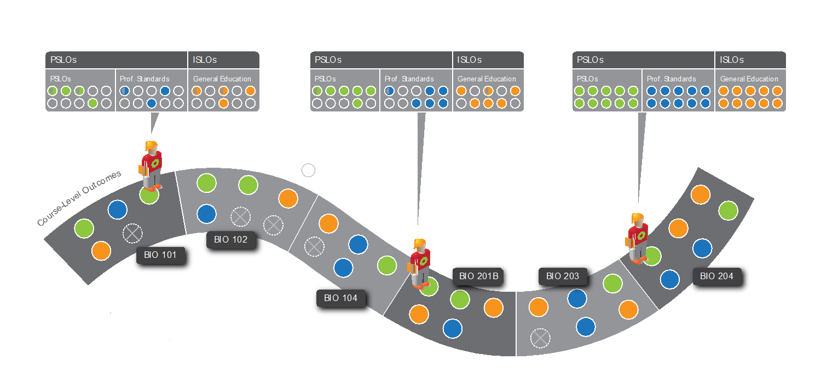
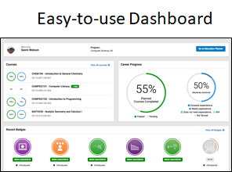
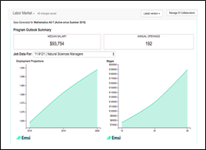
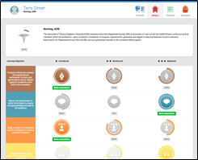
Enable Guided Pathways for Student Success
Outcomes (from Assessment)
Self Monitor Progress
Modern “GPS” for Students
Tools to Show Achievements
Recommended Sequence (from Curriculum)

Slide 15
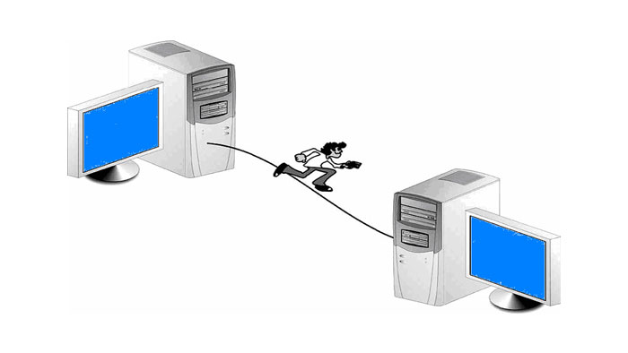
Benefits of eLumen
Integration reduces errors!
No more redundant data entry
Graphics source: DataBasable
Graphics source: TCEA Blog
Fewer errors means more funding:
Students with accurate pathway info more likely to graduate on time!
Reduced errors = Stable funding
Built-in data integrity rules greatly reduce errors!
Graphics source: Comprose
Catalog Automation alone can pay for the system!
Counsellors more efficient w/accurate info!
Co-remediation at scale
Graphics source: Afro Hustler
Student visibility of assessed outcomes makes assessment meaningful
drives positive change with faculty and students
Students can focus on achievement and “self-serve”
Critical College personnel can focus on Student Success!
Graphics source:
Rise Networks
Graphics source: Tim and Julie Harris

Slide 16
Join us for the Virtual eLumenation Conference

Slide 17
Questions
Mitch Shively
VP Business Development, West Region
eLumen, Inc
mitch@elumenconnect.com

