Slide 1
Curriculum Institute 2020
Stackable Certificates
Brandi Asmus, Lynn Shaw, David Williams, Steven Wright
Tuesday, July 7 2:45pm-4:00pm

Slide 2
What are Stackable Certificates?
The U.S. Department of Labor defines a “stackable credential” as “part of a sequence of credentials that can be accumulated over time to build up an individual’s qualifications and help them move along a career pathway or up a career ladder to different and potentially higher-paying jobs”
(Training and Employment Guidance Letter 15-10, U.S. Department of Labor, Employment and Training Administration).

Slide 3
What will you need to know before you begin a Stackable Certificate?
Affirm the need for stackable credentials and clarify training goals. You might think stackable credentials are a good strategy for your department or students, but what is the value for employers? What data do you have to support this assertion? How well do you understand what employers need? Before initiating program design, decide how you will engage employers and what the engagement process will yield.
Create a culture of employer leadership. The design of stackable credentials should be driven by industry demand and led by employers. Pipelines to jobs are important outcomes. Establish the understanding, among employers and education partners alike, that employers’ needs will drive this effort.
Build expectations for the future. You will need engaged employers at all stages of design, development, and implementation. Set the expectation from the outset that this is a partnership, not a cursory curriculum review.

Slide 4
Why use Stackable Certificates?
Meets workforce needs of today
Provides current employability skills
Aligns with business and industry certifications and licensure
Links skills for continuous improvement
Structures learning in short easily connectable parts

Slide 5
How to begin
Contact your Regional or Statewide Director
Review other programs in your disciple that are stackable
Know your regional or local employment gaps
Anticipate ongoing changes in industry that will impact curriculum
Engage in partnership opportunities, including work-based learning and apprenticeship
Include “soft-skills” in the curriculum

Slide 6
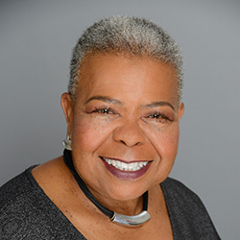
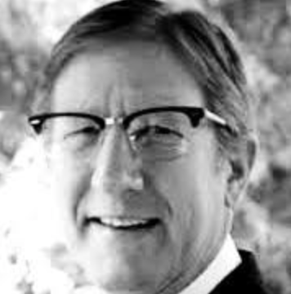
The ICT Sector Team
Workforce & Economic Development,
CA Community Colleges
12 RD-EE Positions, 9 filled
1 Support ‘Community Manager’
www.ictdmsector.org
Notes:
Wendy Porter Northern Inland/Northern Coastal Region Markus Geissler Greater Sacramento Region Richard Grotegut Bay Area Region Ray Kaupp Bay Area Region Dennis Mohle Central Valley/Mother Lode Region Paula Hodge South Central Coast Region Charlotte Augenstein Los Angeles Region Susanne Mata Inland Empire/Desert Region Steven Linthicum Orange County Region Duane Rinehart San Diego/Imperial Region Shawn Monsen IT/Cybersecurity Statewide SME Nicole Sherman Communications Manager/Sector Support Stephen Wright Statewide Director

Slide 7



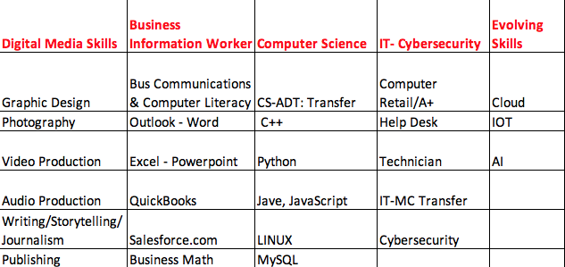
From Desktop/Device to Cloud and Sensor…. and Back…is ICT

Slide 8


Slide 9
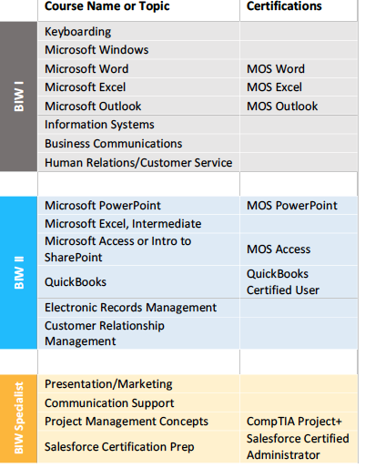
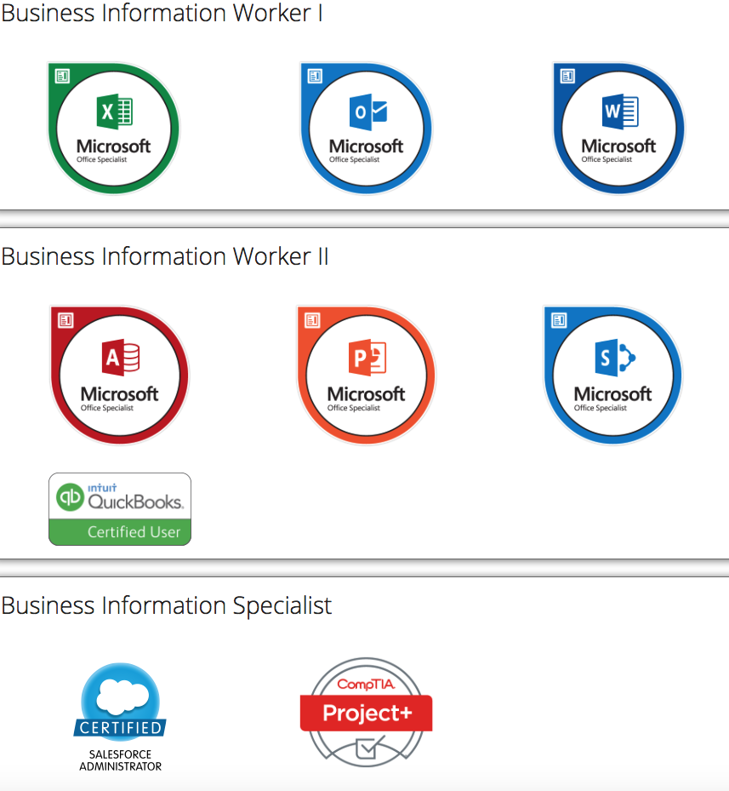
Get Industry Recognized Certifications/ Digital Badges for LinkedIn Profile
Notes:
For:
HS entry, existing students, incumbent and stranded/displaced
Why, Vetting, sequence, value, DBs
TCO
Career Potential: Office, Sales ,
Endorsements

Slide 10

Manpower Support
^{Get Hired}
“Employers can confidently look at the California Community College’s Business Information Worker Work Readiness Certificate/Pathway as a tool to identify qualified potential job candidates. This program provides the “hiring for attitude and training for skills” foundations for entry-level jobs.”
^{~ Phil Blair}
^{Executive Officer –}
^{Manpower San Diego}
Author of “Job Won” (job-won.com)

Slide 11
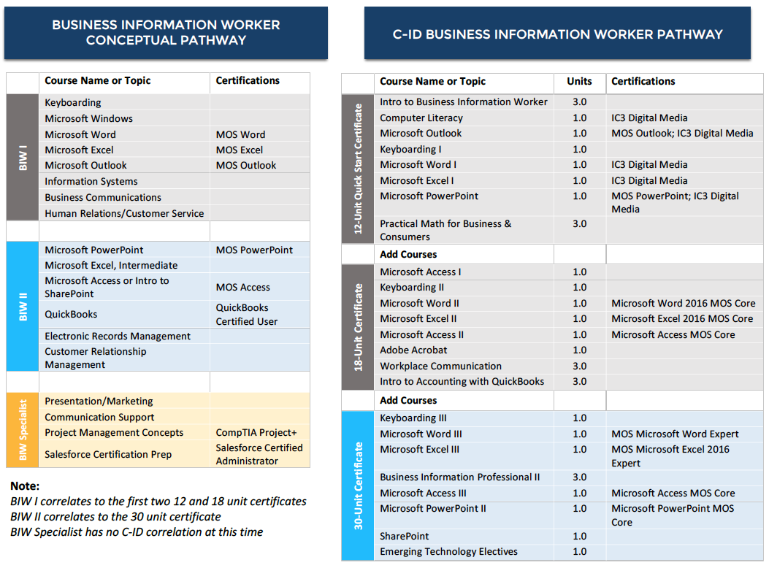
Collaboration of Academic Senate DIG Team and ICT- Sector Team

Slide 12

Notes:
From hundreds of similarly named courses and with input from industry
Get students started in an ‘Organic Real world pathway’..that leads to career success
Starts the experience clock ticking

Slide 13
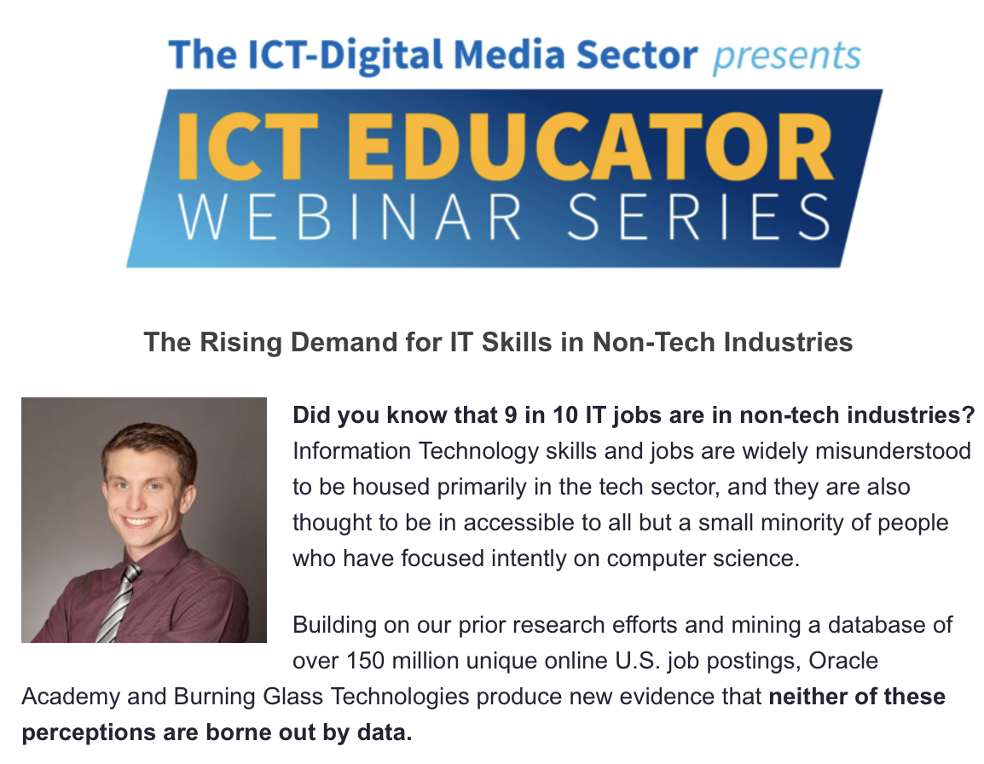
Industry LMI Experts
Will Markow –
Manager of Client Strategy - Analytics
Burning Glass

Slide 14
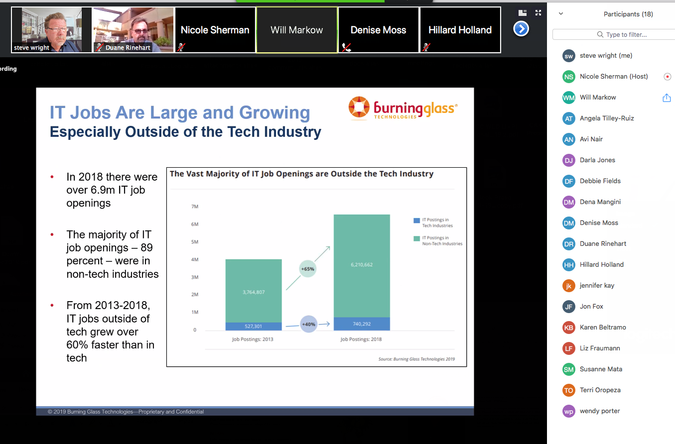

Slide 15
Relevant IT Training Benchmarks
Consolidated from numerous one on one interviews with industry experts
High School w/ Certification
  CyberPatriot and A+ Certification
‘Recognized’ CCC credential
Specified 3rd Party Certifications
Relatively Low demand for AA/AS
Bachelors Degree
Ten years experience
Up-Skilling as incumbent
Lesson: Get in the field, get started, continue to train

Slide 16
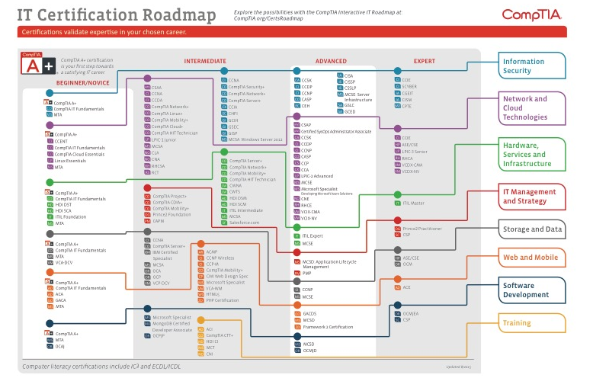
Workforce Demand Increasing in Size and Complexity
Confusing???

Slide 17
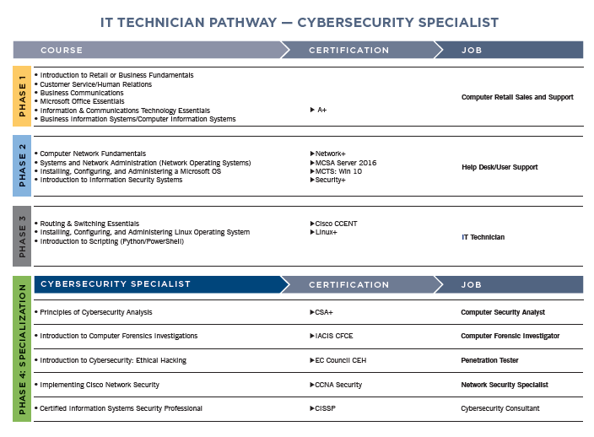
Made simple
Notes:
For:
HS entry, existing students, incumbent and stranded/displaced
Why, Vetting, sequence, value, DBs
Based on IT MC..rigor for transfer for CSUs
TCO:
$46T/unit, $100 books= $250/course
Certification exam: $200, optional prep $100-500.
ITTP >$5K
Career Potential: IT, IOT, Cybersecurity…SME/B2B sales/support
Endorsements

Slide 18
35 POSTED
WEBINARS!
Watch these and more at www.ictdmsector.org
Here are some of our Top Webinars of the year:
IT/CYBERSECURITY
DIGITAL MEDIA/ENTERTAINMENT
Cloudification of the IT Model Curriculum
Completing a 4-Year Degree in Cybersecurity Through the CCCs
Skills in Demand for Creative/Digital Professionals
BUSINESS APPLICATIONS
BIW Dual Enrollment at Cerro Coso College
BIW Cross-Disciplinary Certificates at College of the Desert
VIRTUAL LABS
NETLAB+ Updates & Cybersecurity Summer Camps & Competitions
Practice Labs in the South Central Coast Region
ICT GENERAL
Exploring the ICT Disciplines: Helping Students Decide Which ICT Career is for Them
Boosting Hispanic Student Success in ICT

Slide 19
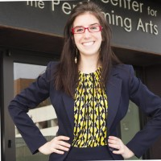


11
WEBINAR PRESENTERS
One Year Update: The Google IT Support Professional Certificate’s Impact and How Colleges Can Get Involved
MARA LOCKOWANDT
RICKI MEYER
Senior Program Manager, Economic Advancement Strategies, Jobs for the Future
.
Program Manager, Grow with Google

Slide 20
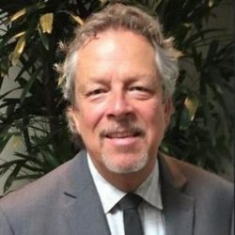

How To programs and student success strategies
11
WEBINAR PRESENTERS
Cloudification of the IT Model Curriculum
RICHARD GROTEGUT
MYRA ROLDAN
TRACY APPLEGATE
Regional Director, Employer Engagement Bay Region,
ICT-DM Sector
Program Manager, Higher Ed Tech Curriculum, AWS Educate
Global Program Manager,
AWS Academy

Slide 21
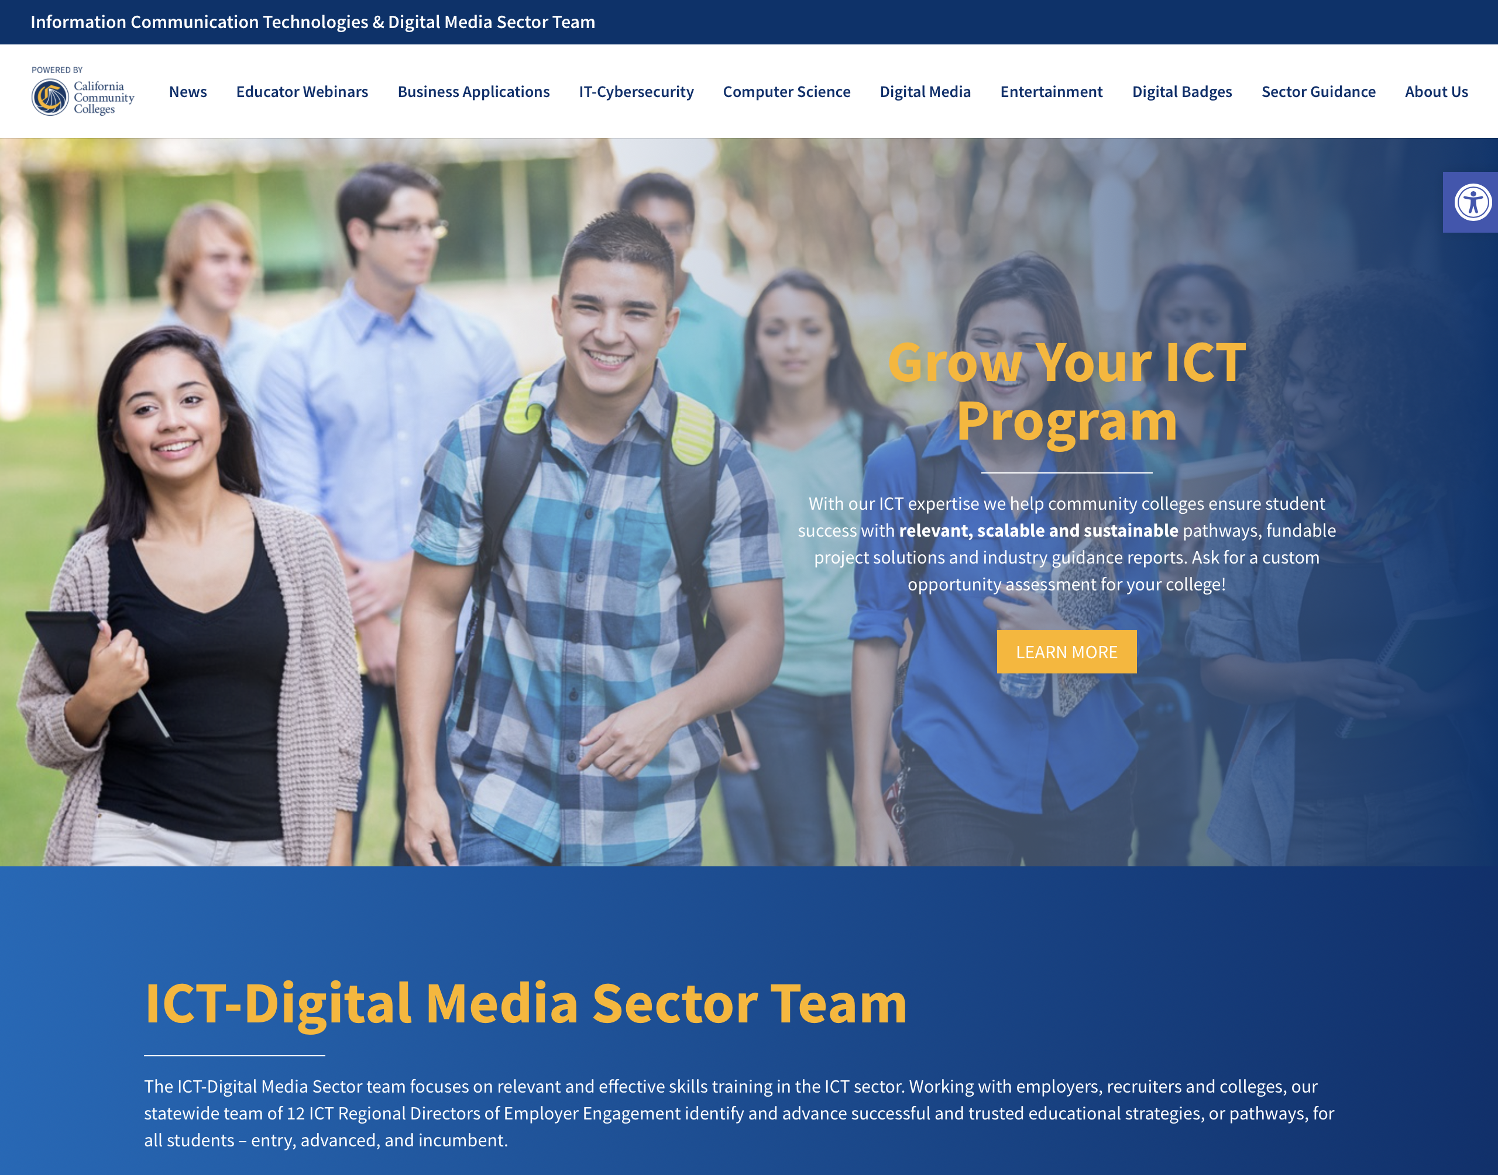
Website
www.ictdmsector.org
Resources for ICT Guided Pathways:
ICT Educators Webinar Series & Archives
Sector Newsletter to 5000+
Bi-monthly/ 36 articles
Tools: Nicole Sherman: Integrative Impact

Slide 22
Business Pathway (example)
Non-Credit Basic Computer Skills
Certificate of Completion
Busines Information Worker – Clerical
15.5 units
BCA 557 – Intro to Computing
BCA 558 – Basics - Computer Keyboarding
BCA 59 – Computer Literacy
BCA 60 – Computer Keyboarding
BCA 66 – Microsoft Outlook
Business Information Worker – Administrative Assistant 29.5 units
(14 more units!)
BCA 15 – Business Computer Applications - Beginning
BCA 20 – Computer Calculation
GNBUS 56 – Business Math
GNBUS 72 – Intro to Business Information Worker
BCA 33 – Microsoft Excel II
BCA 37 – Microsoft Access II
BCA 38 – Microsoft Access III
BCA 64 – Microsoft Word II
ACCT 50 – General Accounting
BCA 68 – Records and Information Management
ACCT 3 – Computerized Accounting
GNBUS 21 – Business Communication
(15.5 units from BIW-Clerical Certificate)
Occupations
Customer Service Rep, Data Entry
Occupations
Clerical Assistant,
Clerk
Based on C-ID Model Curriculum
Occupations
Administrative Assistant, Shift Manager

Slide 23
Business Pathway (example)
Business Information Professional A.S.
35.5 major units + GE
29.5 units from BIW Admin Assistant
BCA 34 – Microsoft Excel III
BCA 65 – Microsoft Word III
BCA 70 – Microsoft Powerpoint II
GNBUS 74 – Business Information Professional
Occupations
Office Manager / Coordinator, Administrative Professional

Slide 24
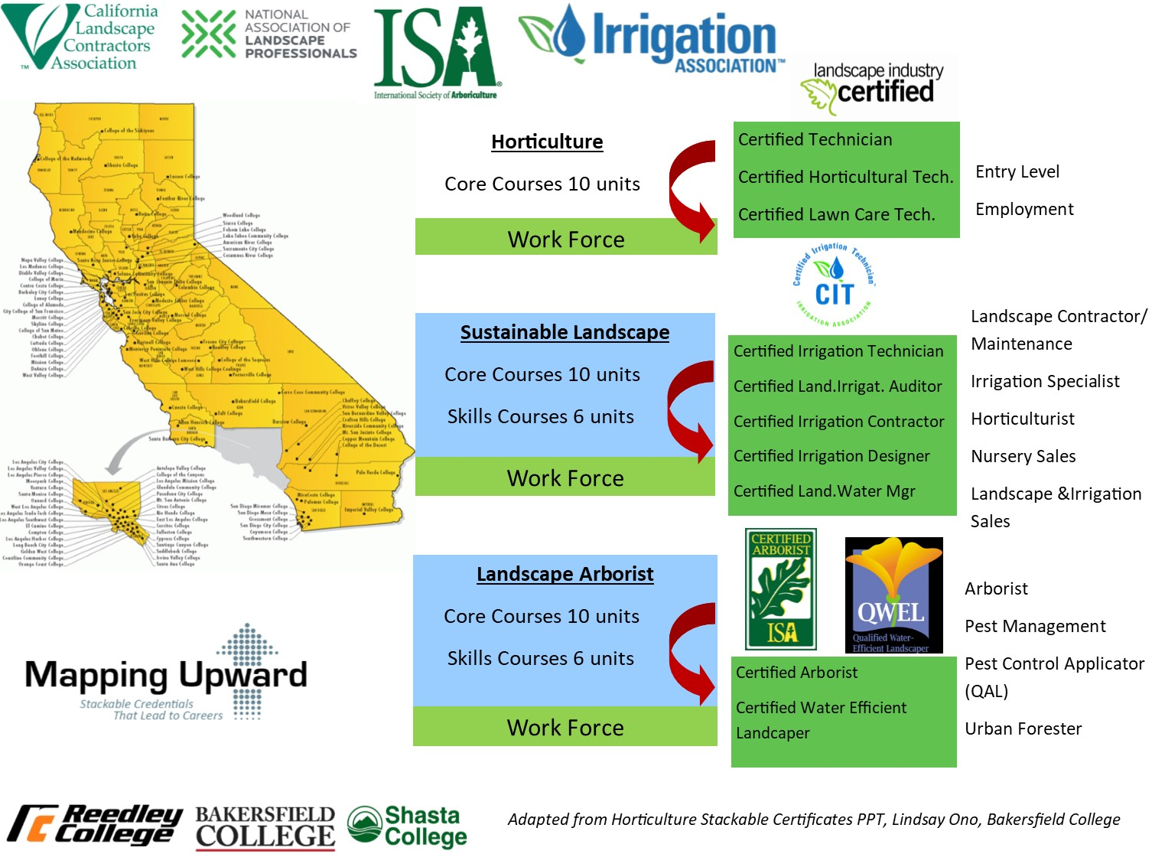
Example –
Horticulture / Irrigation

Slide 25
Another type of stackable credential: common core plus electives
Airframe Maintenance Technician |  | Powerplant Maintenance Technician
Required Courses: |  | Required Courses:
AERO 055 |  | AERO 055
AERO 103 |  | AERO 103
AERO 102 |  | AERO 106
AERO 105 |  | AERO 107
AERO 118 |  | AERO 119
Combined Airframe/Maint. Tech |  | Combined Airframe/Maint. Tech
AERO 106 |  | AERO 102
AERO 107 |  | AERO 105
AERO 119 |  | AERO 118

Slide 26

Discussion and Questions
Any comments, examples, or advice from the group?

Slide 27
Resources
This is a 66 page toolkit with examples from around the United States.
https://www.cord.org/stackable_credentials_toolkit_EDversion_2018.pdf
A listing of the California Community College regional and statewide directors in various industry sectors.
https://www.cccco.edu/About-Us/Chancellors-Office/Divisions/Workforce-and-Economic-Development/Technical-Assistance-Providers
This is a toolkit on steps to adding qualified industry experts to your hiring pool by recognizing industry experience as equivalent.
https://asccc.org/sites/default/files/ADAversion_CTEMinQualsToolkit.pdf

Slide 28
Brandi Asmus basmus@yccd.edu
Dr. David Williams david.williams@solano.edu
Dr. Lynn Shaw shawlynn@gmail.com
Steven Wright steve@wrightca.com

